Slide 1
UC Riverside Chairs 201 Workshop
Compliance Considerations for Faculty Chairs
Compliance & Principles of Community
UC Riverside is subject to myriad federal and state laws and regulatory regimes that govern the way it is
“Living the Promise.”
Every employee at UC Riverside is responsible for understanding when and how such laws apply to their job duties. Faculty, staff, and students working on behalf of
UC Riverside are responsible for conducting themselves within the law and adhering to the
UC Riverside Principles of Community.

Slide 2
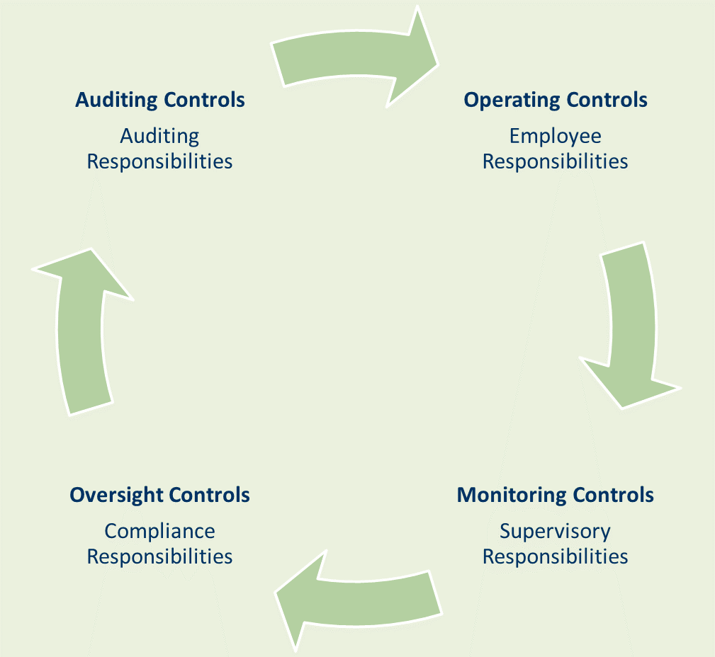
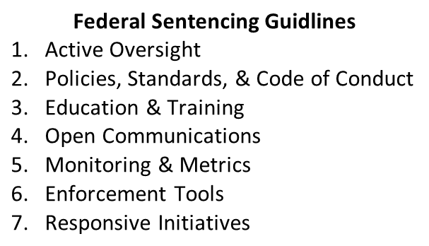
UC Riverside Chairs 201 Workshop
Compliance Considerations for Faculty Chairs
UC Ethics & Compliance Charter
Each Campus and Medical Center compliance and ethics committee provides Program oversight and advice to the SVP/Chief Compliance and Audit Officer. The Committee is charged with the following, including but not limited to:
Performance Metrics
Compliance Plan
Risk Assessment Tools
Monitoring
Reporting Risk Areas

Slide 3
UC Riverside Chairs 201 Workshop
Compliance Considerations for Faculty Chairs

Slide 4
UC Riverside Chairs 201 Workshop
Compliance Considerations for Faculty Chairs
Office of Compliance

Slide 5
UC Riverside Chairs 201 Workshop
Compliance Considerations for Faculty Chairs
Twenty Areas to Consider
Equal Opportunity/Discrimination
Workplace Harassment & Bullying
Threats/Students in Need of Assistance
Mandatory Reporting
Anti-Discrimination Laws
Religious Accommodations
Political Activity
Conflicts of Interest
Gifts & Gratuities
Outside Employment
Family Members
Conflict of Interest in Research
Purchasing/Contracts
Intellectual or Copyrighted Property
Export Controls
Records
Information Security & Confidentiality
FERPA
Obligation to Report Wrongdoing
Reporting

Slide 6
UC Riverside Chairs 201 Workshop
Compliance Considerations for Faculty Chairs
Equal Opportunity/Discrimination/Diversity
Equal Employment Opportunity Employer
Seeks Best-Qualified Individual
Mandated Training
Resources
UC Equal Employment Opportunity and Affirmative Action website
UC Discrimination, Harassment, and Affirmative Action in the Workplace Policy
UCR Academic Hiring Toolkit (AY 2017-2018)
UC Sexual Violence and Sexual Harassment Policy
UCR Equal Employment & Affirmative Action website
UCR Title IX Office website

Slide 7
UC Riverside Chairs 201 Workshop
Compliance Considerations for Faculty Chairs
Workplace Harassment & Bullying
Environment Free from Illegal/Inappropriate Conduct Including:
Violence
Harassment
Sexual Misconduct
Threats
Hazing
Students, Faculty, Staff & Visitors Should Promptly Report Incidents of Misconduct
Resources
UCOP Guidance on Abusive Conduct and Bullying in the Workplace
Guidance from Provost Regarding Abusive Conduct & Bullying Involving Faculty & Academic Appointees

Slide 8
UC Riverside Chairs 201 Workshop
Compliance Considerations for Faculty Chairs
Threats/Students in Need of Assistance
Resources for Students Who
There is Concern for a Need to Seek Assistance
Made Threats Against Classmates or Faculty member
Comprehensive Counseling & Psychological Services Available
Resources
UCR Responding to Distressed Students website

Slide 9
UC Riverside Chairs 201 Workshop
Compliance Considerations for Faculty Chairs
Mandatory Reporting
Equal Employment Opportunity Employer
Seeks Best-Qualified Individual
Mandated Training
Resources
UC Equal Employment Opportunity and Affirmative Action website
UC Discrimination, Harassment, and Affirmative Action in the Workplace Policy
UCR Academic Hiring Toolkit (AY 2017-2018)
UC Sexual Violence and Sexual Harassment Policy
UCR Equal Employment & Affirmative Action website
UCR Title IX Office website

Slide 10
UC Riverside Chairs 201 Workshop
Compliance Considerations for Faculty Chairs
Export Controls
Govern shipment, transmission, or transfer of regulated items, information and software to foreign countries, persons or entities.
Information sharing with colleagues in certain countries may constitute the export of services or technology.
Traveling with sophisticated programs or apps on laptop, tablet, or cell phone may be restricted
Resources
UCR Sponsored Programs Administration Export Controls website

Slide 11
UC Riverside Chairs 201 Workshop
Compliance Considerations for Faculty Chairs
Records
Maintain in a manner that they can be identified and provided when requested by members of the public. Faculty research is not a “record” for the purposes of this requirement, but documents related to department business, faculty committees, and employees generally are. Office of Campus Counsel is responsible for processing public records requests and faculty may refer any such requests to that office.
Resources
Records Management and Retention Policy
UC Records Retention Schedule
Notes:
R

Slide 12
UC Riverside Chairs 201 Workshop
Compliance Considerations for Faculty Chairs
Information Security & Confidentiality
Protects Information
Resources
Security@UCR website

Slide 13
UC Riverside Chairs 201 Workshop
Compliance Considerations for Faculty Chairs
FERPA
Student Records may not be Released without Written Consent
(with limited exceptions)
Resources
UCOP Office of General Counsel (OGC) Guide:
FERPA 101 – FERPA at the University of California
PACAOS 130:
Policies Applying to the Disclosure of Information from Student Records
UCR FERPA Policy

Slide 14
UC Riverside Chairs 201 Workshop
Compliance Considerations for Faculty Chairs
Obligation to Report Wrongdoing
Obligation to Report, or Cause to be Reported, & to Assist in Investigation by Persons Authorized or Responsible for such Matters, the Following:
Illegal or Fraudulent Activity
Financial Misstatements or Accounting/Auditing Irregularities
Conflicts of Interests or Dishonest/Unethical Conduct
Violations of Code of Conduct; &
Violations of Laws, Rules, or Regulations
Resources
UCR Academic Senate By-Laws website
UCR Reporting Academic Misconduct website
UCR Research Misconduct website
UCR Title IX Office website

Slide 15
UC Riverside Chairs 201 Workshop
Compliance Considerations for Faculty Chairs

Slide 16
UC Riverside Chairs 201 Workshop
Compliance Considerations for Faculty Chairs
Other Resources
Higher Education Compliance Alliance (HECA) website
Compliance Matrix

Slide 17
UC Riverside Chairs 201 Workshop
Compliance Considerations for Faculty Chairs
Thank You
Questions
tim.Willette@ucr.edu
951.827.8246

