Slide 1
Non-Senate Updates
Esperanza Steward
esperanza.steward@ucr.edu
Schedule a meeting: https://calendly.com/esperanza-steward/apper-one-on-one-session
11/5/2024

Slide 2


UAW Time Reporting
UC and UAW recently reached a Time and Attendance System Compliance Settlement.
All UAW employees (BX, BR, PX, RA) are expected to use TARS to report any leave time taken and also requires UAW employees to indicate if they did not have any absences in any given month.
Failure to engage with TARS will lead to counseling or discipline.
If an employee has no updates to their time they must still open, save and submit to certify their time.
Supervisors are required to review and approve time.
Timesheet.ucr.edu

Slide 3
Time Reporting Job Aids
TARS Job Aid for ASEs and GSRs
TARS Job Aid for Supervisors
TARS Job Aid for Exempt Staff
TARS Job Aid for Non-Exempt Staff
https://academicpersonnel.ucr.edu/Non-Senate-Academics#academic-student-employees-ase

Slide 4

Non-Senate Appointments
Please do not make appointment commitments verbally or via email.
All appointment commitments should be made through the appropriate AP Analyst in your department.
The AP analyst will confirm the scope of work, appropriate title and salary. Represented employees are governed by their bargaining unit contracts and the work they perform is specific to what was agreed upon and their pay is generally reflective of their experience.

Slide 5
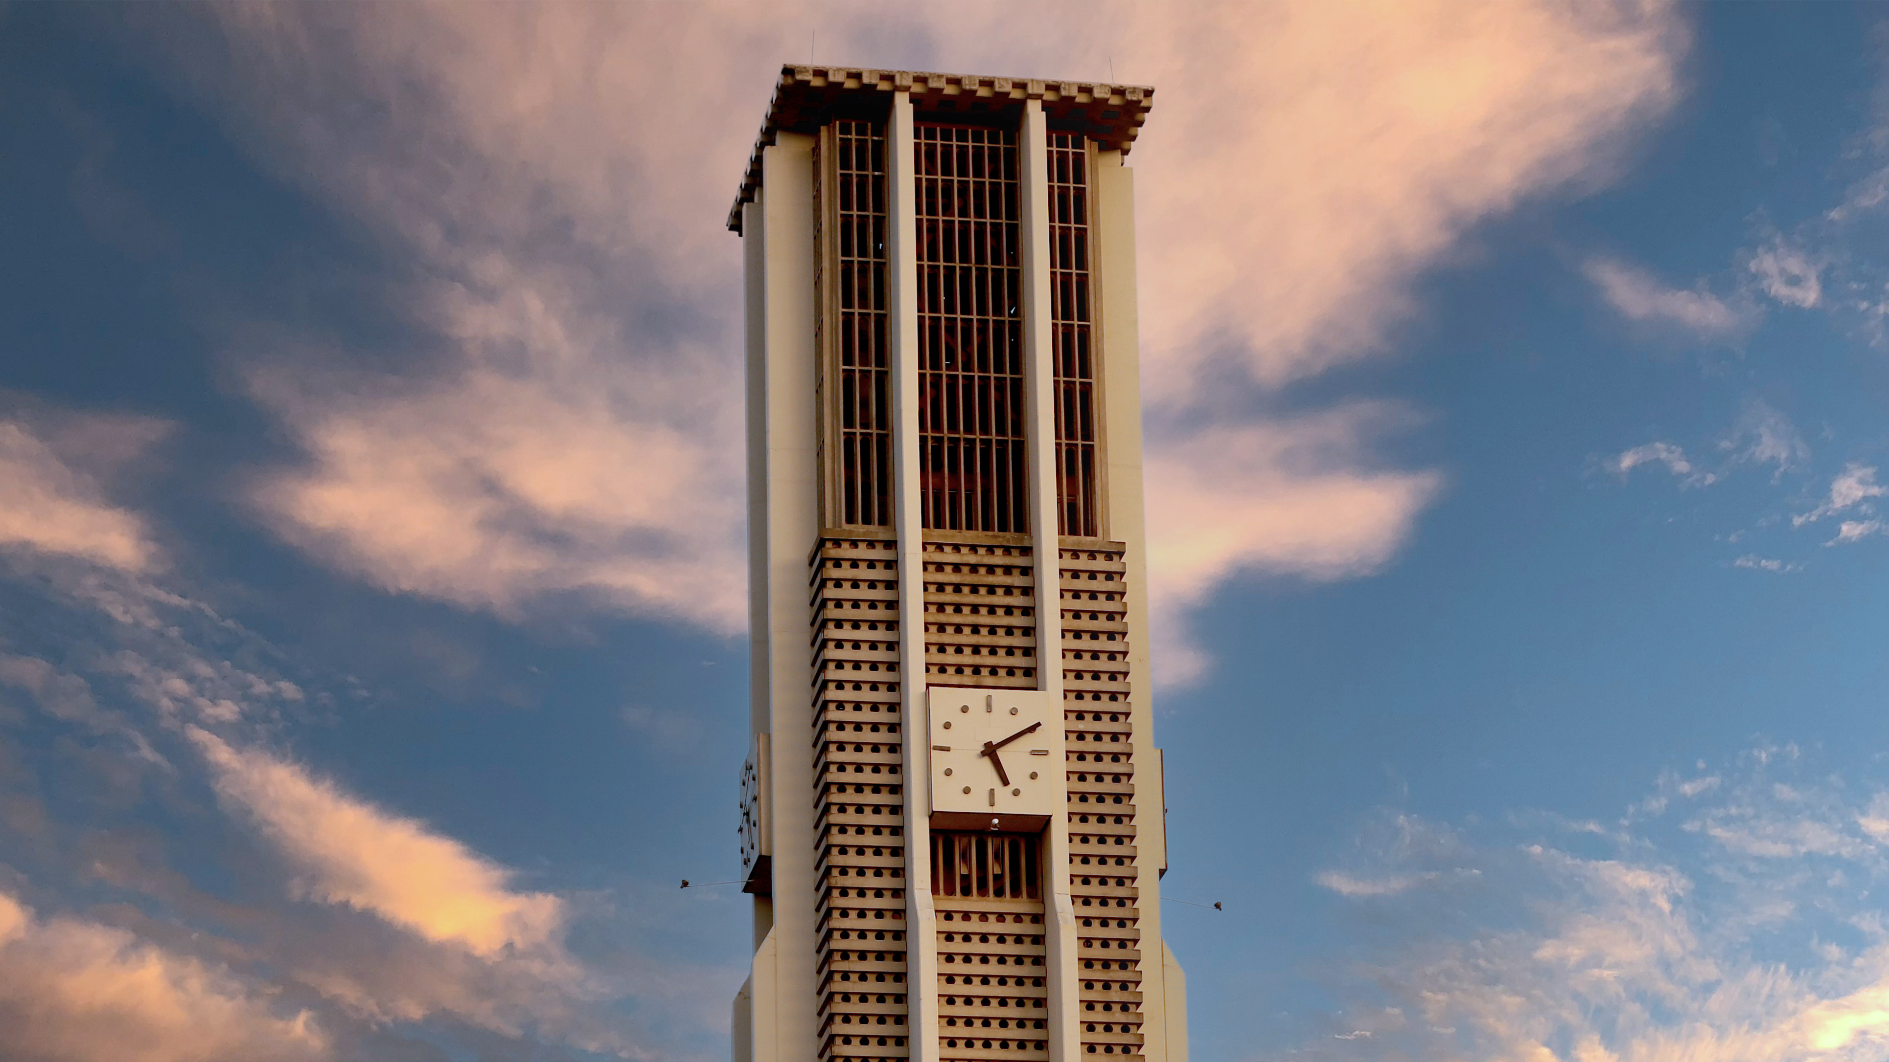
UAW Appointment Percentages
UAW ASE and GSR contracts recognize them as employees (in-unit). Their employment is separate from their academic pursuits and are covered by the bargaining unit agreement.
APO is also strongly advising that every effort is made to ensure ASE and GSR appointments are 50% appointments (20 hours/week) unless there has been consultation with your AP Director and/or APO that is consistent with the respective Workload and Time and Effort Commitment articles in the contracts.
We have discovered that some departments have continued making ASE and GSR appointments at less than 50% that cannot be adequately equated to workload resulting in union grievances.
Top-ups, micro appointments, and other appointments that are not whole hours must be discontinued to be in compliance with the contract.

Slide 6

Non-Senate Performance Management
The Academic Personnel Office provides proactive problem solving for departments and divisions in situations involving work-related issues. We provide consultation and advice to supervisors and employees in the areas academic personnel issues, including performance management, corrective actions, interpretation of policies and procedures and collective bargaining agreements, conflict management, counseling, and training. Academic Personnel Office also partners with the campus’ Labor Relations office to ensure the correct application of policies, procedures and laws are being used to manage a large and diverse academic workforce.
If you have a concern please reach out so that we can provide guidance.
There are specific Performance Management, Corrective Action and Dismissal Policy and Procedures for Non-Senates.

Slide 7
Non-Senate Performance Management
Do’s
1. Communicate with employees about work assignments and work support mechanisms. For example, tell them what their duties are, tell them where their workstation is, and provide them with reasonable supplies.
2. Communicate with employees about work expectations, measures of success, and professional development.
3. Provide feedback to employees regarding their performance.
4. Answer employees’ questions about work assignments, your expectations, and how they can meet with you to answer additional questions.
5. Clarify what is a part of their work assignment and what is a part of their academic work, but in separate discussions. For example, set up separate meetings to discuss work assignments versus academic progress. a. Note: It can seem difficult in certain disciplines to differentiate between what is considered “employment” and what is “academic.” A good rule of thumb is that work assignments should align with expectations communicated in a written notice of appointment, discussions during work meetings, and confirmed over email. Academic progress or conversations about academic work should align with expectations communicated through, and established by, the syllabi or the program’s requirements towards academic progress.
6. Familiarize yourself with language in the relevant collective bargaining agreement(s) that pertain to the issues you are planning to discuss.
7. Explain work rules so that employees understand work expectations.
8. Consult with the Academic Personnel Office, if you have any questions regarding this guidance.

Slide 8
Non-Senate Performance Management
Dont’s
9. Don’t talk to employees about your views on the collective bargaining agreement (contract), the union, or ask about their union activities or membership. For example, don’t discuss what you believe are the problems with, or changes that need to be made to the collective bargaining agreements or give advice to a student about how they should interact with their union.
10. Don’t discipline employees without first talking to your local central office who oversees academic labor relations issues, such as the Labor Relations or Academic Personnel Office.
11. Don’t conduct a meeting with a union representative present without your local central office who oversees academic labor relations issues, such as the Labor Relations or Academic Personnel Office, present.
12. Don’t create a workgroup with represented employees to discuss changes to working conditions.
13. Don’t poll or ask for feedback from represented employees regarding terms and conditions of employment. If you are not sure if a poll or feedback would be in violation of law, consult with your local central office who oversees academic labor relations issues, such as the Labor Relations or Academic Personnel Office.
14. Don’t talk to employees about their participation, or non-participation in “protected activity.” a. Protected activity refers to engaging or exercising a right that is protected by law. Some examples of protected activities include, but are not limited to, the following: talking with co-workers about wages and benefits or other working conditions, circulating a petition asking for changes to working conditions, participating in a concerted refusal to work in unsafe conditions, and joining with coworkers to talk directly to management, a government agency, or the media about problems in the workplace.
15. Don’t take any employment action (positive or adverse) based on an employee’s participation, or non-participation, in a protected activity. See protected activity list above.

Slide 9
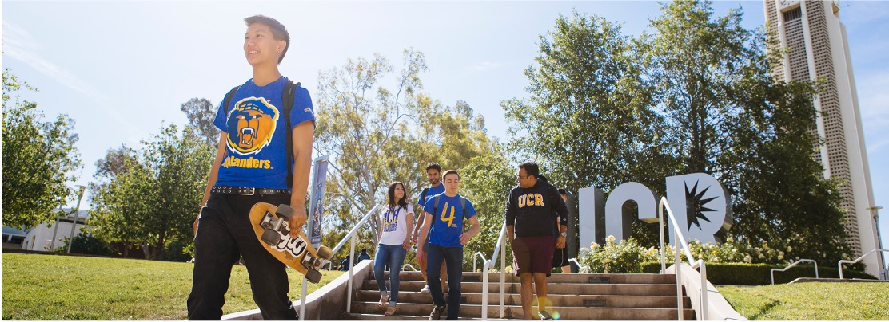

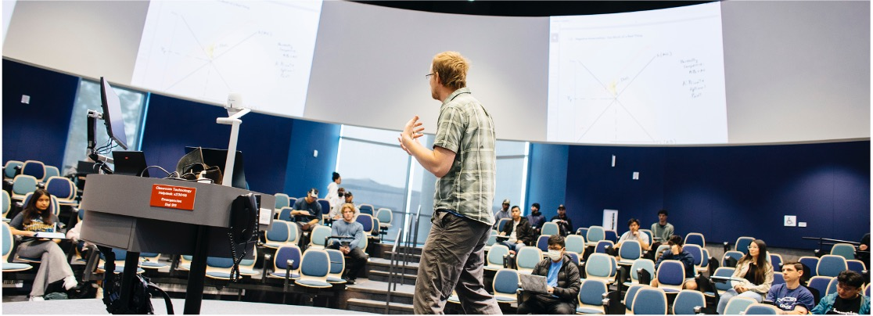
Academic Personnel Office
Academic Personnel Policy
Partnership
Employment

Slide 10
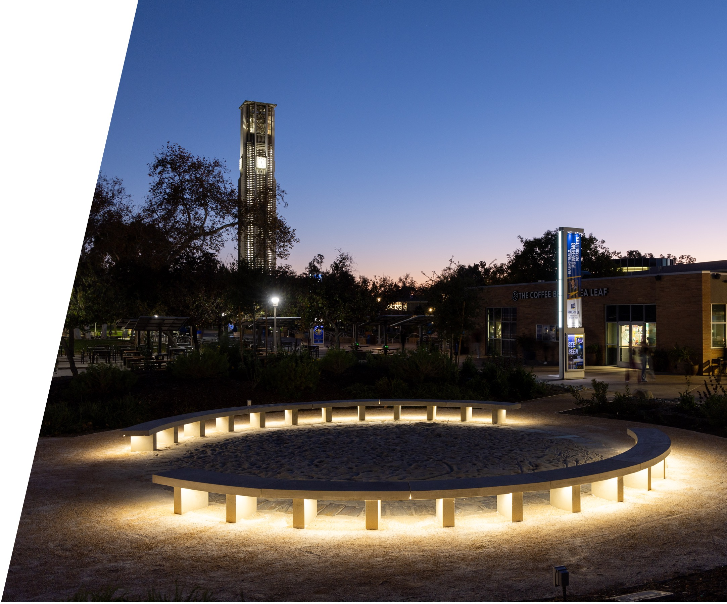
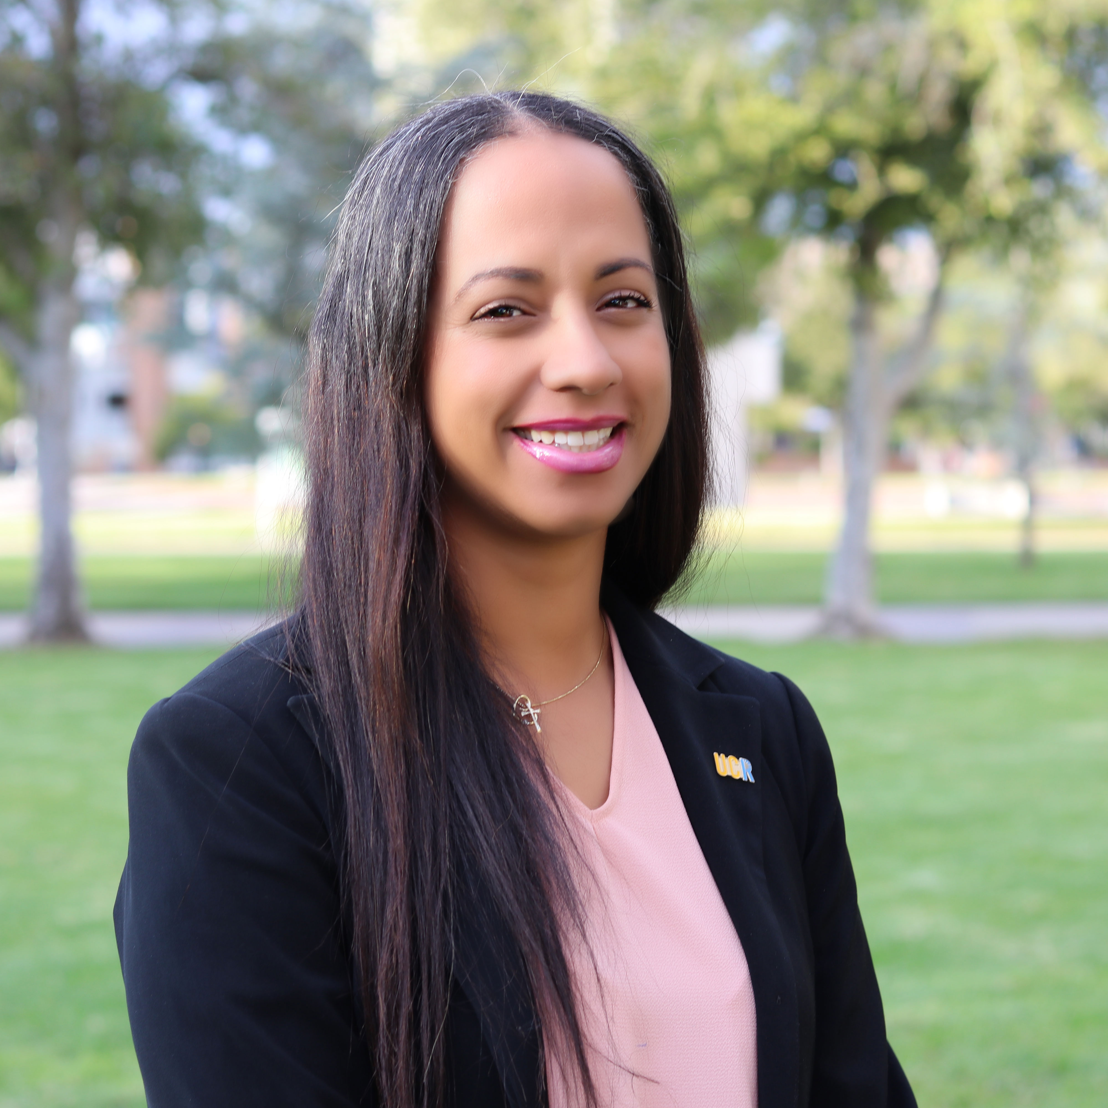

Questions?
Esperanza Steward
Director of Academic Personnel Policy and Employee Relations
esperanza.steward@ucr.edu
https://academicpersonnel.ucr.edu/Non-Senate-Academics
Schedule a meeting: https://calendly.com/esperanza-steward/apper-one-on-one-session

