Slide 1
Compensation Resources
New Faculty Orientation September 25, 2020
Sonia Kalogonis, Academic Personnel Policy & Compensation Analyst

Slide 2
TOPICS
What is UCPath Campus Support Center (CSC)?
How Do I Access My Pay Stubs?
What is Negotiated Salary Trial Program (NSTP)?

Slide 3
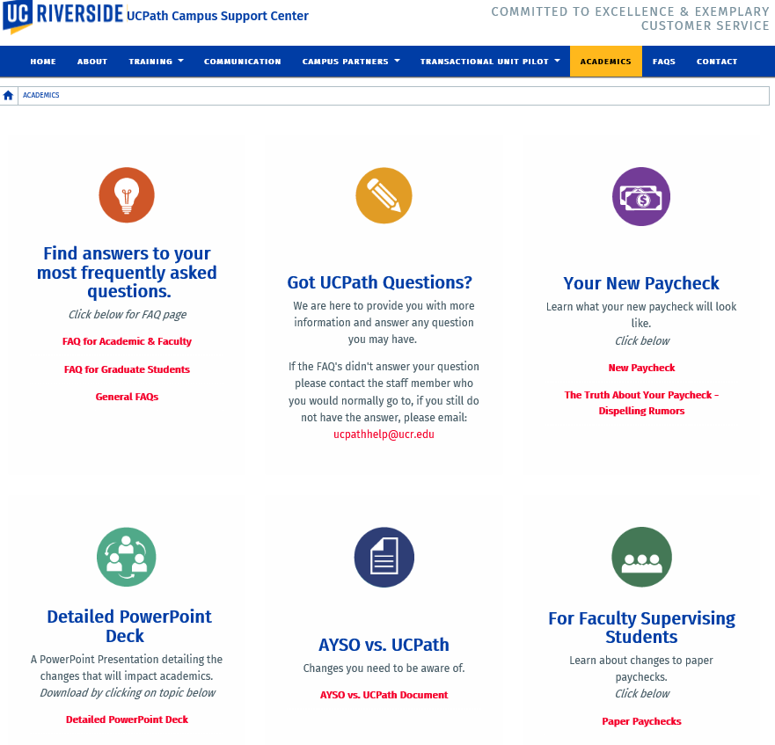
What is UCPath Campus Support Center (CSC)?
UCPath is University of California’s system-wide payroll system.
UCPath Campus Support (CSC) supports UCR campus by providing UCPath training services to the campus. CSC works closely with UCPath Center to address and resolve campus UCPath issues.
CSC website has good payroll related resources for academic appointees under the Academics tab.
If the resources provided on the CSC website doesn’t answer your question please contact the staff member who you normally go to. You may also email: ucpathhelp@ucr.edu
https://ucpath.ucr.edu/academics

Slide 4
How Do I Access My Pay Stubs?
UCPath system provides a self-service portal called UCPath Portal for all employees to access their pay stubs in addition to enroll/change direct deposit, update tax withholdings, view/enroll in benefits.
Employees may access the UCPath Portal through R’Space or through the link.
https://ucpath.universityofcalifornia.edu/home

Slide 5
What is Negotiated Salary Trial Program (NSTP)?
Negotiated Salary Trial Program (NSTP) allows eligible lander rank faculty to utilize external sources to increase their total compensation.
Participating faculty is required to generate the additional negotiated income.
Participating faculty maintains teaching and service activities commensurate with rank and department and no course buyouts are allowed.
Additional compensation for a faculty may not be at the expense of support of graduate students and postdocs; but rather additional funding must be obtained to support participation.
UCR is entering year three of the NSTP (trial period) FY20-21. Trial program period July 1, 2018 through June 30, 2022. The annual call is emailed to the Deans and Dept Chairs in March.
NSTP eligibility and procedures are available on the Academic Personnel Office website/Compensation tab/Local Compensation Policy and Guidelines.
https://academicpersonnel.ucr.edu/compensation#negotiated_salary_trial_program_nstp

Slide 6
Any Questions?
Sonia Kalogonis – Sonia.Kalogonis@ucr.edu
Office - academicpersonnel@ucr.edu
Phone- 951.827.2934

