Slide 1
Academic Leaves and Academic Systems
New Faculty Orientation September 25, 2020
Sara Umali
Director of Academic Personnel Data & Technology
(951) 827-5810
sara.umali@ucr.edu
academicpersonnel.ucr.edu

Slide 2
Academic Policies
Systemwide
Academic Personnel Manual (APM) – systemwide policy manual for academics issued and maintained by the Office of the President (UCOP). The APM applies only to the extent provided for in a Memorandum of Understanding (MOU) for academic appointees covered by collective bargaining. Cli (click to view table of contents)
Health Sciences Compensation Implementing Procedures – provides a common administrative framework within which a participating health sciences school can compensate its faculty according to the competitive requirements of each discipline.
Bargaining Contracts – existing employment contracts with each bargaining unit.
UCR
Delegation of Authority – this provides information on approval authority of various academic activities such as merits and promotions, academic leaves, etc.
Senate CALL
Non Senate CALL
Quick Links, Academic Personnel Office Website

Slide 3
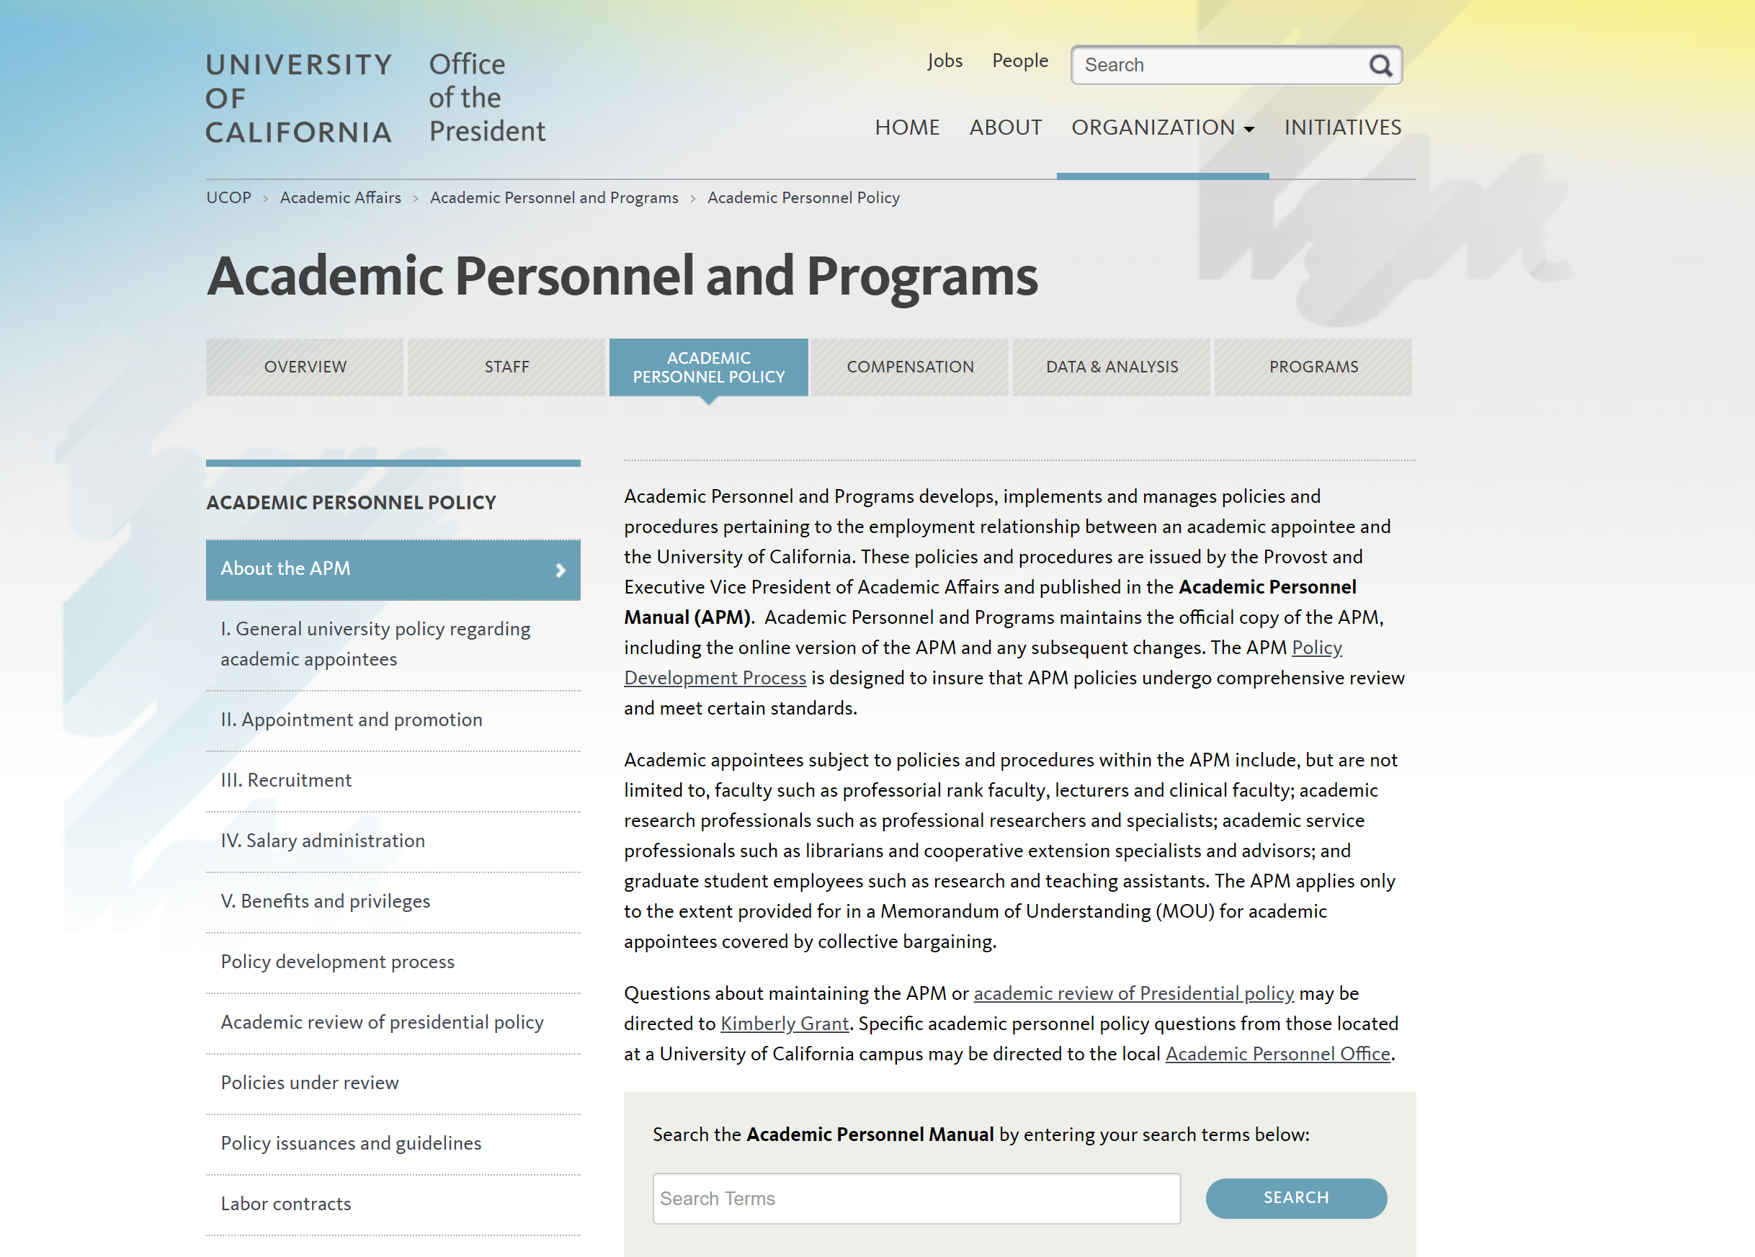
Academic Policies
Systemwide
Academic Personnel Manual (APM) – systemwide policy manual for academics issued and maintained by the Office of the President (UCOP). The APM applies only to the extent provided for in a Memorandum of Understanding (MOU) for academic appointees covered by collective bargaining.
Quick Links, Academic Personnel Office Website

Slide 4
Academic Policies
Systemwide
Academic Personnel Manual (APM) – systemwide policy manual for academics issued and maintained by the Office of the President (UCOP). The APM applies only to the extent provided for in a Memorandum of Understanding (MOU) for academic appointees covered by collective bargaining. Cli (click to view table of contents)
Health Sciences Compensation Implementing Procedures – provides a common administrative framework within which a participating health sciences school can compensate its faculty according to the competitive requirements of each discipline.
Bargaining Contracts – existing employment contracts with each bargaining unit.
UCR
Delegation of Authority – this provides information on approval authority of various academic activities such as merits and promotions, academic leaves, etc.
Senate CALL
Non Senate CALL
Quick Links, Academic Personnel Office Website

Slide 5
Academic Leave Types
Sick Leave
Paid Medical Leave for Academic Appointees Who Do Not Accrue Sick Leave
Family and Medical Leave
Vacation Leave
Sabbatical Leave
Leave for Service to Governmental Agencies
Military Leave
Leave to Attend Professional Meeting
Other Leaves with Pay
Other Leaves without Pay
Family Accommodation for Childbearing and Childrearing
Childbearing Leave
Parental Leave
Active Service Modified Duties (ASMD) – this is not a leave of absence
Stop the Clock (STC) – this is not a leave of absence
APM 700, Benefits and Privileges
Academic Leaves Guidelines

Slide 6
Academic Leave Approval Process
Delegation of Authority
Sabbatical leave (Regular and In-Residence) – Dean
Non-Senate leaves – Dean
Senate leaves that are thirty (30) calendar days or less (with the exception of leaves with FML designation) – Dean
Faculty Members of Health Sciences Compensation Plan (HSCP) & School of Medicine (SOM) Faculty Members – Dean
All other Senate leaves – Vice Provost for Academic Personnel (VPAP)
Academic Employee
Department Chair (or equivalent)
Dean (or equivalent)
Vice Provost for Academic Personnel
Delegation of Authority Charts, Academic Personnel Office website
Academic Leaves of Absence Guidelines, Academic Personnel Office website

Slide 7
Academic Systems
Academic Personnel Recruit System or AP Recruit is a secure online academic employment recruitment management system, supporting the entire recruitment workflow from creation of a recruitment plan, application, reference gathering, review by the search committee, and, finally, selecting a hired candidate. This is a systemwide application used by all 10 UC campuses.
UC Outside Activity Tracking System or UC OATS is a secure, online application that supports the required collection, review, approval, and annual reporting of the outside professional activities subject to the University of California's Conflict of Commitment policies: APM-025, APM-240, APM-246, and APM-671. This is a systemwide application used by all 10 UC campuses.
eFilePlus (link) is a secure, online academic review management system that supports the personnel actions for appointment and advancement. This is a UCR-developed system originally developed in 2006 and rebuilt in 2018.
https://academicpersonnel.ucr.edu/systems

Slide 8
Resources
Subject Matter Experts (SME) in your ORG
AP Recruit: contact information and levels of support
UC OATS: contact information and levels of support
eFilePlus: contact information and levels of support
Information Websites
AP Recruit: about AP Recruit
UC OATS: about UC OATS
eFilePlus: about eFilePlus
How to Log In – all systems are single sign on. Just have your UCR NetID and Password available to access the system.
AP Recruit: https://aprecruit.ucr.edu/
UC OATS: https://ucr.ucoats.org/
eFilePlus: https://efileplus.ucr.edu

Slide 9
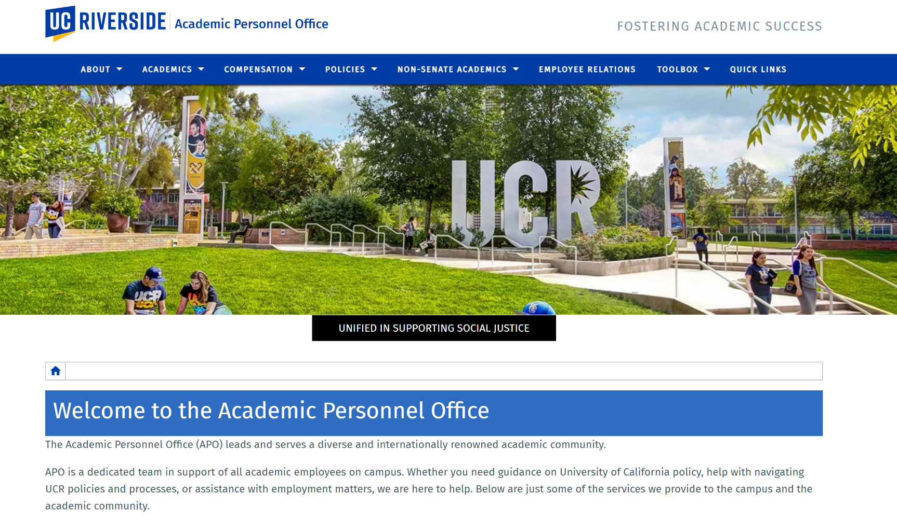
APO Website
https://academicpersonnel.ucr.edu/

Slide 10
Questions

