Slide 1
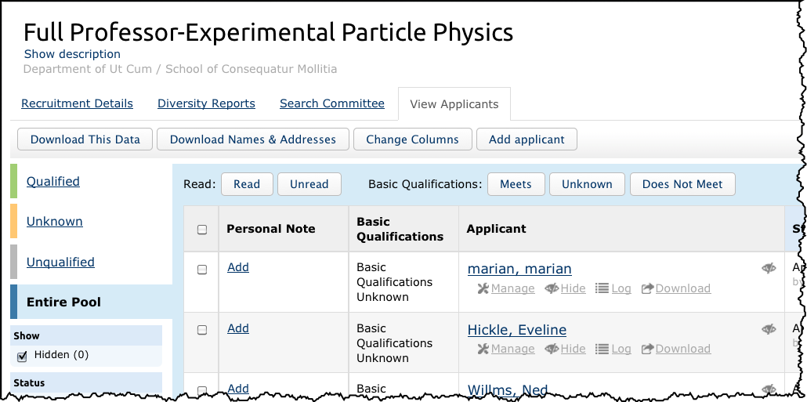
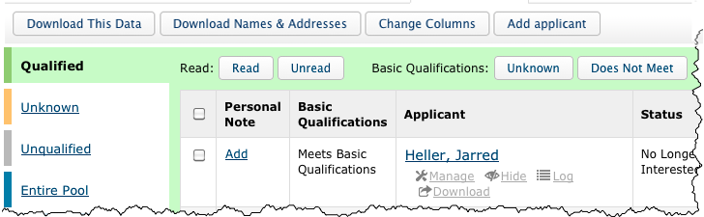
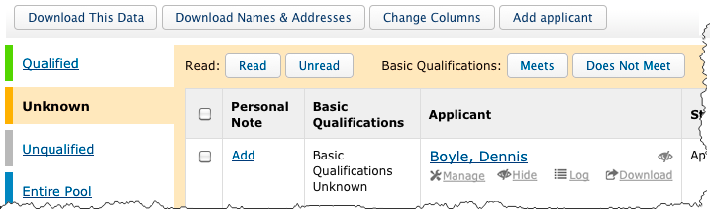
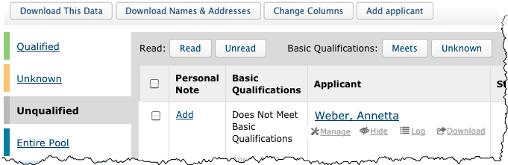
Marking Applicants as Meets/Does Not Meet Basic Qualifications
AP Recruit
As of July 1, 2013 an analyst, editor or chair will be able to mark applicants as “Meets” or “Does Not Meet” basic qualifications. This action ensures the reporting on the applicant pool diversity as required by the Office of Federal Contract Compliance Programs, Department of Labor.
1
To access the feature, find the applicant’s list, just as you would do with any other applicant management task.
Periodically check the Unknown (Orange) tab as new applicants enter the pool.
Put a check in the box next to a completed applicant. Then click the “Meets” or “Does Not Meet” button at the top of the column. The name will be moved to the Qualified (Green) tab.
You may mark names all at once by putting a check in the master box at the top of the column. Only completed applicants will be moved.
Run Diversity reports as needed. Only qualified applicants will be included in the report. You will be reminded to mark applicants if any remain in the Unknown category.
2
Entire Pool
View all applicants, regardless of their basic qualifications on the blue tab.
3
Qualified
Applicants listed on the Green tab are those who meet the basic qualifications.
4
Unknown
Applicants who have not yet been marked appear on the Orange tab.
What will the Reviewers see? Reviewers will have the same color-coded tabs. They will see applicants who are completed and categorized accordingly. They will not have the ability to mark the applicants as “Meets/Does Not Meet” or edit their designations.
Unqualified
Applicants not meeting basic qualifications appear on the grey tab.

Slide 2
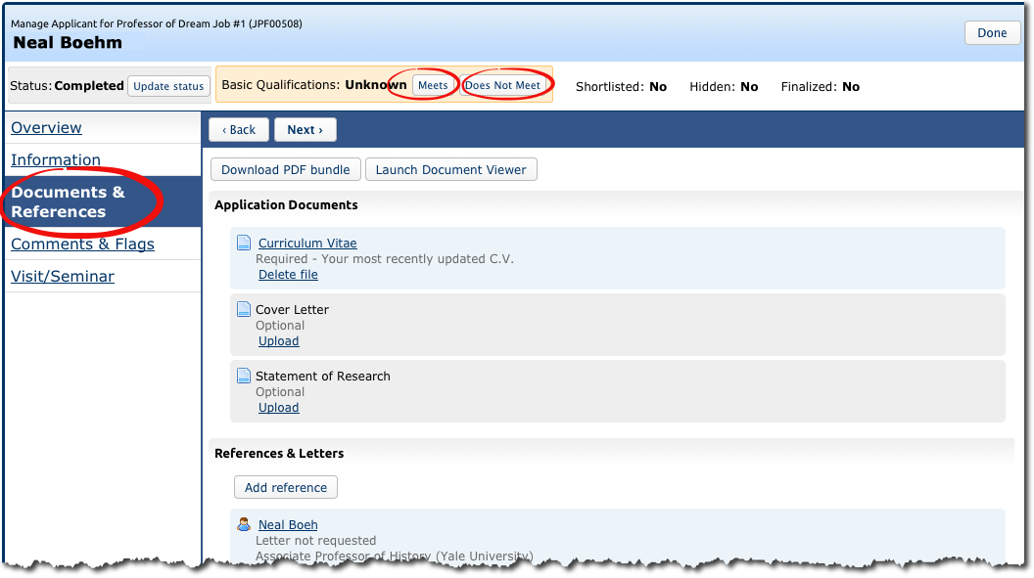
Marking Applicants as Meets/Does Not Meet Basic Qualifications
AP Recruit
You may need to evaluate and mark each applicant individually from within their application. For example, 2 years of teaching experience should be indicated in their CV.
1
Open the application by clicking the “manage” link.
2
Review the files in the Documents & References section.
3
Use the buttons at the top of the applicant’s screen to mark MBQ.

