Slide 1
Welcome
Department Chair Workshop
Spring 16-17AY
Tuesday, May 30, 2017
8 a.m. -1.00 p.m.
Ameae M. Walker
Vice Provost for Academic Personnel

Slide 2
Agenda
8 –8:30am Registration and Table Assignment
8:30-8.40 Welcome, Announcements & Explanation of Workshop Structure
8.40-9.40 Working Session
9.40-10 Break
10-12.40 Review & Discuss Results of Working Session –some while we eat lunch
12.40 -1 pm Additional VPAP items and Wrap up.

Slide 3
Workshop Purpose
To announce/discuss good news of importance to the academic review process.
Obtain your input about some problem issues
Obtain your input about future items that may impact academic personnel.
The goal is to have everyone benefit from the collective wisdom of the group.

Slide 4


Announcements
Extramural Letter request function live in efile – your choice whether to use or not http://efileinfo.ucr.edu/extramural_letter_solicitation.html.
Thanks due to :
Bourns College of Engineering: Cecilia Gonzalez, Tiffany Lindsey
College of Humanities, Arts, and Social Sciences: Annette Brock, Susan Brown, Kathleen Carter, Michael Haeberle
College of Natural and Agricultural Sciences: Wendy Alvarez, Joy Ashburn, Laurie Bollinger
Graduate School of Education: Janet Harshman
School of Business Administration: Ana Kafie
School of Medicine: Terri Buchanan, Jami Holland, Wydette Morales
School of Public Policy: Angie Gonzalez, Jasmine Mejia
Sara Umali

Slide 5
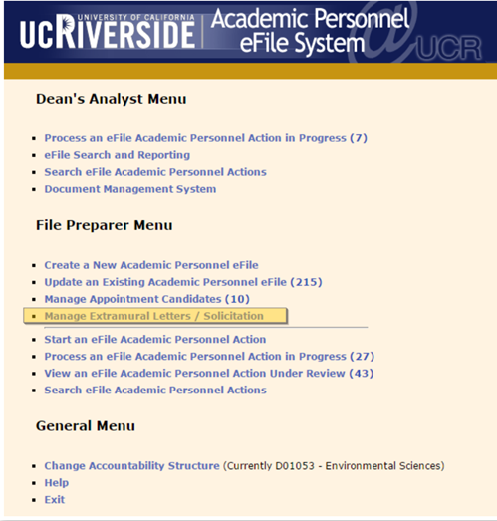
Step 1: Login to the eFile system and click on the link labeled "Manage Extramural Letters / Solicitation".

Slide 6
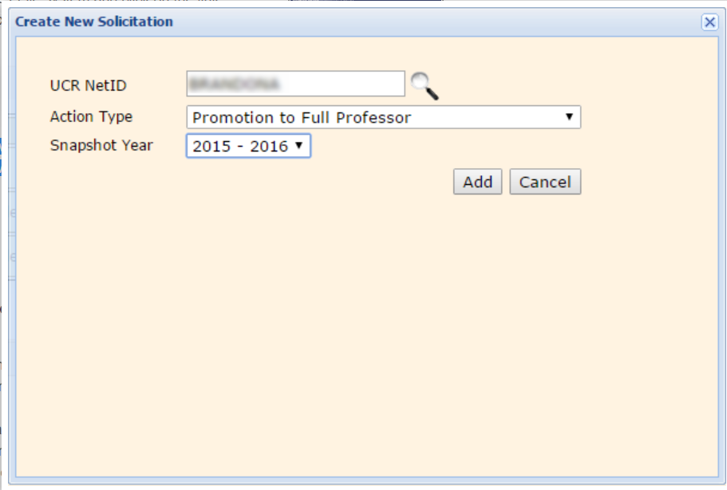
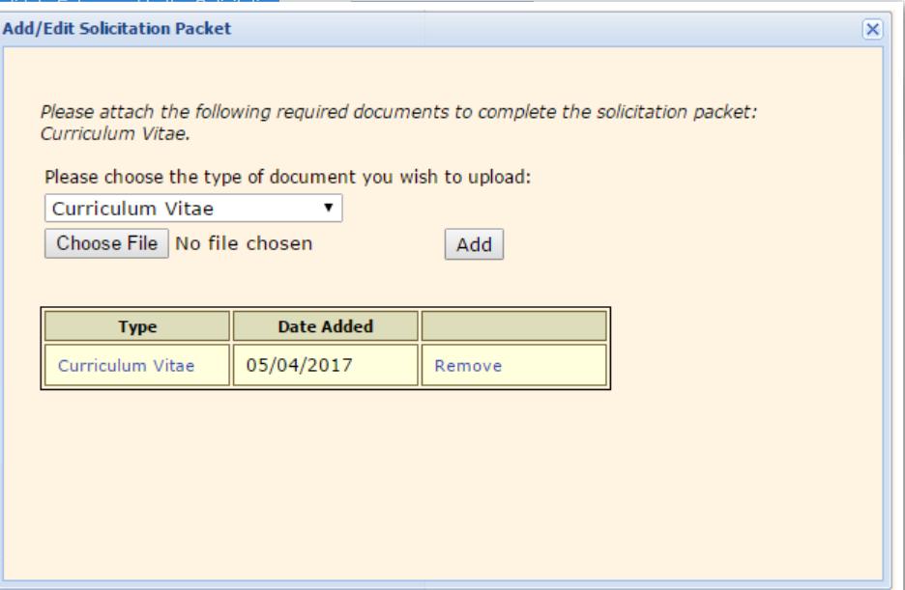
Step 2: Begin a new extramural letter solicitation by clicking on the "Create New Solicitation" link.
Step 3: On the Candidate Extramural Letter Solicitation Page, upload documents by clicking on the “Add/Edit Solicitation Packet” link.

Slide 7
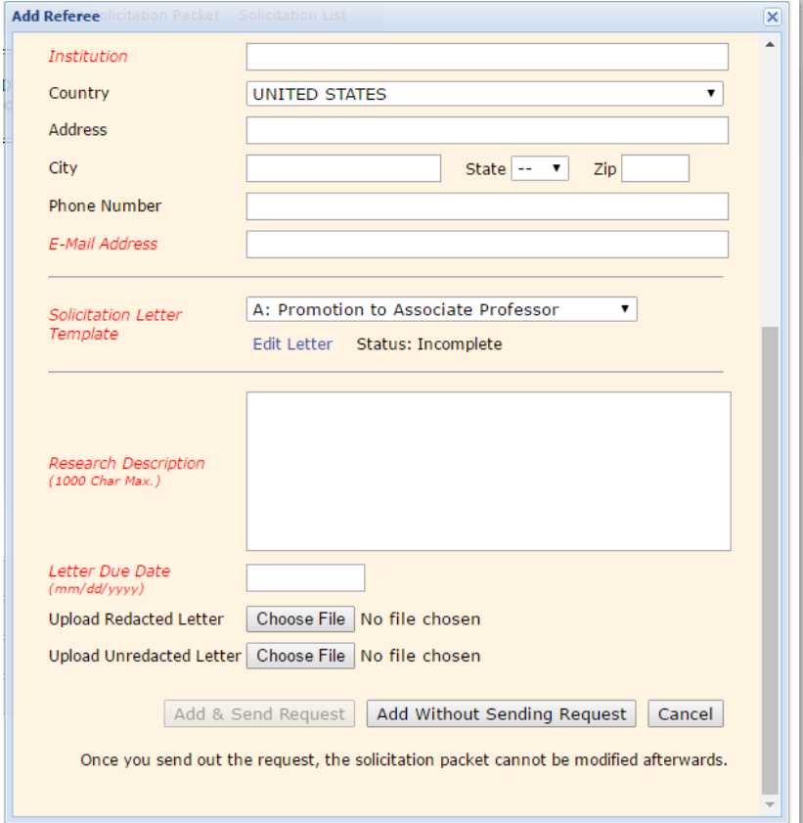
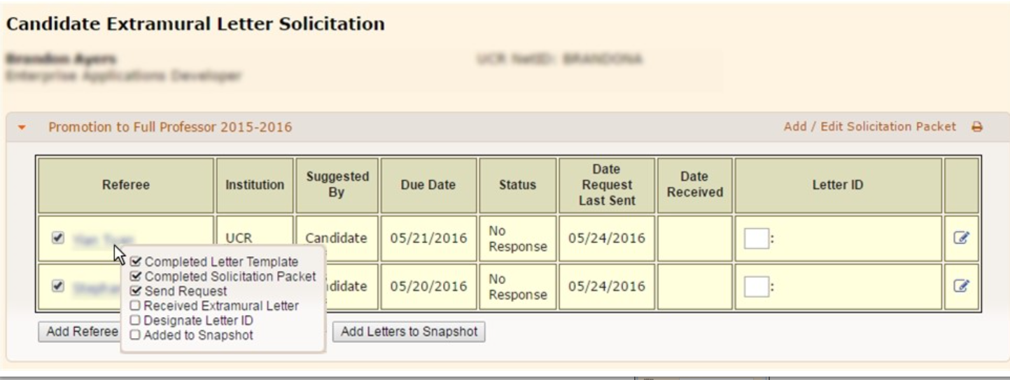
Step 4: On the Candidate Extramural Letter Solicitation Page, add new referee by clicking on the “Add Referee +” button.
How to Check on the Solicitation Process
On the Extramural Letter Solicitation and Management Page, hover over the referee’s name to view the tooltip to check the process for each referee. The "Status" column displays the current status of the request.

Slide 8
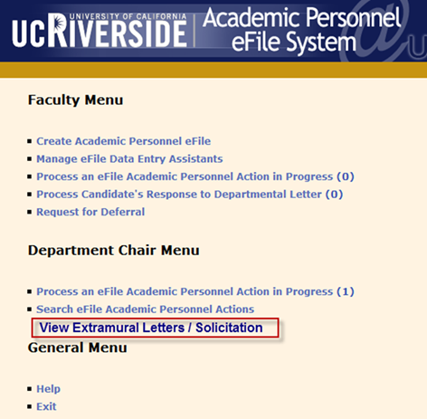
For Chairs:
You may, of course, add to (customize) the solicitation letter, as before, that is then uploaded by analyst
Check on the number and source of those received without having to ask staff so it is easier for you to keep track when you have a moment and make sure they are received by the deadline.

Slide 9
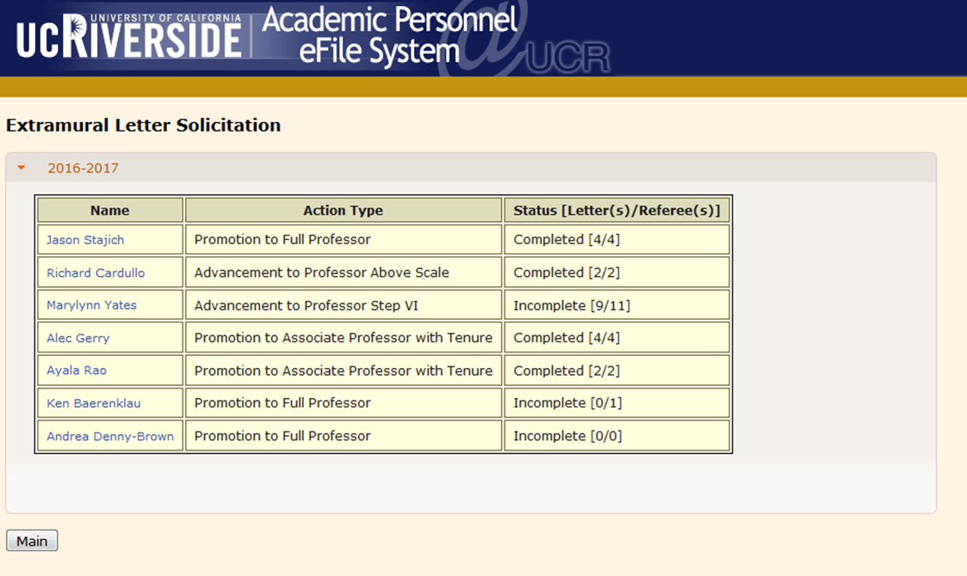

Slide 10
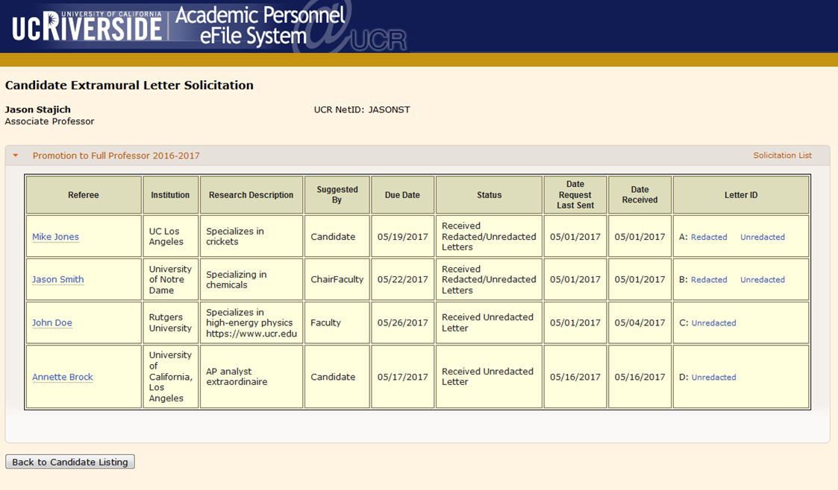

Slide 11
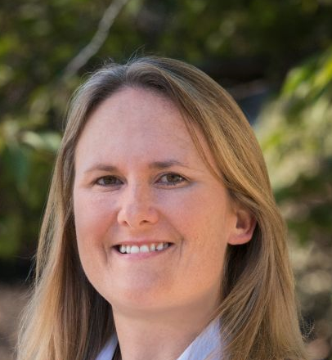

Announcements
We are to have a new efile system by next Spring!
The coming cycle will all be in current efile
All data in current efile for those not undergoing personnel review will be automatically transferred
Will be able to copy and paste entries
Will no longer require separate entry of authors
Can reorder to prioritize most important items (e.g. grants and service so things don’t get buried)
Danna Gianforte
Eric Martin

Slide 12
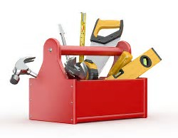
Discussion Mechanics
You have been randomly assigned to tables so that you discuss with those from outside your unit – needs and opinions are different and we learn/understand more
For the discussion topics, please elect a “scribe” who will put the suggestions/answers to questions onto the jump drive for sharing.
Give this to Jill Sadey who will assemble during the break
We will then ask someone from your group to present opinions

Slide 13

Discussion topics
Every table has
What would you most like to see/not see in the New eFile system (Eric is listening)?
An additional set of questions on different topics

Slide 14
Following is output from each of the discussion tables in regard to the question on efile. VPAP comments are in red, when offered.

Slide 15
What would you most like to see/not see in the New eFile system (Eric is listening)? (Table 1):
More flexibility within to add categories and to explain the value
Should be on the faculty member to order items for placement
Upload field specific CV in addition to input into eFile
Scale to weigh value of record
Removal of journal impact factor using metrics or external metrics as designed
Balance student evals and peer evals as an automated entry/prompt
Visual format- can’t see what you’re entering. No easy preview or second screen opening

Slide 16
What would you most like to see/not see in the New eFile system (Eric is listening)? (Table 2):
Automatically calculate totals (e.g., # of publications, # of papers with graduate students, grant totals, students, etc.). As long as we don’t get too numerical – quality and impact are important
Ability to download information from central offices (RED, Graduate Division, etc.)
Grants (overall amount, P.I. amount, and personal amount). Not as simple as it sounds and would requires a lot of additional information input to be accurate plus after establishing the sustainability of your research program, its what you do with the funds that count and not the amount.
Remove as many drop down menus as possible
SOM – build new functionality based on year round teaching
Ability to feed publications from publication databases or word files

Slide 17
What would you most like to see/not see in the New eFile system (Eric is listening)? (Table 3):
Grant Access to both Chair and Vice Chair
Table summaries for milestone of progress of the academic file with completion/approval date
Make it clear which fields are optional, i.e., affiliations of non-primary co-authors.
Output pdf file with the order of the sections that can be selected.
Easier navigation with new eFile.
Import the list of publications either through copy/paste or download from CV

Slide 18
What would you most like to see/not see in the New eFile system (Eric is listening)? (Table 4):
Electronic Conflict of Commitment and Safeguard forms (built into system), different than annual CoC reporting
Summary numbers: Same comment as for table 2
  Publications – Total per category
  Difference list preview
  Grants:
    Total awarded
    Amount awarded to candidate
  Summary table of course evaluations (enrollments, evaluation average, etc.)
  Correct enrollment numbers, so they are not different in system vs. evals.
  Summary that allows candidate to highlight certain items
Publications – Link that shows how many times the publication has been cited- using which source since they all give different metrics?
Help for new faculty with creating eFile – Ability to import information
Template for department letter available to Dept Chair with cover sheet info pulled in
Prominent listing of proposed rank and step – Maybe allow candidates to enter and Dept. Chair can add other actions
Time at current rank and step (is this normative progress or accelerated?)
Clarification of review period
Auto message to candidate regarding expectation for action requested, with Cc: to Chair
Auto generation of snapshot and eligibility list with notifications to candidate
Grants – Put all submitted and unfunded in a separate category at the bottom. Bring in info from eCaf

Slide 19
What would you most like to see/not see in the New eFile system (Eric is listening)? (Table 5):
Electronic safeguard - chair can be in efile and process the form. Chair authorizes, candidate approves , then digitally entered the safeguard authorization. Following normal meeting with chair and perhaps some time to think.
Conflict of commitment should also be processed solely electronically - rather than the electronic > paper > electronic.
Video and sound media files to be processed in efile. The current system only allows for external hosting of these media files - they are separate and secondary to other items.
CV generator only produces an overly elaborate output
Snapshot preview should be available to each faculty (and chairs!)
Prior final file snapshot pdf should be collected and accessible to candidates.
Journal entry field for impact factor. Using what date? When paper submitted or time of file prep?
Cleanup the teaching evaluation extraction.
New faculty members should get an introduction to efile.
Journal citation should be ordered by date accepted/published - rather than by in-process status
How will the change of efile be assessed to prove that it is actually an improvement, how will it be reverted if not? To much a culture of constant administrative changes lately.

Slide 20
What would you most like to see/not see in the New eFile system (Eric is listening)? (Table 6):
Medical School needs more categories related to the medical field that are not exclusively tenure track driven. Currently the categories are Technical/Non-technical/ Other. Make files available to non-senate clinicians.
Files are too cumbersome
Suggestion: build in a place for personal comments – visible only to the reviewer. All comments would be discoverable in any court case.

Slide 21
What would you most like to see/not see in the New eFile system (Eric is listening)? (Table 7):
Add lecturer files to efile (all types)
Reduce the granularity
Increase autofill capability
Self-statement should be entered as pdf only. Eliminate text box.
Ability to get complete difference list that includes pubs, grants , talks, etc. Something that includes all information in one step
Ability to capture faculty comments on the file easier and attributable. Chair should know who is making the comments. Same comment as for table 6
Still useless for printing out a CV. Formatting still is poor and requires massive editing.
Ability to highlight non- or quasi-academic writing in the humanities. Better way to frame the categories.
Place course evals in same place as teaching information

Slide 22
What would you most like to see/not see in the New eFile system (Eric is listening)? (Table 8):
Auto-fill available information:
  Connect efile to other systems on campus so that information can be added error free more easily
  Connection between efile and faculty website – automatic addition of recent material to faculty website
  Supervision could be self-populated from grad division
  Comparison of files for collaborating faculty. Let’s be careful not to discourage collaborations.
Greater availability of selected faculty data
  Enabling ongoing “read only” access by Dean’s office
  To selected individuals on campus (for recognition, data collection)\
  Searchable for reporting, solicitations, etc./IRB approval or oversight
  Creation of comparable data on service, mentorship, etc. (like evals., to see how well faculty are sharing burdens)
User interface update, one that is easy to view and capable of producing a “bundle” (as in in AP Recruit), with capability to select contents, such as “difference list”
Greater transparency – Access to timeline so that Dean, possibly also Chair and faculty, are able to prepare.
Help in context:
  add prompts for missing information
  add definitions, clarifications to terms—i.e., “technical,” etc.\
  add prompts when publications come out (“you have a new publication, would you like to add it?”), when travel is reimbursed (“you’ve just taken a trip, would you like to add this conference or talk?”)
Electronic worksheet that facilitates listing of publications, grants, etc. with the capacity to upload into efile. (like igrade) with review (like tax programs)
Site map so that faculty and staff know where to list activities – Who knew that “mentoring” is teaching, not service?
Regular offering of online tutorial (like AP recruit)

Slide 23
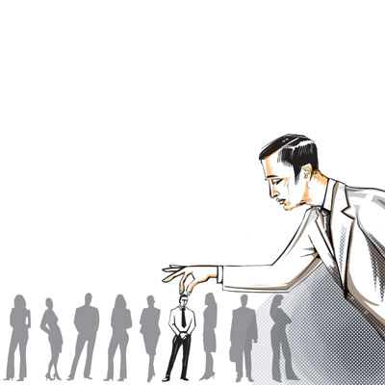
Table 1: Additional topic-Professional Nepotism
In the search process, how do we avoid professional nepotism?
Whom/what does it hurt?
If you think a search committee has been guilty of professional or other nepotism, what should you do?
How might a criterion-scoring rubric help avoid problems of this kind?

Slide 24
Professional Nepotism (Table 1)
Something to be aware of, but not necessarily “bad”. Evaluate what the effects are
Need transparency and input safeguards
Transparent and clear rubric for hiring and promotion. Must be explicitly stated and adhered to avoid implicit bias. Also allows subsequent review if implicit bias occurred.
Sometimes unavoidable, especially in small fields
Size of the department may have an impact
Every application is viewed by at least 2 or more members of the search committee
Is there an appropriate office to register complaints? At what point of the search can a faculty member voice their concern?

Slide 25

Table 2: Additional topic
Negotiated salary plan
There has been a negotiated salary plan for non-health science units at UCI, UCLA & UCSD for 4 years. This plan allows for faculty to pay themselves extra salary from non-19900 funds (grants, gifts etc), but they have to maintain normal teaching loads and are expected to maintain the same number of graduate students/postdocs as prior to joining the plan. Those campuses say it is useful in recruitment (they steal our faculty!) and retention and the funds for extra salary are not coming from college funds – to the benefit of all in the college.
If offered at UCR, what would your concerns be?
What would it take to make you feel comfortable with such a plan?

Slide 26
Negotiated Salary Plan (Table 2)
Fewer teaching buyouts
Have a certain percentage (e.g. 15-20%)
NSF – more restrictions than NIH; DOD – depends on the mechanisms, DOE, foundation, gift money, non-19900 funds
Perceptions of compensation and equity
Question: should this scale be progressive so that % may be increased if some milestones are achieved ? (e.g. the number of students increased, etc.)
Limits on time, not affect teaching, research, or professional activity
Central disclosure database that is updated/reviewed annual by a Senate committee

Slide 27
Table 3: Additional topic
Faculty salary plans
Once again, we have a ~1.5% + ~1.5% salary plan
What are your concerns about this kind of plan?
If given any say in future plans, what would your input be?

Slide 28
Faculty salary plans (Table 3)
Lack of transparency and who makes decision and how decision is made with respect to the second 1.5% salary increase.
Identify productive long-term faculty who are below the average for their step.
Maintain the integrity of the step system.
How to bring steps and salary in line with reality

Slide 29

Table 4: Additional topic
Achieving equity
Some campuses have equity advisors (faculty members) who provide input on salary plans, retentions, recruitments and inequities among faculty salaries. On one campus, where they are compensated, they also play an observer role during department meetings and help to mediate contentious faculty meetings. Some campuses have one or two per college and some have one per department.
Do you think UCR would benefit from equity advisors?
If so, how should they be selected?
How many should we have?
What should be their roles?

Slide 30
Achieving Equity (Table 4)
If people aren’t trained to serve in a particular role, this can be more problematic.
Ideally someone from another college/school would serve in this role
Potentially use outside consultant to be a little more unbiased. Although, those from the outside likely will not understand our salary dynamics.
What data is being used to evaluate equity issues? Different within fields, depts., across university
More transparency regarding how off-scales and salary offers are determined at college level
Have people who are trained to help with mediation act as advisors
Survey faculty, Chairs, and Deans to see if there is a need for mediation

Slide 31
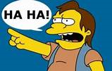
Table 5: Additional topic
Bullying by faculty
We would like to create campus guidelines for dealing with faculty bullies
What kind of activities do you consider fall into the category of bullying? Don’t forget to include bullying of chairs!
How many incidents/duration makes it bullying rather than an unpleasant interaction?
For each form of bullying identified, what do you think is an appropriate censure/disciplinary action?
How do we promote a culture of bystander intervention?

Slide 32
Bullying by faculty (Table 5)
Financial issues between staff and faculty lead to trigger point - especially at end of fiscal year
Other trigger points: contracts and grants; merits and promotions; graduate program work; hiring
Anonymous way to report bullying is needed. -especially for untenured faculty
Bullying needs to have consequences.
Don’t resolve conflict issues through email, hold a meeting!
Bullying is a pattern - first time is flag. Second time hold a meeting with faculty member. 3 times a change of action is not perceived go to the dean for how to implement consequences.
Chair should be the contact point for faculty and FAO for staff.
These are isolated incidents that are usually pertain to only certain faculty

Slide 33
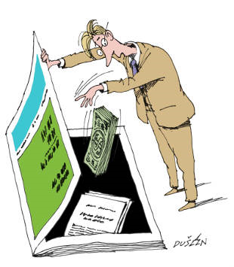
Table 6: Additional topic
Department letter
There are now predatory journals (asking for submissions not critically peer-reviewed) and professional meetings where, for example, everyone can be a keynote speaker if they pay to attend or anyone can be a meeting organizer. i.e. they know what we are looking for in faculty merits and promotion files.
How do we guard against “counting” these?

Slide 34
Table 6: Additional topic
Department letter
How do we distinguish between community-engaged research and community service to be sure we give adequate credit to the former?
How do you think blogs should be credited? What criteria are appropriate?
Why are book reviews under publications, whereas manuscript reviews are under service?

Slide 35
Departmental Letter (Table 6)
Provide list of potential predatory journals – new ones appear every week. Better to have department address this
If the work has been done, should it still carry some weight even if conference at which it was presented was one where presenter “paid” for inclusion?
colleagues in the department become guardians against non-credible journals/confernces/etc.
Community Engaged research must be directly related to the faculty member’s field, accompanying paper was mentioned as possible necessity for credit.

Slide 36
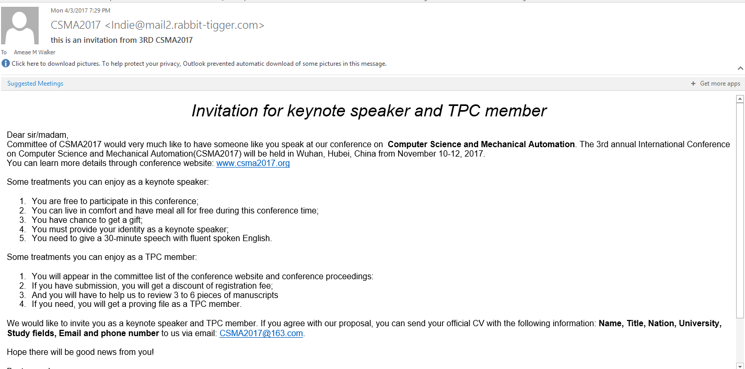
VPAP Comments: What do we need in the department letter we aren’t getting from some? Context!
Comments on whether a meeting is an important one in the field
A determination of whether real keynote or like the one below

Slide 37
VPAP Comments:What do we need in the department letter we aren’t getting? Context!
3^{r d} Global Summit and Expo on
Dental & Oral Diseases
February 26-27, 2018 at Abu Dhabi, UAE.
Sounds important
But I don’t work on this
Want me on the organizing committee!
Dear Dr. Ameae M Walker,
We would warmly welcome you to attend as Organizing committee member for 3rd Global Summit and Expo on Dental & Oral Diseases which will be held at Abu Dhabi, UAE. During February 26-27, 2018
This year we have adopted the theme " Focusing on Advancements for the Future of Dental and Oral Health Care." GSEDOD-2018 is a scientific congregation which brings together researchers, scientists, and key decision makers, industry professionals in the respective fields for a brief yet intense period of discussion, collaboration, and addressing related problems in current research.

Slide 38
Table 7 : Additional topic
Solicitation packet
What input should there be by the Chair in regard to the contents of the solicitation packet?
What items in the solicitation packet cause subsequent problems in the review process?
What is it useful to say in the solicitation letter
If someone is at 8 years of service?
If someone is up “early” for tenure or promotion to full professor?
•Is there any change to the solicitation letter you would like to see?

Slide 39
Solicitation Packet (Table 7)
For reviewers
Lack of understanding of Step VI
Lack of understanding of UC system in general
Important to add verbiage explaining the above for the reviewers.
For 8 year file (stop the clock), need to inform the reviewers in some way.
For Candidate
Include a detailed self-statement that includes research, teaching, and service. Highlight big accomplishments
Include a good quality CV
Current representative teaching evals.
Emphasize balance in the file
Choose wisely and practically what information to send to reviewers.

Slide 40
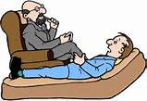
Table 8: Additional Topic
Knowing your faculty
We had a number requests for late file submissions this year because of a change from a merit to a promotion, an appraisal to an appraisal plus a merit etc. i.e. the Chair had no idea this was likely until the scheduled materials came forward.
What should a Chair be doing to make sure that potential changes are taken care of in the schedule?
How do you know if your faculty are on the job market? What kind of pre-emptive measures do you think are useful?
What kind of intervention strategies do you think would help in departments with very split views or otherwise “difficult” faculty?

Slide 41
How Chairs can Respond to Change (Table 8)
Best Practices for Senior Faculty, Staff Support
  Prompts re: timeline for accelerations, promotions – challenging when staff turns over, faculty assume new duties
  Transparency about CAP workload so that Deans, Chairs can anticipate hold ups, look for flexibility when possible
How about a “shadow” CAP just for hiring, waivers, approvals, etc.?

Slide 42
Are Colleagues on the Market? (Table 8)
Preemptive action is not about retention packages
Chair needs to chat with faculty – get to know them, respond to questions, make them feel included, support them
  It need not be the chair
  Think about ”coaching”
  Establish awards and Nominate colleagues for awards
  Look for fellowships and encourage faculty to apply
  Take opportunities for career review
Managing “hot shots”:
    Don’t wait for a letter, get ahead of it
  Identify hot shots to create a “watch list”
  Take then to lunch, show appreciation
Diversity!
  Men play the game, are seen as more mobile
  Identify women, people of color, recommend career review
  Make everyone feel more welcome
Recognize that bureaucracy contributes to climate – it can be painful to get grants, get reimbursed, develop courses, programs
  Consider college level awards committees, as these do not always exist or function at department level

Slide 43
How to Handle Split Views
(Table 8)
Split views may be reasonable and should be reported as such
Recognize that strong opinions may register as signs that less central research will not be read fairly
    Voting rights may exacerbate the problem
    Teach faculty how to discuss files, what is/is not to be included
    Squash inappropriate commentary, use as teaching moment
  Consider an alternate chair for personnel
Responses to Personnel Discussions
  Consider using the Chair’s Letter to characterize context in which vote was taken – make sure this only addresses research, teaching and service. Can say, for example, research undervalued, but not because the person is not liked or vice versa.
  Consider minority letter- please try to come to some consensus as a department
  Is there a way to voice/report well-done discussions, versus ones that are not
Create mechanisms for ensuring participation
  Begin with everyone taking a turn to speak
  Maintain a queue to prevent outbursts

Slide 44
What has slowed files this year?
Mostly due to a failed experiment. We eliminated the deadline in the CALL when files were due to the deans’ offices because the same analysts were involved in provision and receipt (it seemed silly). However, the upshot of this is that many departments have been very slow to process files. The problem is that now we have an avalanche of files from the slower colleges and CAP and APO are overwhelmed instead of being able to spread the load.

Slide 45
What is the problem?
APO and CAP review ~350 files per year plus g new appointments (above Asst III) plus Chair appointments plus changes to the Call etc.
CAP consists of a balanced committee to best represent all of the colleges across the university.
If files are submitted to CAP in an unbalanced manner (all files during a quarter from one college), this places undue strain on a proportion of CAP members to review those files, and to then on all members to balance those reviews across the entire university.
Suggestion: earlier submission, processing, and APO acceptance of all files, including a better balance of early files (appraisals, merits and quinquennials)

Slide 46

What has slowed files this year?
Some files were held by the Senate during the transition between Provosts so that all files would be handled by the same Provost
You may not be aware that files come into my queue in alphabetical order and not the order they are received and so, apart from always prioritizing appointments and promotions, sometimes a particular file can, just by chance, sit in the queue a long time. This will be fixed with the new eFile!

Slide 47

What has slowed files this year?
Errors in the file requiring them to be returned
Difference list cover sheet (DLCS) talks about the content of papers i.e. it has been used to circumvent the 2 page limit on the self-statement
Excessive discussion of submitted papers in DLCS, Self Statements and Department Letters.
Submitted/working papers sent to extramural reviewers. This leads to a discussion of same by extramural letter writers, then further discussed by department and dean.
Discussion of articles/service/grants etc. outside of period of review

Slide 48

What has slowed files this year?
Discrepancies between the department’s and Dean’s letters re votes, step or even rank
Department chair’s signature missing
Department letter talks about items not in the file – did department faculty read the file they are voting on?
Department letter gives no reason for negative vote/s –required by CALL

Slide 49

Thank you for your contributions today and for all your hard work this academic year

