Slide 1

New Chair Orientation
2017

Slide 2
Agenda
8:00 a.m. – 8:45 a.m. Budgeting 101
Umar Mohideen, former Chair of Physics, Current PhySci Div. Dean.
8:45-9:45 a.m. Campus Resources & Policies for Department Chairs Andrew Larratt-Smith, Ombuds, and John Andersen, VPAR.
10:00-10:30 a.m. Managing Emergencies
Lisa Martin, Campus Emergency Manager.
10:30-12:00 Academic Personnel Processes that you May Not Yet Know About Ameae Walker, VPAP.
12 noon-1:00p.m. Lunch, Group Introductions, and Getting to know your Colleagues
1.00p.m. – 3.45p.m. Know Yourself, Time Management Tips, Order at Faculty Meetings, Chair’s Responsibilities, Who You Gonna Call? Ameae Walker
3:45p.m. – 4:45p.m. Promoting Best Practices and Avoiding Legal Traps for Department Chairs David Bergquist, Chief Campus Counsel.
4.45-5:00pm Mentor Support Program for Chairs Ameae Walker.

Slide 3

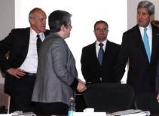
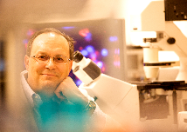
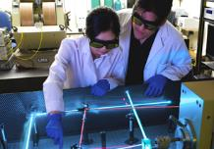

VPAP New Chair Forum:
Topic: Department Budget
Umar Mohideen
October 11, 2017

Slide 4
Outline
Authority: Supervisory & Budgetary
Departmental Permanent Funding: S&E (cash)
Permanent Departmental Salaries, staff & faculty (paid by college)
Departmental Temporary Funding: Lecturers, TAs, benefits
Summer Session allocations:
Student Instructional Fees: (UNEX & Lab Fees)
Other Funding: (teaching release, grad recruiting, faculty recruiting, staff ‘cost savings’, overhead return, student lab fees, etc.)
Grant Administration & Expenditures (submission, oversight, OH, etc.)
Development Donations & Endowments (principal and allocations)
Facilities (ACIF, IIGB, Microscopy, etc.)
Miscellaneous Funding; (e.g. Carryover Reserves, emeritus x-funds, etc.)
Departmental Expenditures (Salaries, Inst. Labs, S&E, Grants, Seminars, Recruiting, etc.

Slide 5
1. Supervisory Authority
Staff facilitate the faculty’s education, research & outreach mission
FAO/MSOs have longer tenure & historical memories than Chairs – however, Chair has ultimate supervisory authority and responsibility for the department.
Keep Supervisory Authority Clear & well Demarcated (e.g. complaints, overtime, staff appreciation, evaluations)
Staff evaluations done in the presence of Chair with Faculty written input (redacted) (support staff, ask questions of human resources & Labor relations if necessary- take vice Chair, mentoring opportunity)
Chair
Phys & Astr Dept Profile:
-38 Faculty
-130 PhD students
-150 BS majors
~4000 Enrolled Students/yr
-13 Staff
-$10 M Grant Funding
FAO/MSO
Lab Supervisor
FOM
Lab Staff (3)
Grants Analysts (3)
SAO, Purchasing, M&P Assistant, Travel + Receiving

Slide 6
Salaries & Benefits
Biggest Component is Ladder Rank Faculty & Permanent Staff Salary and benefits- Paid for by College from Provost (Faculty + Staff Salary ~$6M).
If an expensive faculty separates and replacement by inexpensive faculty, College gets back equiv of Asst III after this year. If an expensive Staff separates and replaced by less expensive Staff, Department keeps the difference for 1 yr!!
Temporary teaching faculty, TAs and Temporary Staff paid by yearly allocation from College
Funding comes with number 19900 with Budget Categories (BC
  BC10 – Faculty salaries
  BC13 – Academic Coordinator salaries (none in Physics)
  BC25 – Staff salaries
  BC≥40 – S&E subcategories

Slide 7
2. Departmental Permanent Funding: S&E (cash)
S&E – Supplies and Expenses Budget (19900 cash to run the dept- Flexible $, Discretionary to Chair)
  S&E = Budget Categories BC≥40 within 19900. e.g printing 43, Facilities 70)
~$120K/yr for a large dept spread over many bldgs (facilities costs included).
Covers all dept purchases:
Xerox paper, Facilities repairs, computers, seminar room upgrades, temporary staff, student assistants etc.
S&E allocation should correlate with dept faculty size/ teaching- research workload
  Periodic review of S&E every 2-3 yrs to assess need.
  Current Review Metric is Total Expenditures by the Department (CNAS views this as a more comprehensive metric).
College ‘Financing’ of dept expenditures is possible
Special Equipment loans from College or Provost can on rare occasions with typically 5 year terms to be repaid from grants can be obtained.

Slide 8
4. Departmental “Temporary” Funding:
Items that require proactive requests & justification to College
Lecturers (~$10K) – paid directly by college if authorized;
TAs (Stipend + Tuition ~$12K/TA/qtr) – paid directly by college ; About ~$11 M per year cost to college. Largest non fixed costs to the college and biggest uncertainty as it depends on enrollment and Union contracts – CFAOs Panic.
In Physics annually 61 TAs (50%) – Cost $2.1 M
Allocated to Department at start of year on projected enrollment for year. Corrections done end of every quarter.
What if a Chair deems it necessary to overspend the allocation to meet teaching needs especially TAs?
  Convince the college that expenditures are justified.
  Otherwise pay the difference out of S&E or ‘reserves’, summers session $, Concurrent enrollment.
  Or cancel classes.

Slide 9
5. Summer Session Revenue:
:
Augmentation to Departmental Funding- Flexible use $
Summer Session Allocations can be comparable or larger than Dept S&E:
  SS generates. ($90 to Physics, ~$170K for Chem) .
Physics uses SS to support: Colloquium, Seminars, GSRs and Fill in deficits Graduate and Faculty Recruiting,
Provides Direct Faculty Summer Salary - 8.5% of AY salary per class.
Ladder rank Faculty Participation enhances SS curriculum.
SS classes reduce AY instructional Burden in impacted classes and helps time to graduation.
Summer Session Revenue calculated by Summer Sessions under VPUE after expenses. CNAS keeps 10% for facility upkeep and staff pay . CHASS keeps 30%
Easiest way to grow Departmental revenue. Offer as many as possible. Advertize (Newspaper Ads, Radio Ads)

Slide 10
6. Miscellaneous Student Instructional Fees:
:
Student Instructional Fees
Course Material/Lab Fees (~$25-150/student): sizable budgets when multiplied by thousands of students: Total in Physics is $141k
- Not Flexible $- Only for Student Instruction connected with Lab supplies, computers, software etc.
  can’t be used for equipment i.e. only items <$5k.
  for small items and consumables.
  - Fund Number 6xxxx
UNEX Concurrent Enrollment Return to dept:
  Fund # 20322 - unrestricted non-19900 funds (e.g. can be used for alcohol purchase).
  In Physics used to be $40k, now $14k- has decreased by 70% over the last 5 yrs !

Slide 11
7. Other Funding:
:
Departmental Funding
Graduate Recruiting Funds (from grad division): $15K/yr (Spent $25k)
Faculty Recruiting Funds (from admin): $4K/search (Spent ~$10k/search).
For “cluster hires” ½ paid by Provost, rest split between eventual depts of hires.
Grant Overhead Return: 5% PI, 10% Dept (Physics get $167k this year ! Biggest single source of discretionary $)
Teaching Release funds for Academic Senate/Admin Service: ~$5K-$10K per year. ASMD used to be paid by Provost, but not in new budget model.

Slide 12
8. Grant Administration and Expenditures
Requires Adequate Financial Support Staff
PI Grants: Submission, Oversight, Accounting, Monthly Reports, Projections, Purchasing, etc.
Fund Numbers: 2xxxx or 3xxxx for Federal Grants
8xxxx for State Grants
Grant Funds are not Taxable i.e. no UCOP 3.1% Tax on transactions. (Funding Streams)
Matching Funds commitments: from, VCRED, Dean & Dept

Slide 13
9. Development Donations and Endowments
Acquiring, Administering, Endowing, Expending
Increase Cultivating Relationships with Successful Undergraduate Alumni (larger numbers and typically stronger reminiscences)
Graduation Recognition Ceremonies (invite, Alumni, Emeriti faculty & Donors)
Prizes honoring the Donors
Financial Administration: Foundation Reports on Principal Balance, Dept reports on current balance, disbursement/utilization of expendable balance (3%/yr).

Slide 14
10. Facilities (Machine Shop, Glass Shop, ACIF, IIGB, Microscopy, Nano Fab etc.)
Recharge Fees plus College and/or VCRED partial Subsidy
CNAS supports most Shared Instrumentation and Shops at ~50%
  e.g. 50% permanent funding from college, 50% temporary funded from recharges.
Depts usually administer these facilities (probably because they involve academic staff that need M&P evaluations.
Lobbying for viable facilities support can require Chair involvement.
Facility usage can be part of faculty start-up packages

Slide 15
12. Physics & Astronomy Dept Expenditures
Salaries, Instructional Labs, S&E, Grants, Seminars, Recruiting, etc.
Grant Expenditures ~10M
31 Faculty Salaries ~ $5.1M
61 TAs ~$2.1M
13 Staff Salaries ~$1M
Benefits (~1/3 of Salaries)- Paid by College
Misc Salaries: ~$20k
  Overtime: 150% (straight <40hrs/wk)
  Work Study helpers (e.g. Student lab assistants).
Instructional lab support purchases ~$150k
General S&E, Facilities ~$50-100k
Faculty Recruitment $10-40k
Seminars/Colloquium $20k/yr
Graduate Recruiting $25k/yr

Slide 16
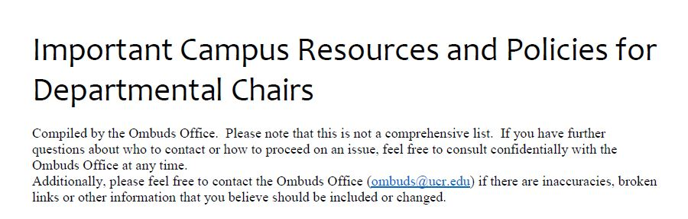
Refer to orange hand out in packet
Andrew Larrat-Smith, Ombudsman
Phone: 951-827-5678
Email: andrew.larratt-smith@ucr.edu

Slide 17

Conflict Resolution
John Andersen
Vice Provost for Administrative Resolution

Slide 18


VPAR Office
My office is available to assist in conflict resolution cases
Do not hesitate to contact me if you have questions
John Andersen,
Vice Provost for Administrative Resolution
Phone: 951-827-4383
Email: VPAR@ucr.edu

Slide 19
Types of Conflict resolution
Understand my role in the meeting – I am here to serve the institution and it’s constituents
Chair as mediator between two parties
  You play a neutral role
  Weigh positive and negative sides of both parties
  Try to build a bridge between the parties
    listen for common ground
You as a party in mediation
  You play a role with a goal

Slide 20
My approach to Conflict Resolution:
Self Assessment and Reflection
Before Meeting: Am I ready?
Understand issue and policy
During Meeting: Awareness of how things are going
Recognize and manage your emotions while staying calm
Allow individuals to speak what they feel (“Their feelings are real”)
Be aware of and respect differences
When appropriate focus on “I” statements
repeat what is said
If discussion gets too heated
  Politely and respectfully end the discussion and reschedule
After Meeting: A teachable moment
How did the meeting go
What worked or did not work
If I did something wrong – apologize
Be OK if parties wish to complain about my actions

Slide 21
New Department Chair Workshop
Lisa Martin, MAOM, CBCP
Campus Emergency Manager
Notes:
Good Afternoon.
Thank you for having me this afternoon.
I’m here to talk to you about emergencies but I’m also here to talk to you about risks
Often it’s a risk that’s taken that blows into an emergency.

Slide 22

Question:
What emergencies or
risks on campus keep
you up at night?

Slide 23
Question:
What area does it fall under?
Risk Services
Emergency Management
EH&S
Continuity Planning
UCPD
Other…
Notes:
Talk to the interdependency of each risk – how they cross to other departmental areas.

Slide 24
ERM Division:
UC Riverside
Enterprise Risk Management
Emergency Management
Environmental Health & Safety
UC Police Department
Risk Management
Notes:
FOCUS: Why is this Important?
UCR operates in an inherently risky environment.
By strategically managing risk,
we can reduce the chance of loss,
create greater financial stability,
free up resources, and
protect the University so we can support teaching, research, and public services.

Slide 25

ERM Vision:
When you call one of us, you get all of us.
-ERM Team
Notes:
FOCUS: Why is this Important?

Slide 26
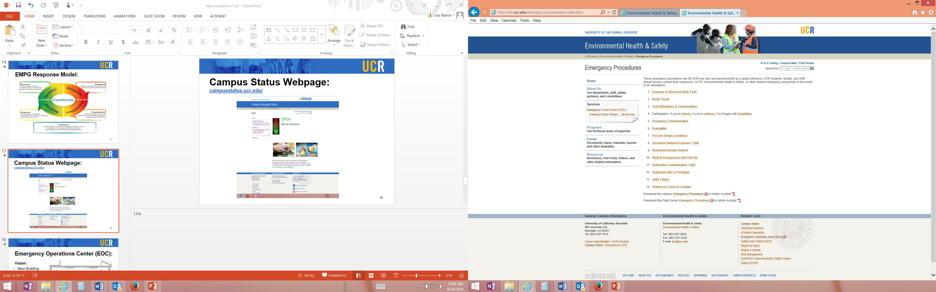

Emergency Procedures: ehs.ucr.edu/emergency/procedures/

Slide 27
http://police.ucr.edu/training/presentation.php

Slide 28
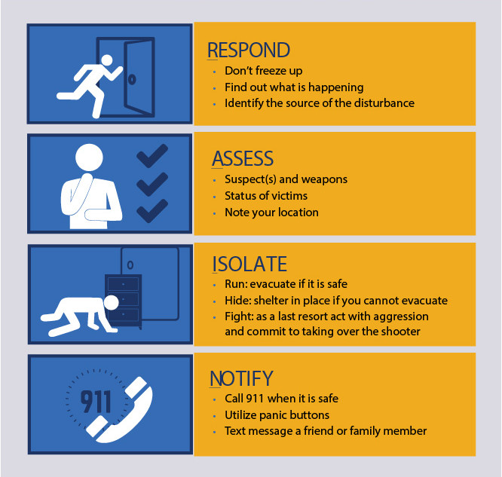
Respond
Assess
Isolate
Notify

Slide 29
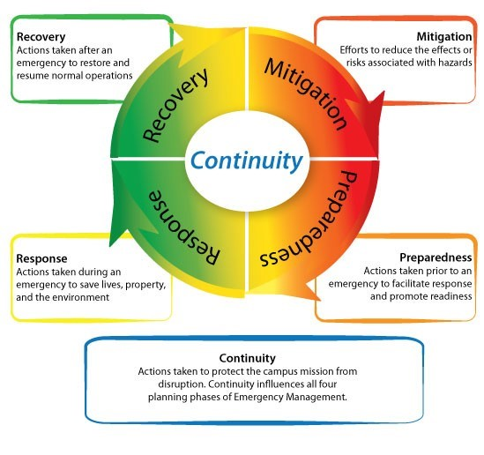
Emergency Management Cycle:

Slide 30
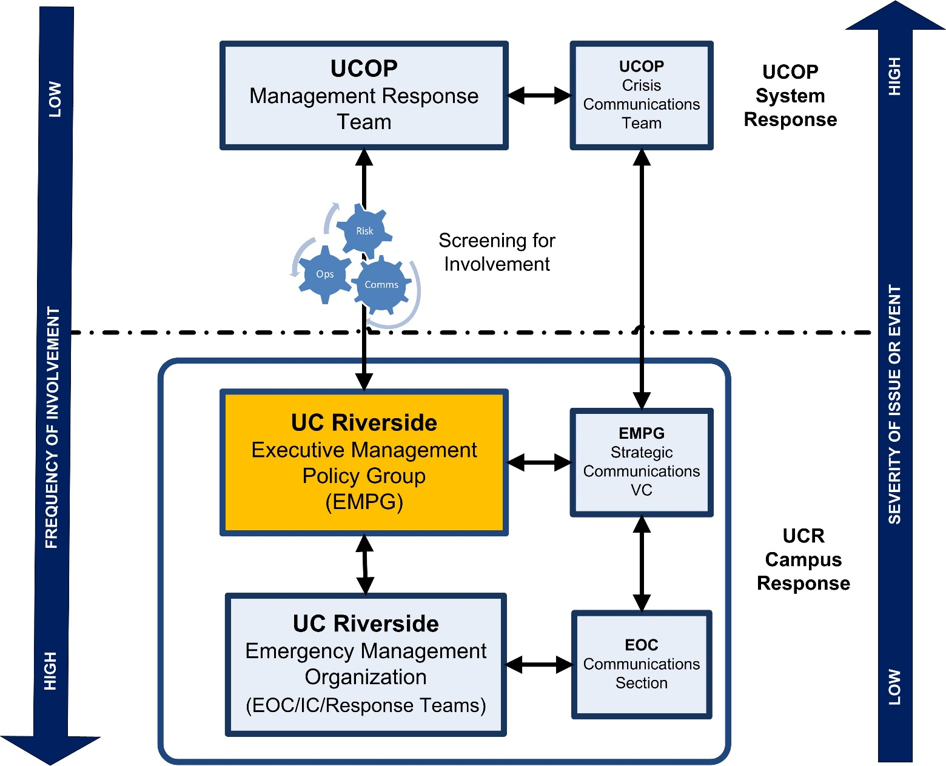
UCR’s Response Model:

Slide 31
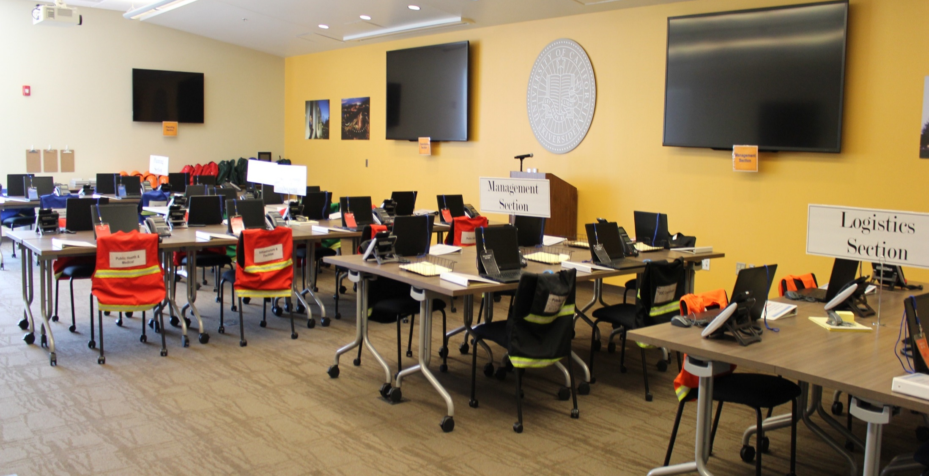
Our Campus EOC
Notes:
New Building
30 Computers / 30 phones
Fully Trained Support Staff
Necessary Support Equipment
Sufficient Space and Resources
Responds to all types of events

Slide 32
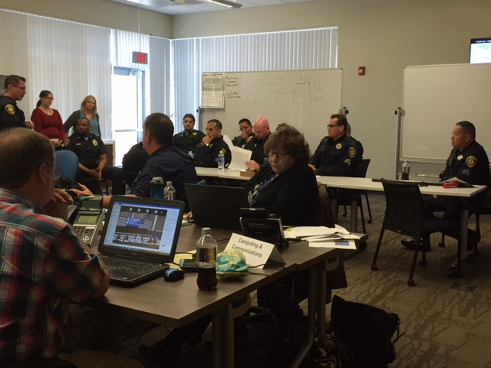
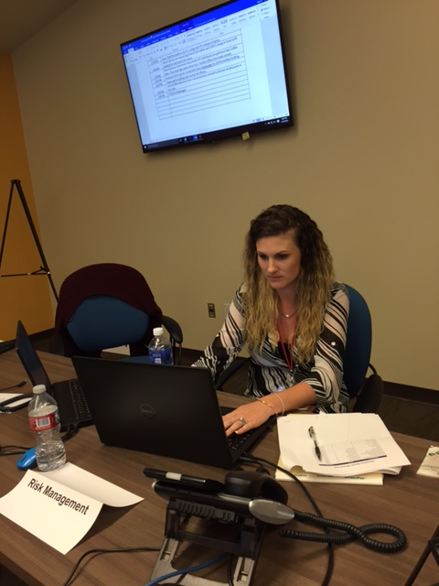
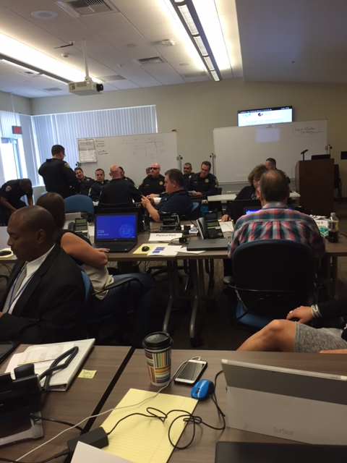
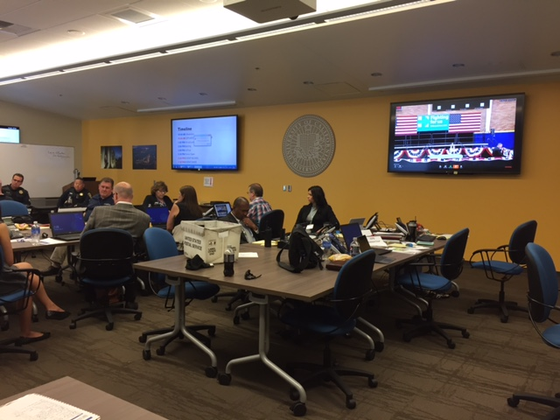
Our
EOC in
Action…

Slide 33
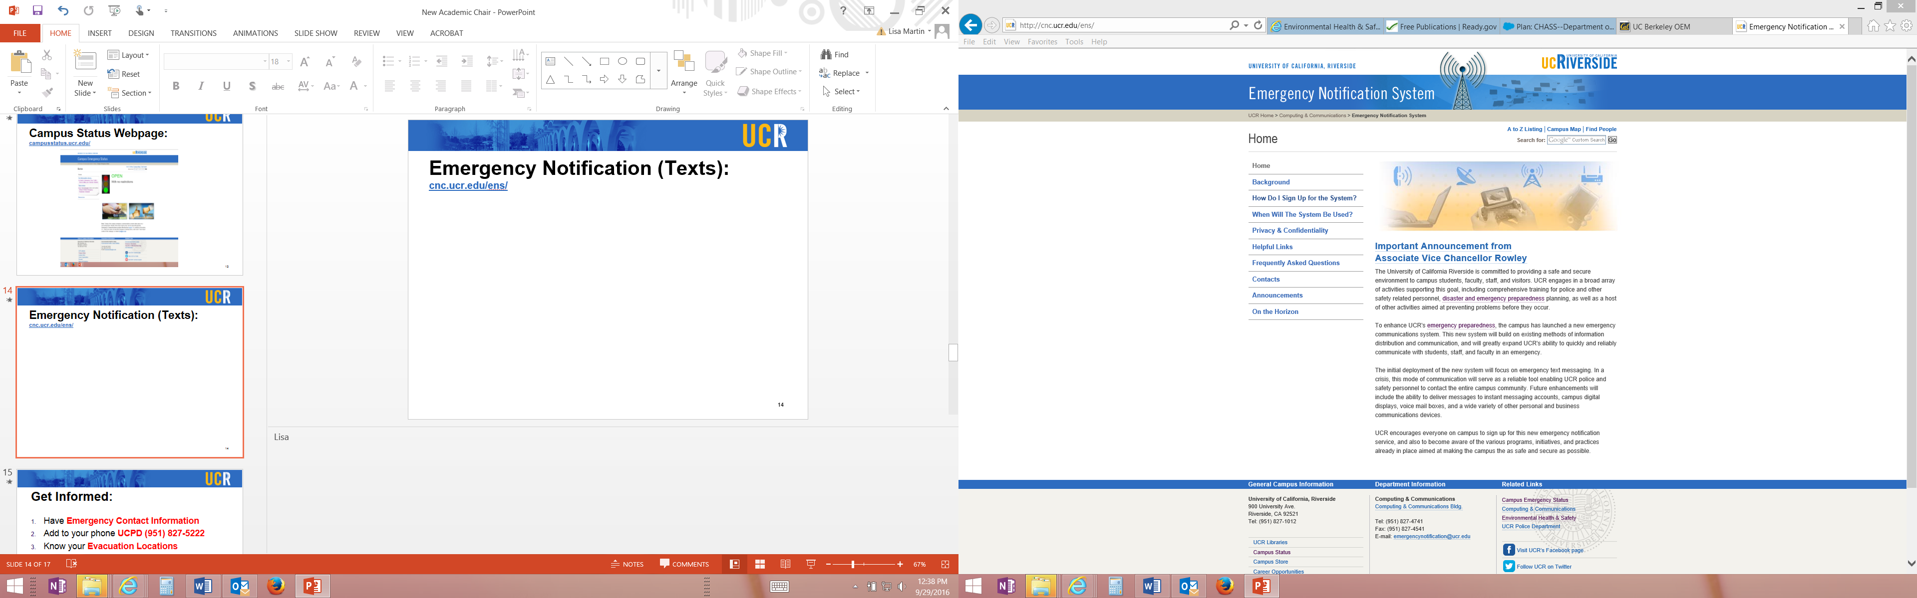

Emergency Notification (Texts): cnc.ucr.edu/ens/

Slide 34
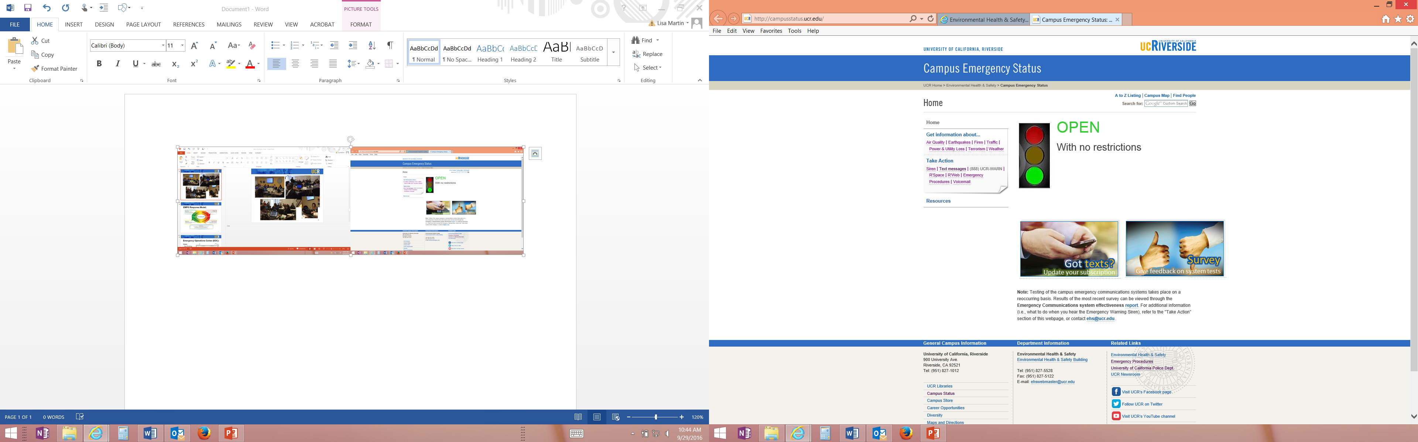


Campus Status: campusstatus.ucr.edu/

Slide 35



Be Prepared:
Have Emergency Contact Information
  Include UCPD (951) 827-5222 & EHS (951) 827-5528
Know your Evacuation Locations
Register for Text Alerts cnc.ucr.edu/ens
Prepare your Vital Records
Make a Work Plan and Home Plan
(For more information: Ready.gov/make-a-plan)
Notes:
Have Emergency Contact Information
department
people in your lab
family
out of area contact
Add to your phone UCPD (951) 827-5222 & EHS (951) 827-5528
To report an incident, injury, chemical spill, a hazard
Know your Evacuation Locations
building
off campus location with your department
for your family – connection site
Register for Text Alerts
For emergency alerts and for test alerts
Prepare your Vital Records
Back up your Work product, lab documents,
home records, personal records
Make a Work Plan and Home Plan

Slide 36
Thank you for your time.
Questions & Comments
Lisa Martin, MAOM,CBCP
Campus Emergency Manager
www.erm.ucr.edu

Slide 37

Chairs 201 sessions – noon-1pm in Hinderaker 0154. Lunch provided with RSVP
Oct 2nd: Good and Bad Department Letters
Nov 2nd: Stalled faculty
Dec 1st: Offer letters/IC Letters
Jan 2nd: Faculty Retention Process
Feb 2nd: Negotiation Skills for Chairs (Rami Zwick)
Mar 2^{nd:} Leaves of all kinds (Sara Umali)
April 2nd: Compliance for Chairs (Elizabeth Boyd)
May 2nd : What was your worst problem this year and how did you solve it? This one 4-6pm

Slide 38
Academic personnel processes
Resources
APM- good for determining correct series to place someone in, as well as expectations for merit and promotion. It is not fair to hire someone into a series that does not mesh with your expectations of them.
The Call – local processes
Hiring Toolkit – step by step for hiring, including all EEAA requirements etc
APO Website – Lots of resources
Consultation academicpersonnel@ucr.edu or vpap@ucr.edu

Slide 39
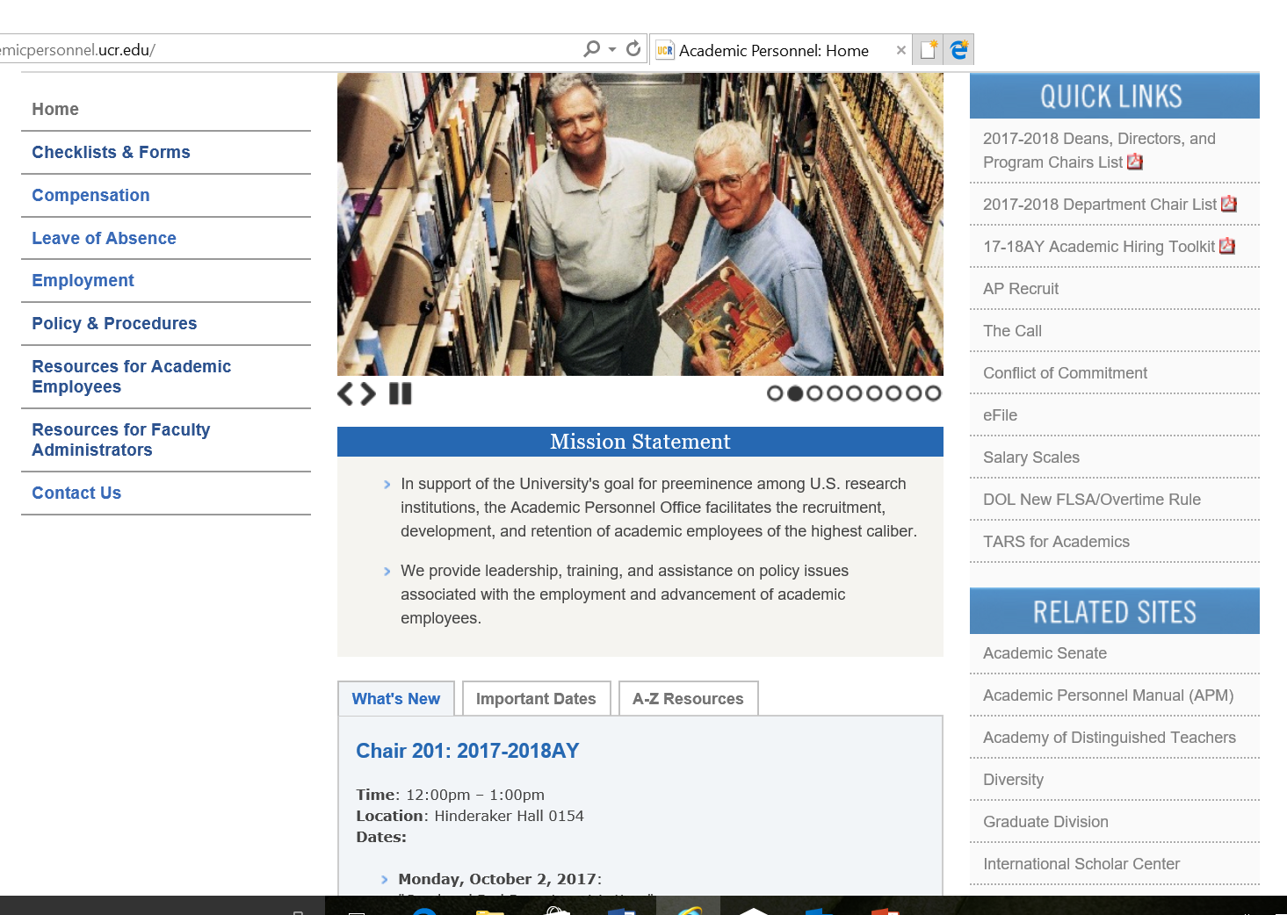
Academic Personnel Website: academicpersonnel.ucr.edu

Slide 40
(%) refers to amount of time dedicated to UCPath
ACADEMIC PERSONNEL OFFICE
Assistant to everyone
Deborah Green
VPAP
Ameae Walker (30%)
Assistant Vice Provost
Katina Napper (50%)
Technology and Data Manager
Antonette Toney (100%) and project specialist Kameron Johnson (100%) currently UCPath backfilled by
Danessa Murdock
Policies, Leaves, APRecruit, new eFile development
Sara Umali (20%)
Project, Admin and Event Coordinator
Jill Sadey (20%)
Analyst for CHASS, SPP, SoBA, GSOE, lecturers, labor relations, librarians Nordene Smith-Hayles
Analyst for CNAS, SOM, BCOE, endowed chairs
Gabriela Zepeda
Temp support Monique Veloz
Student helper Anthony Mai

Slide 41
What happens to an efile?
Candidate initiates (sometimes staff member) and can give chair access as a “data entry assistant”. It is the candidate’s responsibility to ensure accuracy.
Goes to dept or shared services staff for compliance checking and maybe back to candidate and through you again
Faculty Menu
Edit Existing Academic Personnel eFile Manage eFile Data Entry Assistants Process an eFile Academic Personnel Action in Progress (0) Process Candidate's Response to Departmental Letter (0) Request for Deferral

Slide 42
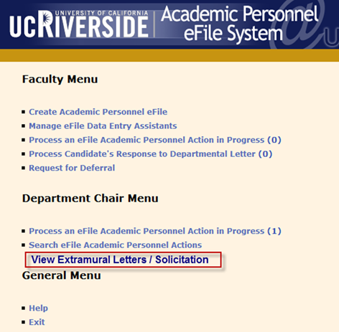
For Chairs re solicitation of extramural letters:
You may, of course, add to (customize) the solicitation letter, as before, that is then uploaded by analyst
Check on the number and source of those received without having to ask staff so it is easier for you to keep track when you have a moment and make sure they are received by the deadline.

Slide 43
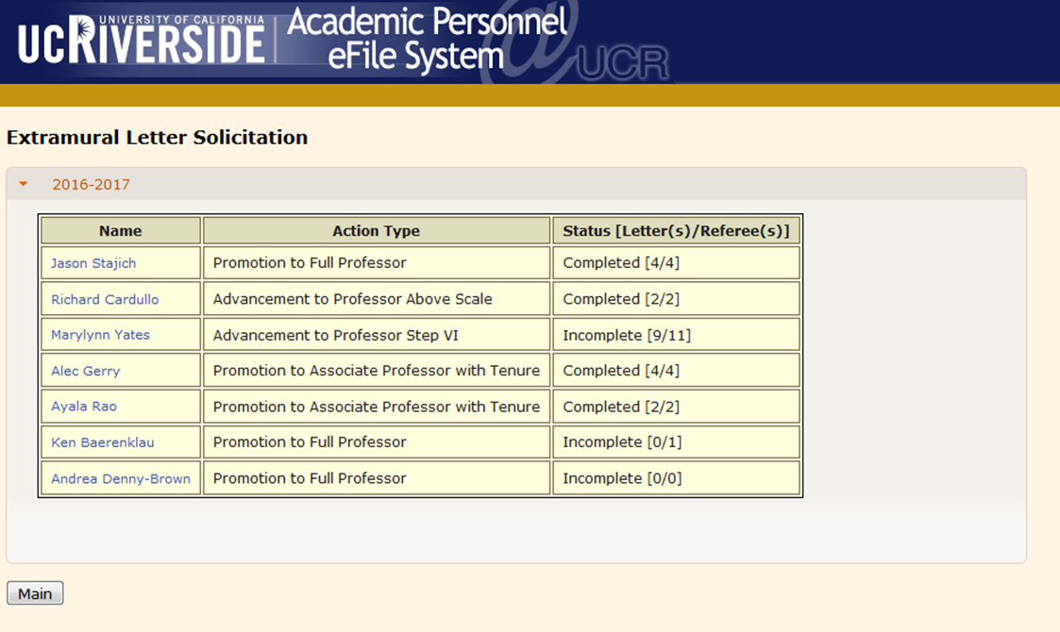

Slide 44
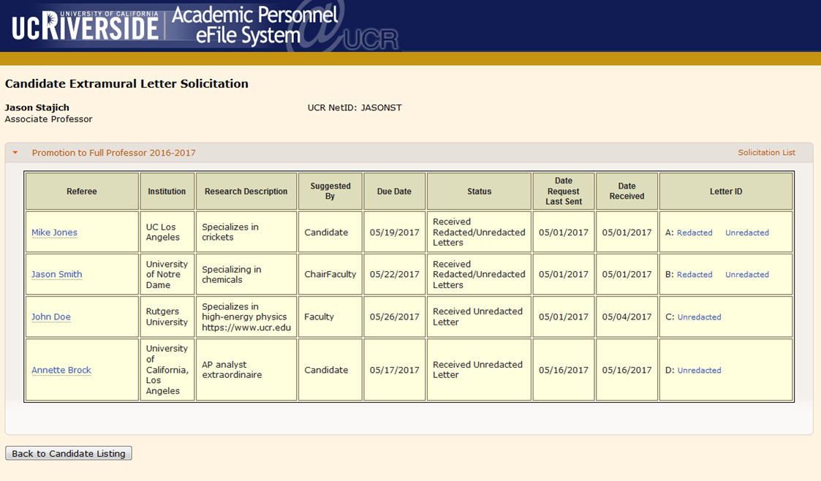

Slide 45
What happens to an efile?
If given access by candidate, chair can help faculty before file finalized and officially routed to chair. Discuss
Chair can approve and route further or send back to candidate with suggestions
File sent to voting/viewing faculty according to bylaw 55 vote (monitored by Senate)
Department letter uploaded and routed to dept or shared services staff who check for accuracy/compliance. May be routed back to dept. Typo corrections do not require a faculty revote
Deans vote/letter uploaded
File routed to APO and crucial aspects checked for accuracy/compliance. May go back to dean or through dean to dept and/or candidate and around again

Slide 46
What happens to an efile?
File is routed to CAP analysts who check again for compliance and accuracy and may send back to APO to send back to dept through dean with memos
CAP reviews file, may also send back to APO etc. CAP analysts upload minute and route back to APO.
APO analyst records vote on advancement summary, re-uploads and routes file to VPAP (I do not see it before this point)
VPAP inbox is in alphabetical and not chronological order and so occasionally a non-appointment, non-promotion file will wait a while just because I don’t know when it came in (can be hundreds in my inbox).

Slide 47
What happens to an efile?
VPAP comments, and vote or recommendation are recorded in system. Final on appointments of asst IV-VI, LPSOEs, 5th year appraisals and quinquennials.
Routed to APO analyst who updates advancement summary
Other files then routed to PEVC. PEVC vote or recommendation recorded in system. Final on all appointments and merits.
Routed to APO analyst who updates advancement summary
Promotion files (including step VI and above scale) then routed to Chancellor

Slide 48
What happens to an efile?
Chancellor votes/comments
Routed back to APO for update of advancement summary
If totally positive outcome, APO analyst prepares weekly announcements so that dept notified through dean (all checked for accuracy by me) to pass on happy news.
If partially or fully negative, APO analyst prepares a template PEVC reasons memo.
If negative on promotion, then the APM220 appeal process is initiated and we go through the whole thing again

Slide 49
What happens to an efile?
If positive on promotion, APO analyst prepares template for Chancellor’s congratulations memo
Candidates and Chair and Dean receive a copy (from APO) of department letter, dean’s letter, CAP minute and, where applicable, redacted outside letters.

Slide 50

Consultations re merits and promotions
If final decision is contrary to dean, I discuss with dean prior to dept notification
If final decision is contrary to CAP, PEVC and I discuss with CAP prior to candidate notification
In person discussion of difficult cases also between VPAP and PEVC and Chancellor
CAP can view final decisions on line

Slide 51
Appointments
PEVC has produced a new form to help keep track of all appointment deals and have on paper who agreed to provide what especially for cluster hires, TOEs, Presidential/Chancellor postdocs, faculty needing expensive equipment and/or space.
APO prepares all appointment letters above Asst III and reconciles with initial complement letter using standard language – all checked by me to make sure reconciliation is accurate and UCR has not committed to a tenured position with lifetime reduced teaching or $400,000 per year for ever etc!
I can’t check salary.

Slide 52
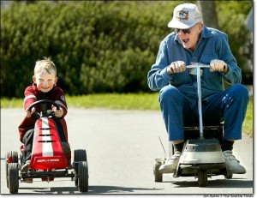
Departmental Meeting
Bylaw 55 and extension of voting rights – pros: increases sense of involvement, reduces appearance of discrimination, increases anonymity and fairness, very best way to learn what is expected of you as a junior faculty member. Work on this during the year.
Participation in discussion without voting.
Advisory voting
What other campuses have done with only a few at senior rank
Notes:
Table 3 output follows this slide

Slide 53

Departmental Meeting
Plan ahead so as many as possible can attend. These MUST BE face-to-face meetings. Attendance is considered part of a faculty member’s duties and therefore “not usually on campus that day” is not an excuse for lack of attendance, whereas being in China giving a talk or in the hospital is. Something in between would make Skyping acceptable
If any absentee voting, it MUST OCCUR before the department meeting. If this is contrary to your department bylaws, then your bylaws need to be changed

Slide 54
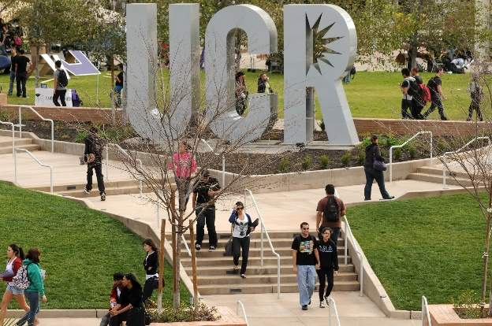
Faculty are supposed to be on campus!
APM 025
“ In order to fulfill those obligations [to the University], faculty members must maintain a significant presence on campus, meet classes, keep office hours, hold examinations as scheduled, be accessible to students and staff, be available to interact with University colleagues, and share service responsibilities throughout every quarter or semester of active service.” Active service includes quarters during which you have no assigned classes.

Slide 55
The Call
Every year there is a request sent to chairs, academic personnel directors and CAP for recommendations to change/update the Call. When you make these, please understand that the Call has to work for all disciplines and that the Call cannot anticipate every eventuality, nor can it repeat all Federal and State laws or repeat all rules and requirements in all subsections.
APO discusses potential changes/clarifications and then passes them to CAP for discussion and after I discuss with CAP and vet written suggestions from CAP, the Call becomes final.

Slide 56

Offscale Salaries
Dean is final on an offscale up to 25% of base salary
Proposed offscales over that require justification and approval by me. Your AP staff have the details.
In your hiring enthusiasm, think carefully about the impact on equity programs. Make sure that you have taken into account the value of tenure (they may be coming from a university where this does not guarantee salary), of the benefits, of cost of living here versus where they are, not to mention sunshine, beaches, mountains and desert and wonderful colleagues!

Slide 57
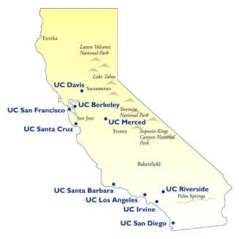
UC Intercampus transfers-APM 510
We are required to inform the other campus of our intent and the package being offered
We can only offer a 1 step increase and not even that if they are currently under review at the home campus (they would come with whatever they receive from that review). Offscale is tricky and, even though unfair, if they are part of the NSTP, we cannot match it through offscale or by giving them extra steps
Earlier date for cutoff where we have to ask permission to recruit (April 1st) for coming academic year
Cap on start-up funds, but more than $1 million
Other restrictions apply.

Slide 58
Joint appointments
Must have an MOU to protect candidate- CHASS/SPP/GSOE have established a standard one. For items to consider see VPAP memo or
https://academicpersonnel.ucr.edu/workshops/chair_201/Chairs%20201.3_Joint%20Appointment%20and%20Joint%20Searches.pdf
If a joint appointment with SOM, there are extra considerations – see above for details, but most important to know is the faculty member will be paid 100% on an HSCP Salary Scale and will have a fiscal year appointment. (4/15/13 memo from systemwide Vice Provost, Susan Carlson)

Slide 59
LPSOE/LSOE https://academicpersonnel.ucr.edu/policies_and_procedures/lecturerssoepsoeguidelines.pdf
An appointee in this series is assigned a heavier instructional load in recognition of the fact that the amount of research or other professional achievement expected is less than for ladder rank faculty. Using the premise that nine courses per academic year plus routine service commitments (i.e. the amount of service performed by a ladder rank faculty member) would constitute full time employment, it is suggested that in order to ensure success in academic progression (i.e. to fulfill all of the criteria listed above) a usual teaching load would be 6 courses per academic year, with the equivalent of 3 courses worth of time (including what would be spent on design, preparation, delivery, grading etc.) devoted to scholarly activity (pedagogical or related to the “X” discipline, the latter often involving undergraduate research participants) and service particular to the position (i.e. over and above an average ladder rank faculty service load). One course is defined as an instructional activity greater than or equal to 3 units. However, the formal teaching load may be reduced or increased by agreement with the Department Chair. A reduction may occur to enable additional instructional service duties (e.g. leading accreditation, curriculum development, special instructional project development, serving as undergraduate advisor for large department etc.) or may increase if duties change or at times of acute need (as happens for all faculty). The discussion between faculty member and Chair should always bear in mind the requirements for progression in the series. An MOU, outlining expectations for a given academic year, should be signed by both the faculty member and Chair each year so that expectations are clear and serve as a guide for CAP’s evaluation.

Slide 60
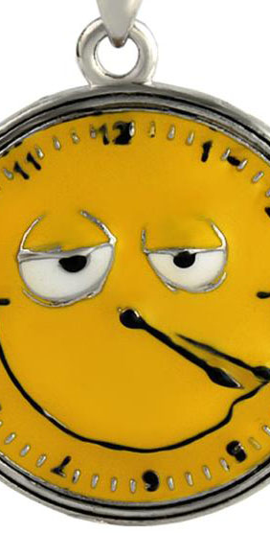
Stop-the-clock
Most frequently used for birth/adoption of a baby (both parents), but also available for other unusual circumstances such as severe illness or substantial interference with research productivity (e.g. equipment could not be used for 2 years).
Each pre-tenure faculty member is entitled to a maximum of two stop-the-clocks- APM-133, but under truly exceptional circumstances and with support of the Chancellor, a petition can be made to OP for a third
Candidate can also request delay of 5th year appraisal on same form

Slide 61
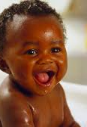
Leaves (our website is really good for all leaves)
For childbirth,
a birth mother is entitled to
a) one quarter full leave where 12 weeks are taken as Family and Medical Leave (FML) and
b) One quarter Active Service Modified Duties (ASMD)
the other parent is entitled to
One quarter ASMD if they declare they are responsible for at least 50% care of the child

Slide 62

Sabbatical
Sabbaticals are a privilege and not a right – APM 740. Discuss
Approval of regular sabbaticals delegated to the dean
For In Residence, sabbaticals the faculty member either has to teach a course or has to petition me to substitute significant service for the teaching or do neither if using the same number of credits as for a sabbatical away.
APM maximum accrual is 30 credits (equiv to a year+ at full salary, although max at any one time is a year) for 9 month faculty, but if there has been administrative service that has delayed being able to take a sabbatical, they can petition to accrue up to 36.

Slide 63
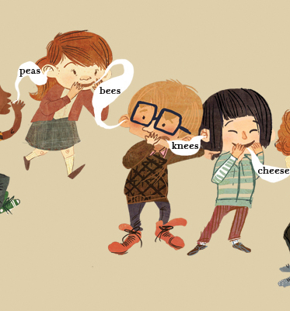
Consultation with APO/me
Most questions best through staff in APO, but if its really complicated, come to me. Sometimes when dept or deans office staff understand 90% of an issue and pose a hypothetical to one of the APO analysts who then really get 80% of information and tries then to ask me and and……you get the picture. We are here to try to help you achieve what you need to in a way that fits within UC/State/Federal regulations. BUT, please send all forms/memos through the staff so we can keep proper records – we are legally required to do so.

Slide 64

Negotiated Salary Trial Program
This Fall, all Senate faculty will be asked to weigh in on extension of this program to UCR. Currently operating at UCI, UCLA and UCSD -and they are stealing our faculty! The program allows a faculty member in good standing to increase their salary up to 30% from non-State funds available to them (e.g. gifts, endowments, grant funds) by negotiation with the chair as long as the funds are stable for that year (must be re-negotiated each year), they do not decrease their classroom teaching load (cannot buy-out of teaching) or quality of instruction, their supervision of graduate students and postdocs, their service duties etc. This is over and above any summer salary and does not count towards retirement benefits. It goes away when funds are not available.

Slide 65
Negotiated Salary Trial Program
How would it be beneficial?
When recruiting from an institution that pays higher salaries or when retaining a faculty member since allowing them to increase their salary from alternate sources does not impact the permanent budget of college (offscales are effectively permanent), making more funds available for other needs. It also does not create large inequities in what UCR pays due to retentions
We lose fewer faculty to other UCs

Slide 66
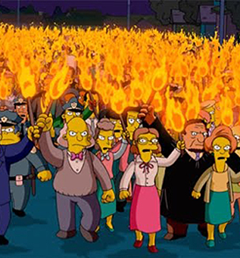
Negotiated Salary Trial Program
What are likely concerns?
Furthering inequities among disciplines. Discuss
Potentially allowing the State/UC to shirk its duty to pay a competitive salary. Discuss
More for chairs and support staff to do, although usually small percentage of faculty participate

Slide 67
Table 4: Department letters
1: Critique the following excerpt from a departmental letter
Professor D’s research is on the electrophysiology of rodent vibrissae. During this review period, Professor D has published 5 technical journal articles in high ranking journals in her field. The faculty consider this excellent productivity.
Lack of specificity about the impact of research on the field.
Lack of context; general impact of scientific endeavor within the field. What was Professor D’s role in the research? Was it done in her lab?
What is the expected productivity in this field, e.g. a paper every year?
VPAP-what is high ranking journal in her field- Top 5% or 50%? What is the field – all those interested only in rodent vibrissae or all electrophysiology or all mammalian biology?

Slide 68
Table 4: Department letters
2: Critique the following excerpt from a departmental letter
Professor E has done an excellent job in all areas of review and so the faculty recommends a merit to Associate professor, step IV O/S with an additional Half step O/S.
This sounds like a concluding sentence. It would be good to give details. If this is not a concluding statement, have a separate sentence for a normal merit, and then a separate recommendation for off-scale. Have separate statements on normal, and the offscales. Indicate a faculty statement about the strength of the vote. The conclusion is too dry.

Slide 69
Table 4: Department letters
Professor F is a full professor, step II in a laboratory science and hence needs grant funding to sustain his research. He has been without grant funding for 3 years and is so frustrated that he refuses to write any more grants. Nevertheless, he has published what most would consider a sufficient number of impactful, high quality papers from his previously-funded work and participated in some interesting collaborative studies. His teaching is excellent and he is an excellent department and campus citizen. What do you say about his lack of grant funding? How do you help?
Absence of money should not be a barrier to advancement. Lack of money is offset by the excellent amount of work in high impact journals. Specifically, while some colleagues may have concerns that lack of success in a peer review grant process indicates poor quality of research, this is off set by the success in publishing in high impact journals where the peer review standards are very high Thus, this publishing in high impact journals should be enough to assuage skeptics. Despite having no money, Prof F has done excellent research. We need to be sensitive to the field and ability to obtain grants in that field. Department should help Prof D to seek help from colleagues (peer critique), grant writers.
VPAP- Office of Research offers a lot of help in this area – contacts at funding agencies, grant-writing, trips to funding agencies etc. Also, some perspective that most have to write several grants to get one.

Slide 70
Table 4: Department letters
Critique the following excerpt from a departmental letter.
Professor G is on 4 department committees, one senate committee and one campus committee. He has reviewed 16 manuscripts for journals, given 2 talks at National meetings and participated in a workshop in Greece. His service is therefore considered excellent
Some of the activities are not service but other activities, Service should indicate extent of commitment. We need context about the impact of these journals that have been reviewed.
VPAP- all of these are service. Don’t list what is already present in the file- talk about quality, hours, importance etc

Slide 71
Table 4: Department letters
How are contributions to diversity included in the letter?
Diversity should be written in research, teaching and service, as research supports. Address positives in the file on diversity.

Slide 72

How do you share the department letter with the candidate?
Best if in person. This is not the job of staff – it is an opportunity for you to interact with and counsel and mentor the faculty member and maybe prepare them for potential eventual bad news. Develop an action plan, if needed. Don’t shirk this responsibility even though sometimes unpleasant.
Providing the letter in person also allows you to obtain the signature on the Procedural Safeguards Statement if the candidate does not wish to write a rebuttal.

Slide 73
Questions about Less Common Actions?
Additional merit offscales and accelerations
Deferrals
Reappointment of Assistant professor
Career reviews
Quinquennials
Above scale

Slide 74
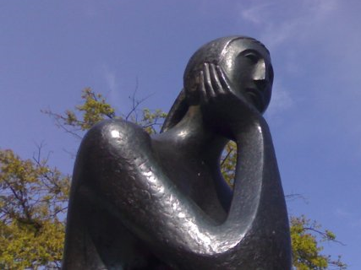
Know yourself
Why did you accept the position? i.e. keep an eye on that goal
What are your weaknesses? Organize compensation for your weaknesses. E.g. Are you a people pleaser? Now, you won’t be able to please everyone nor should you, especially the overly-entitled. Your job is to be fair and provide equitable solutions. Discussion of how to allow yourself time to consider what is fair and equitable.
What are your triggers? The more aware you are, the less you are likely to react

Slide 75
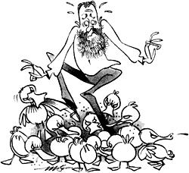
Time Management Tips – or how not to be nibbled to death by administrivia
Create a schedule of activities with due dates for the year so you can plan and work ahead – reduces stress
Schedule your day and only let true emergencies interfere with the schedule. If you don’t, you will work hard and accomplish little! Include time to meet with individual faculty members so that you don’t only interact with them in a faculty meeting or in a situation with some urgency. Include time for new initiatives or even thinking about them
Scheduling includes when to deal with e mails. Turn off the sound and maybe also the pop-ups if you cannot resist looking at them. Don’t give out your cell phone number (except to campus emergency services) and don’t have it ping when an e mail comes in
Keep e mail folders to manage the relative urgencies of them and/or subject matter

Slide 76

Order at Faculty Meetings
You are now an authority figure and it is your duty to keep order and somehow manage to
maintain the focus of discussion
Ensure respectful discussion
Keep to the allotted time frame
Tips
Be very prepared in regard to the items on the agenda
Remember you are running the meeting
Immediately censure any inappropriate comments or behavior. Discuss
Make sure you keep minutes because people hear what they want to hear
If your department is a difficult one to manage, stick closely to Sturgis’ rules of order

Slide 77
Difficult people – we could spend a day on each of these – read the book!
Do you have a bully? Who is the target? Everyone? You? Another faculty member? Graduate student? Undergraduates? Discuss what constitutes bullying
Do you have a very entitled faculty member?
Do you have an incompetent staff or faculty member?
Often, there may be combinations of these and long histories of conflict that have created camps

Slide 78
Exercise from Book

Slide 79

What do you do?
Evaluate the issue from your new perspective and position of authority and remember what you thought you knew may not be correct because the previous chair/dean etc had to keep things confidential.
Do your best to stay calm. Listen carefully and patiently while placing limits on the amount of time spent – giving the feeling that s/he is heard goes a long way towards building trust
Gather facts and not emotions. Explain that your doing so does not mean you disbelieve any person’s version of the facts

Slide 80
Useful Tactics
After listening, ask the person what they expect out of the meeting – sometimes they just want to feel heard
Ask the person to make a presentation at a faculty meeting about the university policies on the issue
Ask them to develop a plan that would be fair to all e.g. how to manage space, how to assign teaching, how to mesh teaching needs, student graduation rates and sabbatical requests etc
If they want special treatment, ask them to put in writing why they should receive special treatment considering the entirety of their jobs-if a faculty member that includes teaching and service as well as research.

Slide 81

Chair’s Responsibilities
Stewardship
Stewardship is an ethic that embodies the responsible planning and management of resources (physical, financial and human) so that you leave the department in good shape for the future.

Slide 82

Chair’s Responsibilities
Morale
The Chair can have a huge influence on general morale. Key issues that contribute to a positive atmosphere
Transparency in everything. If the chair cannot justify why something happened, then likely it should not have happened. Only caveat is required confidentiality.
Equality of treatment
Encouragement of full discussion of issues
Agendas for faculty meetings, minutes that accurately reflect the outcome of discussions, maintenance of a respectful environment during discussion
Trust that the Chair is an advocate for the faculty and department within UCR and in Professional Societies
Give praise and say thank you as often as possible

Slide 83

Chair’s Responsibilities
Academic Plan
The department should maintain a regularly updated academic plan stating the short and long term expectations for growth and development.
In this regard, the chair is responsible for the recruitment of new faculty, overseeing faculty development, and making an effort to retain the current faculty. Cluster-
hiring and shared services add complications to the traditional situation, requiring adaptation and evolution
Staff
Graduate
Faculty
Campus Shared services
Undergraduate

Slide 84

Chair’s Responsibilities
Recruitment
The chair should ensure that the policies and hiring procedures of the university are followed.
The chair should ensure that search committees are not just compliant with affirmative action and equal opportunity policies, but that they actively promote diversity in hiring. It is important in this regard, that search committees (and not staff) compose the advertisement and search plan for APRecruit and that the department faculty endorse these documents after thorough discussion and consideration of how the search criteria will be applied in a uniform manner. Again a little trickier with cluster searches or college searches.

Slide 85

Chair’s Responsibilities
Development of current faculty
In collaboration with the faculty, the chair should set expectations for the department and encourage the faculty to contribute to realization of these expectations.
The chair should be a mentor. S/He may accomplish this by establishment of a mentoring program to provide effective assistance to faculty in their development as scholars and teachers.
Chairs should develop mechanisms to incentivize raising the academic profile of the department.
The chair should follow the professional development of each faculty member and recognize faculty achievements, when appropriate, or provide assistance and corrective measures, if needed.
S/He should mentor the faculty in relation to the UC academic personnel review procedures.
The chair should be proactive in nominating the faculty for fellowships and other honorific titles in professional societies and academies. This is often best facilitated through the establishment of a department faculty awards committee.

Slide 86

Chair’s Responsibilities
Retention
The chair should maintain awareness of the academic market for the expertise within the department and should have the foresight to utilize preemptive actions (be aware of an academic record that deserves an acceleration, or early promotion, or when a career review is called for) to retain the most deserving faculty.
The chair should keep communication channels open so that s/he is aware of any reasons a faculty member may wish to leave.

Slide 87

Chair’s Responsibilities
Administrative Personnel
The responsibilities of the chair cannot be carried out without the assistance of a competent and well-managed staff, whether within the department or in a service center.
The chair should establish guidelines for management of the department staff (if any) in conjunction with the staff supervisor, and work with the shared services center with an eye to always improving service to faculty and students.
The chair should endeavor to help develop the careers of staff members, to recognize excellence, be concerned about morale, and to retain excellent administrative personnel.

Slide 88

Chair’s Responsibilities
Budget Management
Together with the faculty, the chair should ensure that priorities are established for allocation of resources available to the department, and the budget should be transparent.
The chair should supervise resource allocation, be cognizant of budget management principles and understand the different “colors of money” and the constraints on their usage.
The chair should ensure that budget appropriations and expenditures are monitored and implement corrective actions, if needed.
The chair should understand basic auditing rules and practices.

Slide 89
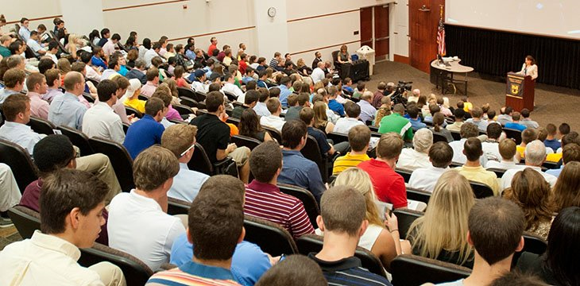
Chair’s Responsibilities
Undergraduate Program
Together with the faculty, the chair is responsible for ensuring maintenance of a sound, updated and relevant curriculum.
The chair is responsible for all teaching assignments of the faculty and the efficient deployment of teaching resources. Discuss
The chair should work with the faculty to create and maintain an academic environment that promotes research opportunities and internships for undergraduates.
The chair is responsible for ensuring that any necessary information to facilitate internal and external reviews and accreditation procedures of the program is provided to reviewing/accreditation bodies.
The chair should facilitate the use of mechanisms to assess learning outcomes, monitor satisfaction levels in the major, and implement corrective measures, if necessary.
The chair is expected to attend commencement whenever possible.

Slide 90

Chair’s Responsibilities
Graduate Program
Together with the faculty, the chair is responsible for ensuring a sound, updated and relevant graduate curriculum is maintained. Commonly, this is done through the establishment of a graduate committee.
The chair is responsible for ensuring that a sound academic advising program for graduate students is maintained.
The chair should ensure that mechanisms for recruiting and retaining the very best graduate students are designed and maintained.
The chair is responsible for ensuring that any necessary information, such as monitoring outcomes, to facilitate internal and external reviews and accreditation procedures is provided to appropriate bodies.

Slide 91

Chair’s Responsibilities
New Initiatives
Chairs are not only caretakers of the status quo, but also leaders looking to further the academic profile of the department and enhance the research, teaching and service mission of the faculty.
The chair should engage in fundraising activities to enable new initiatives, especially those that may seed innovative programs, create synergies within and outside of the department, serve the community, or which otherwise help to fulfill the mission of UCR.

Slide 92

Chair’s Responsibilities
Grant Activity
The primary responsibility for initiating grant proposals within the department rests with the faculty. However, the chair should develop incentives to promote applications, especially for grants that support shared equipment, a core facility, and training grants-i.e. where the PI stands to gain little from the grant in comparison to something like an RO1. The chair must sign off on all extramural grant proposals through the eCAF system.
Some faculty do not seem to know they must submit grants through the university
If you don’t have many grant writers in your department, make sure you set up a system to communicate possible submission opportunities
When funded, make sure grant management support is available (can join forces with another dept or the dean’s office etc)

Slide 93

Chair’s Responsibilities
Facilities and Equipment
The chair should promote a departmental consensus approach to resource allocations. Guidelines, such as when someone receives bridge funds, are very helpful
The chair is the primary representative for the department to establish resource needs with the dean and other levels of the university administration.
The chair should work with the dean to manage space allocations within the department. In order to be effective in this regard, the chair needs to appreciate the scope and direction of the programs of individual faculty.
The chair is responsible for maintaining a safe environment and responding to safety concerns promptly.
The chair is responsible for maintaining a chemical hygiene plan, if applicable.

Slide 94

Chair’s Responsibilities
Safety – not just a lab sciences issue
Department chairs are accountable for establishing, enacting maintaining and enforcing a written injury and illness prevention plan http://www.ehs.ucr.edu/safety/IIPP/iipp.html.
Department Chairs shall
Ensure areas under their management subscribe to and follow the five steps of the UC Riverside Integrated Safety and Environmental Management Program http://www.ehs.ucr.edu/safety/ISEM/isem.html;
Hold periodic meetings, at least quarterly, or use other means of communication to discuss safety related issues;
Establish safety planning procedures, as well as work rules and procedures, for all operations and exposures within their areas of responsibilities;
Ensure that health and safety practices are consistent throughout the Work Unit;
Monitor environmental health and safety performance;
Include compliance with health and safety procedures as part of the annual performance evaluation;
Designate a responsible person (Departmental Safety Coordinator or Lab Safety Officer), within each work unit under their management to partner with EH&S to implement the work unit -specific component of the Injury and illness prevention plan;
Recognize those who consistently perform good safety and healthful work practices;
Discipline and educate faculty/staff/students who knowingly violate safety rules or polices.

Slide 95
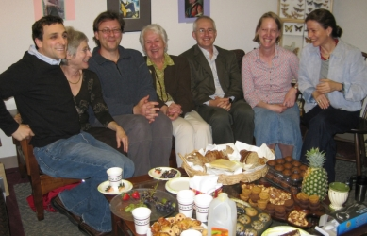
Chair’s Responsibilities
Internal Relations not covered above
The chair should develop procedures and assign faculty responsibility for maintaining and improving the various program components of the department, e.g. instruction, research, and professional activities.
The chair should be responsive to concerns of faculty, staff, and students and know when to take issues to the dean or other administrators.
The chair should encourage faculty to be fully present on campus so that they are available for collaborative interactions and service activities, and to contribute to the general intellectual and social life of the institution.
The chair should create an atmosphere where all faculty feel entitled to use the family-friendly and medical leave programs
The chair is responsible for ensuring reasonable access to sabbatical and research leaves, while also ensuring appropriate coverage of courses so that student progress is not impaired.

Slide 96

Chair’s Responsibilities
External Relations
The chair is the primary spokesperson and advocate for the department in dealing with constituencies external to the university. These interactions may take several forms such as certifications, publicity for departmental programs, public policy issues, public service, alumni relations, and fund raising.
In this regard the chair must be cognizant that in some situations S/He may be considered as a representative of the entire institution. Discuss
In the role of departmental communicator, the chair should develop appropriate presentations, brochures, videos, newsletters etc. and liaise with the college and campus development personnel.

Slide 97
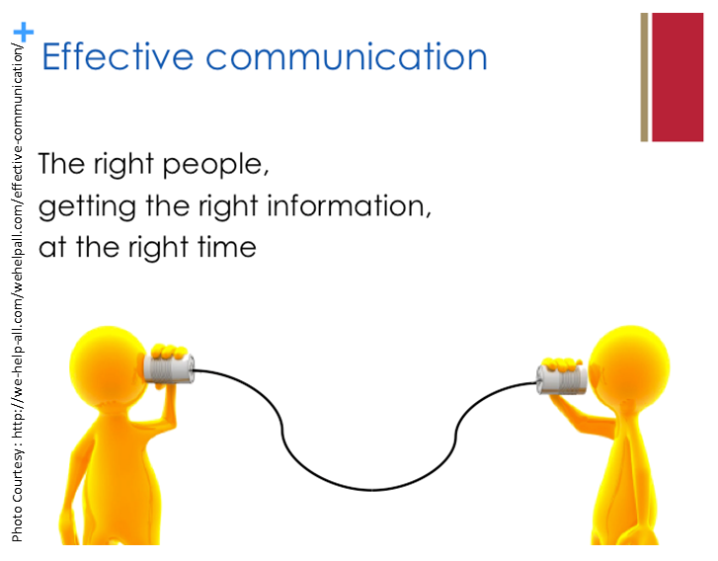
Chair’s Responsibilities
Communication
The chair has the dual role of representing the administration to the department and articulating the department’s achievements and needs to the administration.
In this critical role, they must explain and interpret information so that the intended audience has a full understanding and appreciation of the message. This is often a difficult and time-consuming task.
In addition to this critical role, the chair is responsible for facilitating communication among the various constituencies that relate to department activities, including students, faculty, staff and other individuals throughout the institution

Slide 98

Who you gonna call?
Your Dean
It is important that matters of concern that cannot be readily resolved or which may have legal or other broader consequences be brought to the attention of the Dean. The Dean will consult with higher administration or campus counsel, if required.

Slide 99

Ombuds if
Who you gonna call?
1) You want to confidentially explore your options
2) You want to confidentially acquire information
about a process
3) You want a confidential sounding board on a
challenging matter.
4) There is no formal process for dealing with the
problem.
5) You want to address a problem through an
alternative informal approach

Slide 100

Ombuds if
6) You believe the situation could benefit from an
impartial mediator or facilitator.
7) There is a problem with the formal process.
8) You want to improve departmental climate.
9) You want a sounding board for designing a
process.
10) You would like workshops relating to conflict
management.

Slide 101
The VPAR
Addresses Issues of:
• Inappropriate & improper faculty behavior
• Breakdowns in collegial faculty relations
• Violations of the Faculty Code of Conduct (APM-015)
Through:
• Consulting & Advising
• Mediation & Informal Resolution
• Formal Disciplinary Procedures

Slide 102
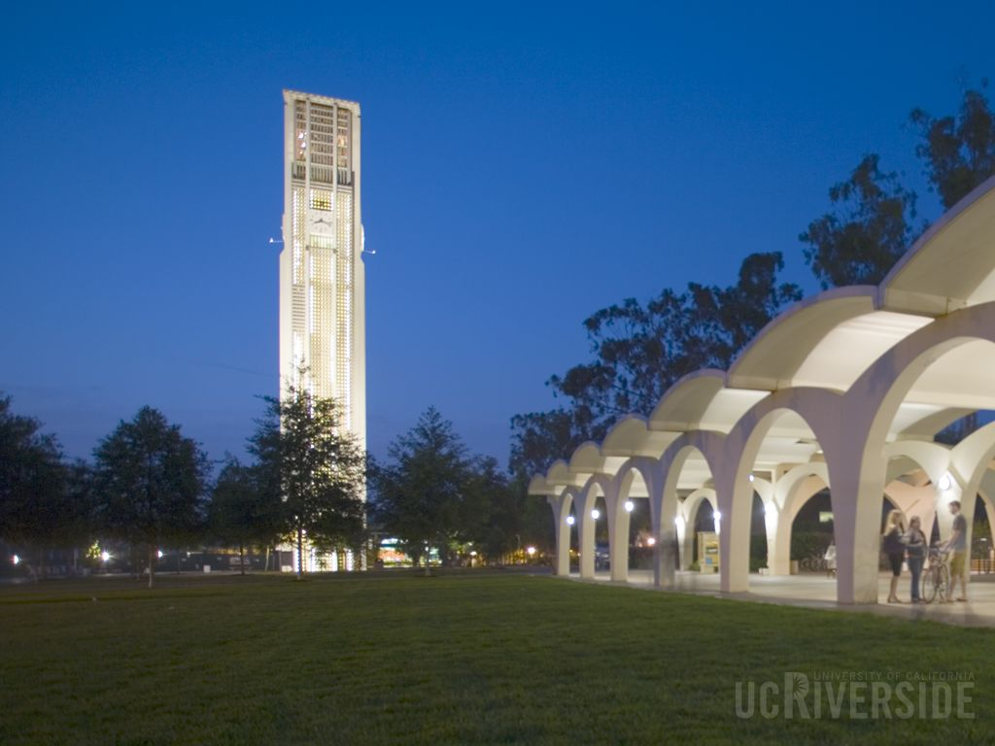
New Chair Orientation: Legal/Policy Issues Facing Department Chairs
Presented at UCR by
David Bergquist, Chief Campus Counsel
October 11, 2017

Slide 103
Role of Campus Counsel
Duty to the Regents (the Institution)
Dual Report to Chancellor and to General Counsel
Clients include Upper Level Administrators of UCR (including Chairs)
Office is a resource funded by the Chancellor to the Schools and Departments within UCR and OP

Slide 104
Do Not Try to Go it Alone
Resources (other than Academic Personnel):
  Locally Designated Official (LDO)
  Student Special Services
  Human Resources and Affirmative Action
  Campus Counsel
  Ombudsperson
  Title IX/CARE Advocate
  Vice Provost of Administrative resolution
  Critical Student Incident Team
  UCR Police

Slide 105
Top Issues for Past 5 Years
Faculty/Staff:
  Hiring/Promotion/Retention/Diversity
  Freedom Of Speech
  Title IX/CANRA
  Disability Accommodation
  Discipline
  Hostile Work Environment
  Discrimination
  Research Misconduct

Slide 106
Top Issues
Students:
  Disability Accommodation
  Free Speech
  Title IX/CANRA
  Understanding when they are acting as a student versus an employee (CBA)
  FERPA/HIPAA
  Hostile Learning/Work Environment
  Posting/Recording IP of Faculty
  Mental Health/Behavior Issues

Slide 107
Top Issues for Discussion
Administrative:
  Public Records Act (PRA) and Information Practices Act (IPA) requests
  Disability Accommodation
  Delegations of Authority
  Stop the Clock
  Whistleblower Claims (LDO)
  Title IX/VAWA

Slide 108

Hiring/Retention/Promotion

Slide 109
Guiding Principles
Equal Access
Diversification of faculty/students/staff
Fair Treatment
Abide by Policies
Consistent Process
Good Faith Efforts

Slide 110
Employment Laws and Policies
Anti-discrimination laws (a subsection of employment law) are designed to protect prospective employees and employees from being treated unfairly based upon a tested characteristic and were enacted to ensure equality in employment.
Supervisors and managers (Chairs) play an integral role in ensuring compliance with employment laws by setting the appropriate tone and fairly and consistently applying:
    Recruiting Practices
    Performance Management (progressive discipline, appraisals and day-to-day supervision)
    Application of Personnel Policies and Practices, including the APM

Slide 111
Federal Employment Laws
Title VII of The Civil Rights Act of 1964 (“Title VII”) – prohibits discrimination in employment based upon race, color, sex, religion, and national origin.
Age Discrimination in Employment of 1963 (“ADEA”) – prohibits discrimination against people age 40 years or older.
Americans with Disabilities Act of 1990 (“ADA”) – prohibits discrimination against qualified individuals with disabilities.
Family Medical Leave Act – in part, prohibits employment actions based upon the taking of protected family medical leave.
Equal Pay Act of 1963 – prohibits wage discrimination based upon gender.
Lily Ledbetter Fair Pay Act – discrimination in violation of Title VII, ADEA and ADA (compensation) will accrue every time an employee receives a paycheck that is discriminatory. Redefined the statute of limitations.
Uniform Services Employment and Reemployment Rights Act (“USERRA”) - prohibits discrimination in employment based upon current or former military service.
Genetic Information Non-Disclosure Act (“GINA”)- prohibits employment decisions based on genetic information (including family medical history).

Slide 112
California Employment Laws
California’s Fair Employment and Housing Act (“FEHA”) prohibits discrimination or harassment on the basis of personal characteristics.
FEHA provides broader protections for employees than the Federal Statutes and most legal actions are brought under state law as opposed to federal laws (Title VII, ADEA, ADA etc).

Slide 113
  University Anti-Discrimination Policies
  A number of University Policies prohibit discrimination in employment based upon personal characteristics.
  Non-Discrimination Policy and Affirmative Action Policy Re Academic and Staff Employment (PPSM 12 and 14; APM-035) – prohibits discrimination on the basis of race, color, sex, sexual orientation, gender identity, physical/mental disability, marital status, Religion, Citizenship, genetic information, physical/medical condition, pregnancy, uniformed services, etc.
  PPSM 14 (Affirmative Action)
  PPSM 20 (Recruitment)
  PPSM 21 (Appointment)
  Principles of Community
  Sexual Harassment & Sexual Violence Policy

Slide 114
Theories of Employment Discrimination
  Disparate Impact – a facially neutral employment practice that has a disproportionate impact on a protected group.
      Largely a statistical analysis and unintentional
  Disparate Treatment – an individual of a protected group is shown to have been singled out and treated less favorably than others similarly situated on the basis of an impermissible criterion.
      Most common type of discrimination claim and is intentional

Slide 115
  Discrimination vs. Harassment
Discrimination - is an adverse employment action based upon a protected characteristic, as opposed to a legitimate work-related reasons. For example:
  Hiring
  Promotion
  Work Assignments
  Pay Determinations
  Failure to accommodate
  Separation
Harassment (a type of discrimination) – is workplace behavior by any person based on a protected characteristic that unreasonably interferes with work performance or creates an intimidating, hostile or offensive work environment.

Slide 116
Discrimination vs. Harassment
Hostile Work Environment
Is a type of discrimination/harassment.
Anti-discrimination/Anti-harassment laws don’t require civil or tasteful behavior. But forbids discriminatory workplace behaviors that are objectively offensive so as to negatively affect the conditions of employment.
The severity of the conduct is judged by a reasonable person considering all the circumstances involved in the situation.
Whether the conduct is severe or pervasive; supervisors should never tolerate conduct or behavior that is unwelcome, offensive and directed at an employee because of any protected status!

Slide 117
The University’s Obligations
The law provides that once an employer knows or should have known of unlawful discriminatory or harassing conduct, the employer must take prompt and effective remedial action.
The remedy used must be reasonably calculated to end the harassment and must offer more than a temporary solution or result. This may require corrective action or discipline.

Slide 118
Harassment
  Workplace Harassment is more than “sexual harassment” but is actually harassment based on all protected characteristics and is prohibited by law.
  All claims of Sexual Harassment or Violence must be promptly reported to the Title IX Compliance Officer or other appropriate official.
  New UC and Campus Policies regarding Bullying and Harassing Behaviors
Notes:
University’s policies are very broad and protect employees, faculty, students, vendors, contractors, and visitors and protects persons who are not the target of the conduct.

Slide 119
Anti-Bullying Policy
New Campus Policy Building on APM and Regents Policy 1111 (Statement of Ethical Values and Standards of Ethical Conduct)
Conduct of an employer or employee in the workplace, with malice, that a reasonable person would find hostile, offensive, and unrelated to an employer’s legitimate business interests.

Slide 120
Anti-Bullying Policy
Abusive conduct may include repeated infliction of verbal abuse, such as the use of derogatory remarks, insults, and epithets, verbal or physical conduct that a reasonable person would find threatening, intimidating, or humiliating, or the gratuitous sabotage or undermining of a person’s work performance. A single act shall not constitute abusive conduct, unless especially severe and egregious.

Slide 121
Anti-bullying Training Requirement
California Government Code Section 12950.1 Effective January 1, 2015
Requires employers with 50 or more employees to include the prevention of "abusive conduct" as a component of training that is already required in the area of sexual harassment.
For purposes of this section, “abusive conduct” means conduct of an employer or employee in the workplace, with malice, that a reasonable person would find hostile, offensive, and unrelated to an employer’s legitimate business interests. Abusive conduct may include repeated infliction of verbal abuse, such as the use of derogatory remarks, insults, and epithets, verbal or physical conduct that a reasonable person would find threatening, intimidating, or humiliating, or the gratuitous sabotage or undermining of a person’s work performance. A single act shall not constitute abusive conduct, unless especially severe and egregious.

Slide 122
Anti-bullying Training Requirement
Already included in UC online and live training sessions.
Does it create a new cause of action for “abusive conduct” in the workplace?
  No. While it may not good business practices, there is no law in California that makes workplace bullying or “abusive conduct” as defined in GC 12950.1 illegal. The policy reason behind not making such conduct illegal is that it would be difficult to determine what conduct is simply discipline, counseling, and day-to-day management actions versus actions taken with “malice” by a manager. Making such conduct actionable under the law would, in effect, make the court system the final decision maker in resolving normal day-to-day workplace disputes, which could stress the already overwhelmed court system.
Could this amendment eventually lead to a law making “abusive conduct” illegal?
  Potentially. Even though there is no legal cause of action for “abusive conduct” as defined in the new law, this type of legislation could be amended to make this conduct illegal in the future.

Slide 123
Chairs are Key Players in Preventing Discrimination and Bullying/Harassment
  Be aware of unacceptable behaviors.
  Be a role model and teach by example.
  Make sure that staff and academic personnel understand the range of behaviors that will not be tolerated.
  Do not allow sexist, bigoted, or sexual remarks.
  Do not participate in sending or forwarding email jokes, cartoons, or articles that could be considered offensive.
  Make it a practice to consistently and promptly address discriminatory or harassing remarks or behaviors.

Slide 124
Duty To Investigate
State and Federal law require an employer to promptly and fairly investigate a charge of discrimination or harassment.
California Law:
  Requires an employer to “take all reasonable steps to prevent discrimination.”
  Some California courts have held that a duty to prevent discrimination includes the duty to investigate allegations of discrimination or harassment.
Duty to investigate simply means that supervisor/managers must have all relevant facts before taking corrective action (fact finding investigation coordinated with appropriate campus office).
The investigation must be “adequate” to objectively determine central facts.

Slide 125
Duty To Investigate
Adequate investigation leads to good decision-making, but also helps as an affirmative defense if a lawsuit is eventually filed. It will show that the University acted in good faith when it learned of the situation.
Chairs are “first responders” in discrimination and harassment complaints. They must learn enough about the facts to determine whether a more extensive investigation is needed. If so, immediately contact HR and/or Title IX Compliance Officer for assistance.
The manager or supervisor should contact Campus Counsel (Faculty) or HR (Staff) for guidance prior to conducting any investigation.

Slide 126
Hypothetical 1
Chair receives email from faculty or staff member asserting unfair treatment, offensive conduct/communication, or violation of law/policy and retaliation.
Example: “Dr. B raised an issue in our discussion about Candidate X; after I informed him I was offended, he devalued my contribution to department discussions and I believe he voted against my promotion. I have audiotape I surreptitiously recorded which backs up my claims.”

Slide 127
Employment Best Practices
What Do You Do If You Learn That Discriminatory or Harassing Behavior May Be Happening in Your Unit or Department?
Meet with the complaining employee immediately to understand the allegations.
If the employee alleges sexual harassment or sexual violence, relay the complaint immediately to the Title IX Compliance Office
If the employee alleges other discriminatory or harassing behavior, contact HR or Campus Counsel.
Once action is taken, follow up, depending on the severity of the action, to see if the behavior has stopped. Document the follow-up conversations.
Don ‘t consider the complaint as “minor” or “insignificant” until you know the facts.
  Complaints of discrimination or harassment must be investigated to the extent reasonably possible, even when the victim is reluctant or declines to cooperate.
  Complaints of discrimination or harassment must be looked into even if you believe the immediate problem is resolved!
DON’T HESITATE TO GET HELP CAMPUS RESOURCES !

Slide 128

Employment Best Practices
Disability Management

Slide 129
DM Best Practices
Disability Management
Disability Discrimination is the most frequent alleged discrimination claim at the UC.
Every Campus has Resident Experts on Disability Management
Marsha Marion, Disability Management Coordinator and Manager, Workplace Health & Wellness
Laura Riley, Student Special Services
Call them early and often.
It can be complicated. Expect to be unsure what to do and get help!
The Interactive Process is the Key!

Slide 130
Employment Best Practices
Disability Defined:
A person is considered disabled in California if he/she:
  Has a physical or mental impairment that limits one or more of the major life activities;
  Has a record of such an impairment;
  Is regarded as having such an impairment (perceived);
  Is regarded or treated by the employer as having some condition that has no present disabling effect, but may become a physical disability; or
  Has any health impairment that requires special education or related services.

Slide 131
Employment Best Practices
Disability puts employees in a protected category along with sexual orientation, race, religion, etc. There is a similar protection for pregnant employees.
Job accommodations for disabled employees are mandated by:
  Federal Law: Americans With Disabilities Act (ADA)
  State Law: Fair Employment & Housing Act (FEHA)
  UC Policy: PPSM 81 & APM 711- Reasonable Accommodation and Collective Bargaining Agreement

Slide 132
Employment Best Practices
What is the Interactive Process (IP)?
It is the “heart” of the Accommodation process.
Ongoing dialogue between the employer/employee department/student regarding how the person is limited in his ability to perform the essential functions of his position or access to an education and what, if any, reasonable accommodations could enable him to perform those essential functions.
If no reasonable accommodations could enable her to perform the essential functions of the current position, the IP then includes an exploration of whether there are alternative positions that are open for which the employee is qualified.

Slide 133
Employment Best Practices
The Interactive process (IP)
Three Basic Steps to the IP:
  Step 1: Identify the essential functions of the job
  Step 2: Determine the employee’s limitations
  Step 3: Explore whether employee’s limitations can be reasonably accommodated.
  DO NOT ASK ABOUT DIAGNOSIS OR FOR HEALTH PROFESSIONAL LETTER

Slide 134
Hypothetical 2
After midterm, student identifies to her professor that she had a health issue that impacted her grade. Faculty member asks her diagnosis and indicates he may be willing to change her grade if she provides a letter from her doctor. She refuses and ends up failing the course. She confides to you as the Chair that she is only 17, and that she was sexually assaulted by her R.A., which caused her to fail her course.

Slide 135
Whistleblower Claims
Examples of Protected Disclosures
An employee filed a whistleblower claim accusing the Department Head of misusing Medicare Funds.
Employee filed a grievance or claim that he or she was denied overtime pay.
Employee used one or all of the complaint processes provided by federal or state law or University policy.
An employee exercised a right guaranteed by Federal law, State law, University Policy or Labor Agreement.
An employee complained about discrimination or the discriminatory treatment of others.

Slide 136
Whistleblowers
What is Retaliation?
Retaliation occurs when a supervisor or employer engages in an activity which, has an adverse action, as it discourages an employee from exercising a right protected by law.
Important Note: A claim of retaliation might be sustained even if the employee’s underlying report is unsubstantiated.

Slide 137
Whistleblower Best Practices
Elements of a Retaliation Claim
Employee made a protected disclosure or engaged in a protected act;
Employer took adverse action against employee; and
Causal connection – Employer took adverse action b/c Employee engaged in a legally protected activity.

Slide 138
Whistleblower Best Practices
Examples of Adverse Actions
Demotion/Discipline (including a counseling memo)
Layoff/Termination
Transfer
Mediocre Performance Review/ Merit Review
Failure to Promote
Change in a complainant’s work assignments
Avoidance of the complainant
Sarcasm toward the complainant
Declining to invite the complainant to an office party, lunch or business meeting
A series of smaller actions that subtly change the terms and conditions of an employee’s job over time.

Slide 139
Whistleblower Best Practices
The Causal Connection – “Because of”
The claimant must provide some evidence that there is a connection between the protected disclosure or act and the adverse action.
If the claimant provides enough information to establish a connection, the University must show the non-retaliatory reasons for the action.
Key point: Any adverse action taken against any employee should be motivated by only legitimate, documented business reasons.

Slide 140

Employment Best Practices
Complaint Processes

Slide 141
Employment Best Practices
Complaint Processes
Any University Employee has the right to redress workplace grievances in one or more of the following ways:
  UC Informal Complaint Resolution Processes
  UC Formal Complaint Resolution Processes
  External Complaint Processes
Formal Complaint Processes – University employees can lodge complaints re: violations of University Personnel Policies or Labor Agreements through a variety of mechanisms
  Academic Personnel
  Labor Agreements
  PPSM
  Whistleblower and Whistleblower Retaliation

Slide 142
Employment Best Practices
External Complaint Processes
The U.S. Equal Employment Opportunity Commission (EEOC).
The U.S. Department of Labor (DOL).
California Department of Fair Employment and Housing (DFEH)
Office of Federal Contract Compliance Program (OFCCP).

Slide 143
Internal Grievance & Complaint Resources
(Academic Personnel)
UC Systemwide Senate Bylaws 334-337
Non-Senate Academic Appointees APM 140
Whistleblower Policy and Whistleblower Protection Policy
UCR Academic Senate Bylaws
Collective Bargaining Agreements
The Office of Faculty and Staff Affirmative Action, Office of the Ombuds, Title IX/Sexual Harassment, Auditing and Accounting, and the Vice Provost of Administrative Resolution.
UCR Campus Policy Number 650-17
Notes:
Created by Amy Lee (slides 58 & 59)

Slide 144
Executive Order 11246
Prohibits federal contractors and subcontractors who have contracts of $10,000 in one year from discriminating in employment decisions on the basis of race, color, religion, sex, sexual orientation, gender identity or national origin, disability and veteran status.
Requires federal contractors to take affirmative steps to ensure that equal opportunity is provided in all aspects of their employment.
Must develop a written Affirmative Action Plan (AAP).
Department of Labor’s Office of Federal Contractor Compliance Programs (OFCCP) is tasked with enforcement.

Slide 145
Executive Orders 11246 & 13672*:
Expanding Non-Discrimination Enforcement
Protects Employees From Discrimination on the Basis of:
Race
Color
Religion
Sex
Sexual Orientation *
Gender Identity *
National Origin
Disability
Protected Veteran Status

Slide 146
New OFCCP Requirements
New OFCCP requirements require that candidates be given an opportunity to disclose whether they are disabled or a veteran at the time of the application.

Slide 147
Public Records Act (PRA) and Information Practices Act (IPA) Requests
Contact Kristen Erving
Don’t perform UC work on personal email
Relates only to documents
Series of exceptions

Slide 148
No good deed goes unpunished
  The doctor’s note also states that Liza should be excused from her duties as a driver. Although Liza’s position requires that she drive 3 times a week to an off-site lab, you reluctantly agree.
  You have tried this for 6 months. Liza’s schedule and her inability to drive are disrupting the work of the department, and she is routinely coming in at 10:30 now. You want to discipline her and call HR.
  What are the problems you see here?

Slide 149
Can you ask/discuss….
Will you need an accommodation if you’re hired?
  What if the applicant has an obvious disability?
Have you had any on-the-job injuries in the past?
Do you speak a foreign language (not pedagogically based?
Are you available to work overtime, if necessary?
What year did you graduate from college?
Where were you born?
Will your spouse be looking for a position?
Are you a US citizen?

Slide 150
Is there TMI in the Personnel File?
Which types of documents should go into a “medical file” rather than the employee’s personnel file?
    All documents related to Family and Medical Leave
    All documents related to disability accommodation, including requests for accommodation and documentation provided to substantiate disability or provide the employee’s limitations
    Doctor’s notes provided to excuse employee’s absences unrelated to FML or disability

Slide 151
No good deed goes unpunished
Scenario:
  About 3 years ago, Liza Round told you that she was having problems arriving by 8. She asked for an 8:30 start time, and you agreed.
  Six months come and go, and Liza starts coming in later and later. When you talk to her, she vaguely references a medical condition and asks to come in at 9. You once again agree.
  When Liza continues to be late, you let her know that she is not keeping her end of the bargain. Liza brings a note from her doctor that says “I recommend that Liza’s workday start at 10.”

Slide 152

Other Employment Issues

Slide 153
Between a rock and a hard place
Scenario:
  Bjorn Lyer, one of your direct reports, filed a complaint with the LDO alleging that you had done something he believed was an improper governmental activity (IGA). An investigation was done under the Whistleblower Policy, which resulted in a finding that (a) you had not done what was alleged and (b) even if you had, it would not have been an IGA.
  You feel relieved and vindicated – but also annoyed that a complaint was ever filed.

Slide 154
Between a rock and a hard place
  Bjorn was never a model employee, although you routinely rated him “Meets Expectations” on his performance evaluations and hoped he would improve.
  Since filing the complaint, Bjorn’s performance has completely gone downhill. Dozens of his projects are overdue, the ones he has turned in are filled with errors, and he is never at the office. Just when you’re about to put him on a Performance Improvement Plan, you happen to overhear him crowing to a coworker that he’s been totally blowing off work but knows he is “untouchable” because he blew the whistle on you.
  What can you do?

Slide 155

Questions?

Slide 156

Got a problem? Who you gonna call?
Experienced Former chairs-
We have provided a list of
those willing to act as mentors
Fellow Current Chairs whom you will get to know through the Chairs 201 lunch time sessions (12-1pm, lunch provided if you RSVP)
October 2nd Good and Bad Department Letters
November 2nd Stalled Faculty
December 1st Offer/IC Letters
January 2nd Faculty Retention Process
February 2nd Negotiation Skills for Chairs (Rami Zwick)
March 2nd Leaves of all Kinds (Sara Umali)
April 2nd Compliance for Chairs (Elizabeth Boyd)
May 2nd What was your worst problem This Year (this one with Hors D’Oeuvres and Wine) so from 4-6pm
Mark your calendars!

Slide 157


Take Care of Yourself!

