Slide 1
Junior Faculty Workshop
Success at UCR and elsewhere
Friday October 26th,2018
1-4pm

Slide 2
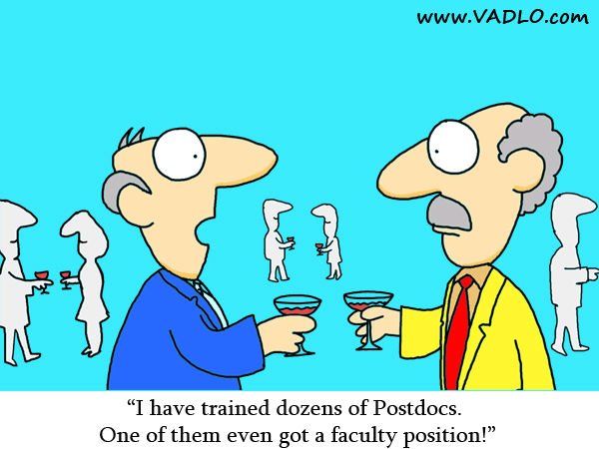
Who is in attendance?
Postdocs
Assistant Project Scientists
Research Assistant Professors
Tenure-track Assistant Professors
Assistant Professors of Teaching
Assistant Professors in Residence
There is the potential for me to confuse you by giving information pertinent to different groups, so please interrupt if I am unclear.

Slide 3
For immediate applicability:
Postdoc – few, but will give you ideas about what is expected of you and what questions to ask at interviews R
Assistant Project scientist R+S
Assistant Research Professor R+S
Assistant Professor in Residence R+T+S
Assistant Professor TT R+T+S
Assistant Professor of Teaching T+R+S

Slide 4
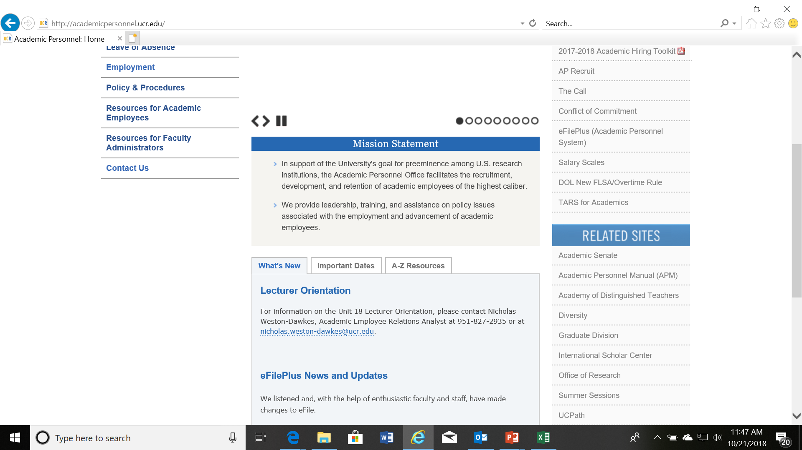
The UC Academic Personnel Manual
http://Academicpersonnel.ucr.edu/

Slide 5
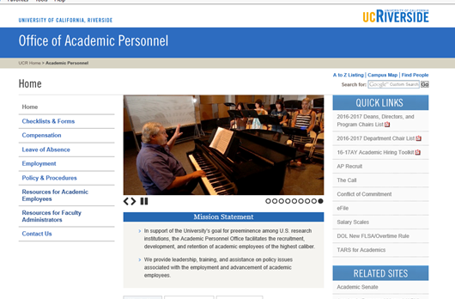

The CALL
APM 220-8-C: “Each campus shall develop guidelines and checklists to instruct chairs about their duties and responsibilities in connection with personnel reviews.”
This administrative document describes the review process implementation at UCR.
This is a UC-Riverside document maintained by the Academic Personnel Office and found on the APO website.
Link:
http://academicpersonnel.ucr.edu/academicreviews/FacCall/index.php

Slide 6


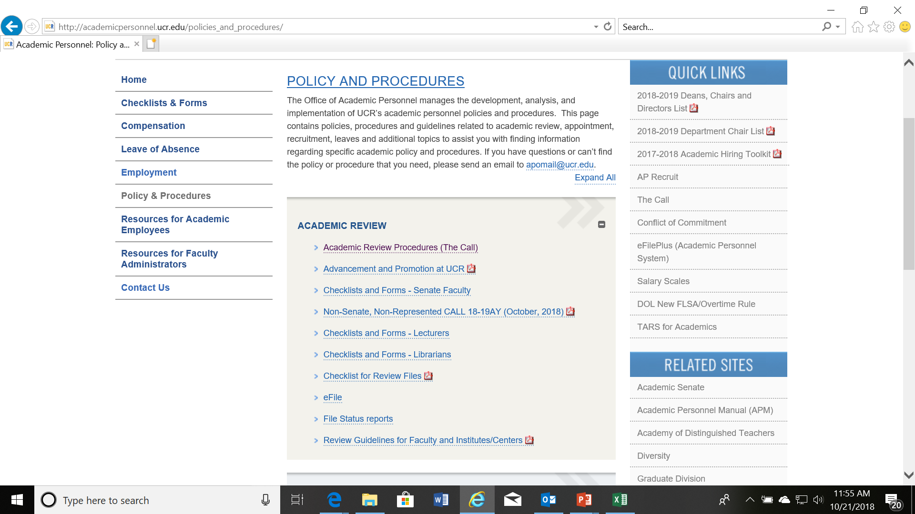
Non-Senate, non-represented Call
http://Academicpersonnel.ucr.edu/

Slide 7

For Union Represented
Refer to the UC APM and Union Contract posted here http://graduate.ucr.edu/pdgeneral.html

Slide 8

Structure of the workshop
A reminder of UC stages in review
Joint appointments (if applicable)
Accelerations
Impact of prior appointments on tenure at UCR (if applicable)
Who doesn’t make tenure/SOE?
Table Discussion of self-statements –help with eFilePlus, if needed
VPAP-led discussion of self-statements
Some general guidelines about the self statement
Table Discussion of questions asked/posed
VPAP-led discussion of posed questions
Time management and work/life balance
Discussion of other FAQs

Slide 9


Stages in a Normal UCR Review-all cumulative
=Differs by department
Candidate assembles efile, including a self statement discussing accomplishments
Departmental colleagues review the file and write a departmental evaluation and recommendation.
Their opinion may have been influenced by extramural letters of evaluation if the candidate is up for promotion
The Chair may add a separate letter, but routinely does not

Slide 10


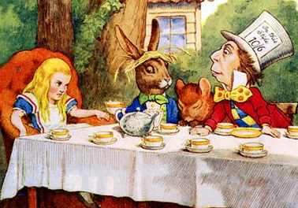
Stages in a Normal Review-all cumulative
The file is evaluated by the Dean, often in consultation with Associate Deans. All actions require a vote and some actions require a letter with reasons.
The file is evaluated by the Senate Committee on Academic Personnel (CAP). This is a body of 10 faculty representing diverse disciplines. Each member will review your file and vote on a recommendation to accompany a minute describing the reasons for their recommendation

Slide 11
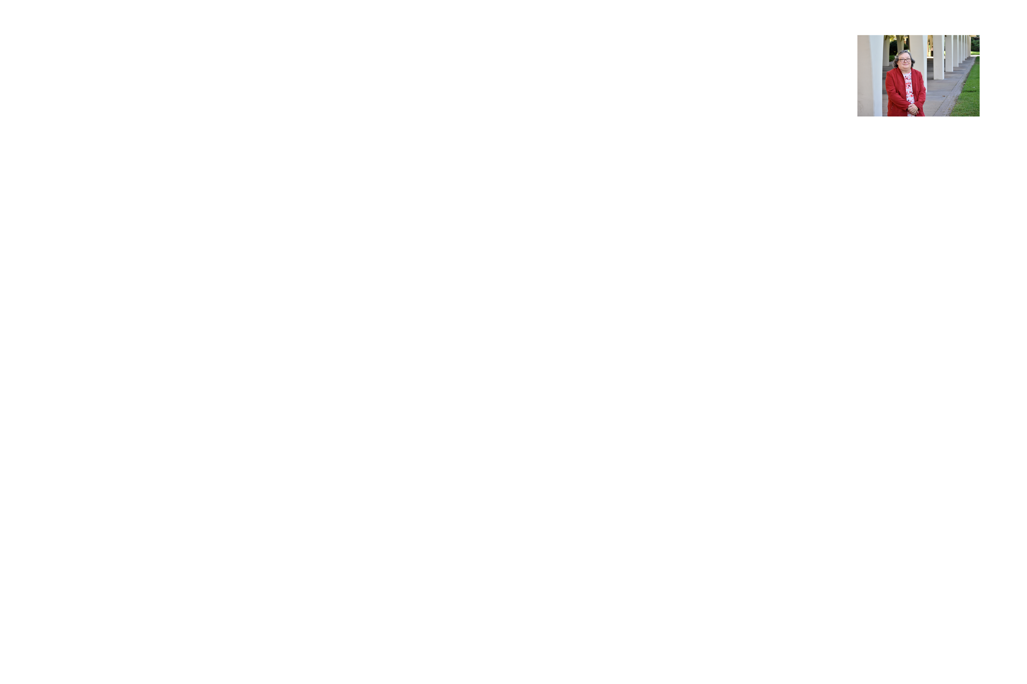

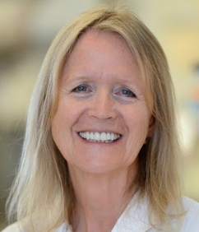
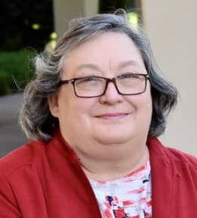
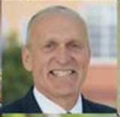
Stages in a Normal Review-all cumulative
The Vice Provost for Academic Personnel (VPAP) reviews the file and makes a recommendation to the Provost (PEVC)
The PEVC reviews the file. If a merit file, then the PEVC’s decision is final. If a promotion, the PEVC makes a recommendation to the Chancellor
Chancellor is final on promotion
There is no quota. If you earn tenure, then you are granted tenure

Slide 12
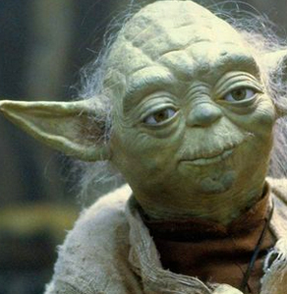
An extra action for Assistant Professors
At the beginning of your 5th year as an Assistant professor, you will put together a file that will not result in either a merit or a promotion and is entirely to advise you on your progress towards tenure “the 5th year appraisal”. The outcomes could be:-
positive – looks as though you are making good progress towards a positive tenure decision,
qualified positive – some areas good, but some deficient and in need of improvement, or
Negative – not on track – can still make tenure

Slide 13

Joint Appointments- from the CALL
For purposes of the personnel review of joint appointees, one of the departments will be considered as the home department. Ordinarily this will be the department with the larger percentage of FTE. For joint appointments in which the FTE split is 50-50, the candidate’s home department will be designated in the appointment letter.
The Chair of the home department has the responsibility of holding a joint meeting with the candidate and other Chair before either department considers the file. The purpose of this meeting is to review personnel procedures, to assemble information for the file and, where appropriate, to allow the candidate to suggest names of persons to be solicited for extramural letters. Names for extramural referees may be suggested to either or both Chairs who then will solicit additional names of referees from their departments so as to ensure the balanced assessment specified in Section III. M. Both Chairs should be aware of all letters being sought.

Slide 14

Joint Appointments- from the CALL
Each department will independently evaluate the candidate and make a recommendation, emphasizing where appropriate those portions of the candidate's responsibilities that are specific to each department. Where possible, department chairs should reconcile the proposed rank and step before writing the departmental letter. The Chair of each department will prepare a departmental letter to be sent to the Dean (and, if another college or school is involved, to the other Dean as well). When both departments are ready to forward their respective recommendations, there shall be a meeting of both Chairs and the candidate, during which each Chair will give the candidate an oral summary of his/her departmental recommendation. If there is a positive majority a separate meeting is fine; otherwise a joint meeting is required. Any written form of the departmental recommendation will also be given to the other Department Chair and to the candidate, on request.

Slide 15

Joint/Split appointments Instructions given to Chairs and Deans
The offer letter/letter of intent/initial complement letter to a candidate must clearly lay out expectations of the faculty member in terms of the 3 areas of evaluation. Also, there should be phraseology allowing future redistribution (by negotiation among candidate and unit heads) to allow for changing needs etc.
teaching in each department/organizational unit (e.g. percentages of courses/course load). As with all initial complement letters, this should be written such as to indicate what a normal load will be if there is some initial course relief.
service in each department/organizational unit (e.g. is attendance at faculty meetings in each department expected etc) and
research (e.g. attendance at seminar series, annual retreats, expectations of research disciplinary emphasis etc) in each department/organizational unit.

Slide 16

These descriptions should be phrased appropriately to allow for whatever initial period with reduced expectations is allotted to a new hire. It is crucial that the candidate be fully aware of all expectations so that they can live up to those expectations and move through the merit and promotion system as expected.
4) a description of how the personnel file will be handled (e.g. which department will be primary- as per appointment and how input will be gathered from the other departments/organizational units)
A copy of this letter must be on file in the department, college, and the academic personnel office. The appointment letter may be substituted if equally detailed.

Slide 17

Normative time until
Associate level =
6 years - maximum of 7 years with
no stop-the-clocks
But if you do well in all three areas of evaluation, you can accelerate up those steps.
gain tenure/security of employment with promotion to Associate level

Slide 18

Stop the clock for Academic Appointees with a seven year limit on service at the Assistant level
For childbearing/childrearing (if your contribution is 50% or more). Can have only up to 2 years (regardless of how many children or what combination of children and other reasons).
For serious health problems that interfere with your ability to do your job
For bereavement
For other major life or career crises.
A request to stop the clock should be made as soon as the need becomes apparent and should be accompanied by appropriate documentation
APM -133-17g-I http://ucop.edu/academic-personnel-programs/_files/apm/apm-133.pdf

Slide 19

Accelerations
Normal review every 2 years
1 year acceleration if you have accomplished research-wise what would be normal+ for 2 years and other areas are fine in quantity and quality for a 1 year period.
Whole step acceleration requires excellence in all 3 areas of review and research accomplishments equivalent+ to 4 years.

Slide 20
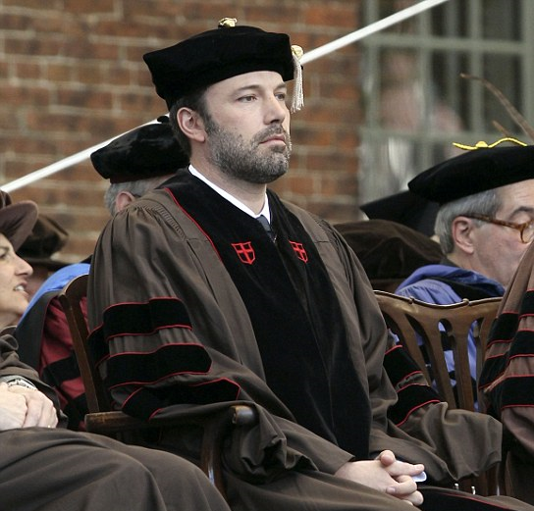
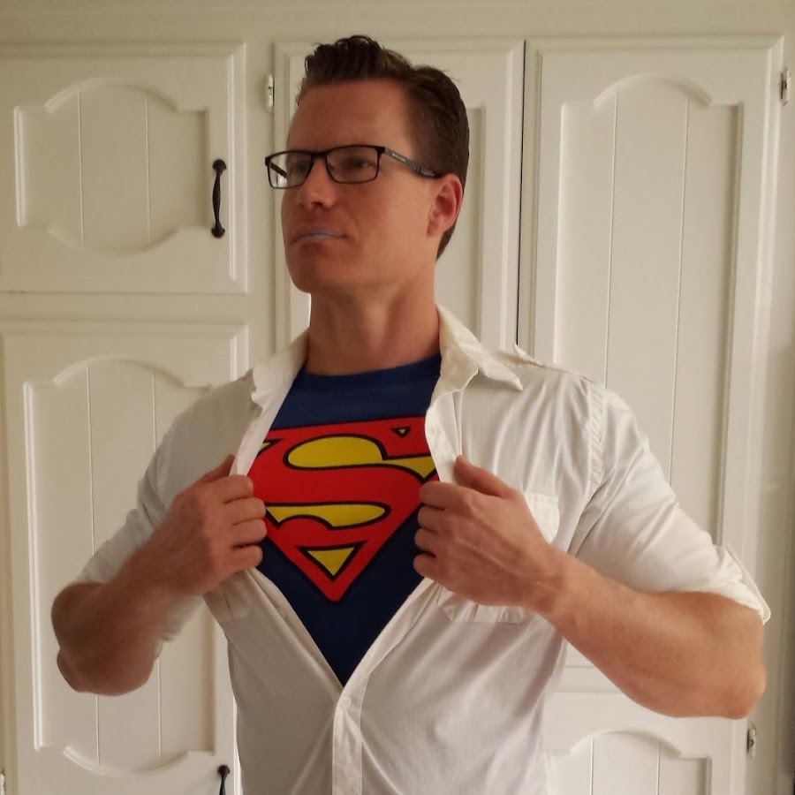
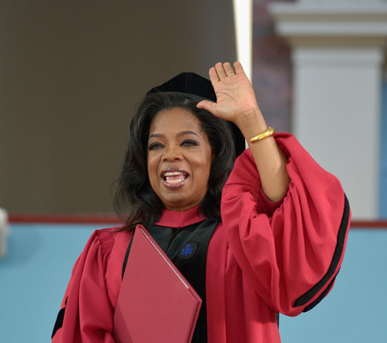
Impact of prior appointments
Your prior record contributes to your record for Associate level and so you do not have to wait 6 years
However, UCR wants to be sure that you can be:
productive in your research at UCR
an excellent teacher of UCR students
and a good campus citizen- service at UCR
Therefore, it is best to put your file forward once this is entirely obvious

Slide 21
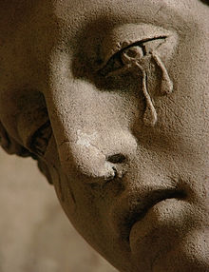
Who doesn’t make tenure?
Those who don’t publish enough in very good outlets even if their contributions to teaching and service are better than average or even outstanding – This is a Research 1 university. What is enough is very discipline and sub-discipline specific
Those whose research/creative productivity is fine in terms of quantity and quality, but whose teaching evaluations show less than acceptable teaching, especially if there is no evidence that the individual has taken this requirement seriously and made an effort to seek help. Aim for at least mean of department evaluations, but pay particular attention to student comments. Also check out http://ueeval.ucr.edu/Wieman-Gilbert_TeachingPracticesInventory_CBE-LS2014.pdf

Slide 22
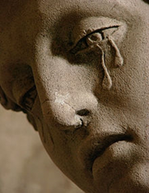
Who doesn’t make tenure?
Those who may have published a sufficient number of papers, but who do not seem to be the driving intellectual force for any of the work
Those for whom sustainability of the research program is questionable
Those who have not participated in professional and campus/college/department service

Slide 23

Who doesn’t achieve security of employment in the PT faculty series?
Those for whom teaching cannot be described as truly excellent. Teaching excellence should be judged in a variety of ways. Examples are
Student evaluations
Student success
Demonstrated level of preparation for an upper division course
Observation of teaching by fellow faculty or member of Academy of Distinguished Teaching
· Depending on date/circumstances of hire, those with no professorial scholarly or creative contributions (i.e. that which distinguishes their profile from unit 18 lecturers) and insufficient service.

Slide 24
Relative Importance of each area of review
Depends on your series!
File Review is Holistic, but all required areas must be represented
Research/Scholarly Activity/Creative Activity. How is funding viewed? Publication numbers versus quality of journal/press versus citations
Teaching
Service within your research/professional area- talks, conference organizing, session chair etc, manuscript review, editorial board
and service to the university
Special weight is given to activities that contribute to diversity and inclusion

Slide 25
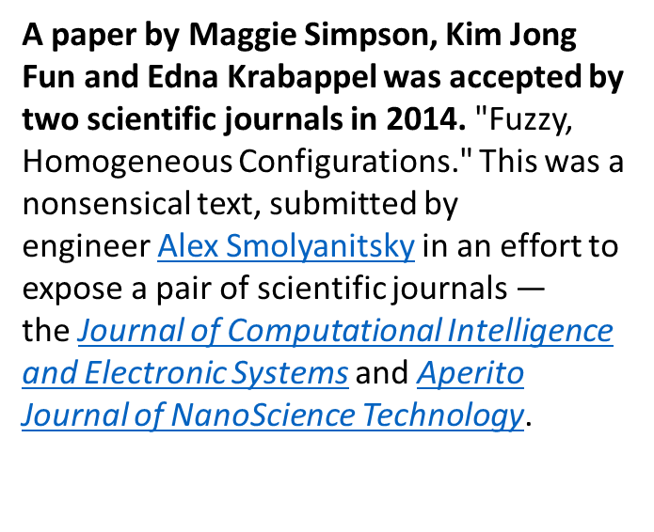
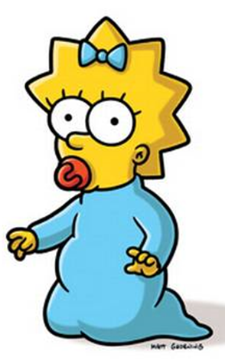

Publications
Anything can get published somewhere!

Slide 26
Editorial Boards and Conference Committees
'Dr Fraud' experiment
In 2015, four researchers created a fictitious sub-par scientist named Anna O. Szust ('Oszust' translates to 'a fraud' in Polish), and applied on her behalf for an editor position to 360 scholarly journals. Szust's qualifications were dismal for the role of an editor; she had never published a single article and had no editorial experience. The books and book chapters listed on her CV were made-up, as were the publishing houses that published the books.
One-third of the journals to which Szust applied were sampled from Beall's List of 'predatory' journals. Forty of these predatory journals accepted Szust as editor without any background vetting and often within days or even hours. By comparison, she received minimal to no positive response from the "controls" which "must meet certain standards of quality, including ethical publishing practices."Among journals sampled from the Directory of Open Access Journals https://en.wikipedia.org/wiki/Directory_of_Open_Access_Journals 8 of 120 accepted Szust. The DOAJ has since removed some (but not all) of the affected journals in a recent purge. None of the 120 sampled journals listed in Journal Citation Reports (JCR) offered Szust the position.
The results of the experiment were published in Nature in March 2017.
Again, I receive invitations daily to be on editorial boards and conference committees for subject matter way removed from my expertise.
Therefore, we need to ask departments for context in department letters when reporting on such items

Slide 27
Discussion of self statements

Slide 28
Application for a faculty position.
Postdoc Table Letter 1
Faculty Position Application Cover Letter (there will also be a CV, but no separate research or teaching statement). XYZ is a Research 1 university.
Dear Search Committee,
I am writing to apply for the faculty position with an emphasis on gender and literature that you advertised in (name of the source of the advert) on (date). I am a Ph.D. candidate at MNQ University, currently revising the final chapter of my dissertation, and expecting to graduate in May 20XX. I am confident that my teaching experience and my research interests make me an ideal candidate for your open position.
Over the past three years, I have tutored and co-taught a variety of English Literature courses. I have extensive experience working with ESL students, as well as students with a variety of learning disabilities, including dyslexia and dysgraphia, and disabilities like ADD and ADHD. I pride myself in creating a tutorial environment that accommodates the needs of my individual students while still promoting a high level of critical thought and writing skills. I know I would thrive as a teacher at XYZ University.
Not only does my teaching experience suit the needs of your school and department, but my research interests also fit perfectly with your description of the ideal candidate. My dissertation examines the rise and development of female authors with a particular focus on patterns of magazine publication. I argue that, rather than being submissive to the requirements of the editor or publisher, female authors in fact developed a more transparently reciprocal relationship between themselves and their readers than previously has been assumed. I apply recent print-culture and book-history theory to my readings of novels, magazine articles, letters, and diary entries by various female authors, with a particularly focus on Sara Willis (known by her pseudonym Fanny Fern).
Thank you for taking the time to review my application. I look forward to hearing from you. Should you wish to contact me for an interview, please contact ne at cell number or email address.

Slide 29
Application for a faculty position.
Postdoc Table Letter 2
Faculty Position Application Cover Letter (there will also be a CV, but no separate research or teaching statement). Application is to a Research 1 university.
Dear search committee,
I am writing to apply for the tenure track position in Cancer Cell biology, recently advertised in Science. I believe I am a good candidate. I was graduate student at Yale University and have been postdoc at Harvard for last 3 years on NCI training grant. I have published 6 papers in Cancer journals in the last 6 years and now want to have my own lab.
My research is in tumor microenvironment, which is the hot area. In the future, I intend to continue to work in this area to expand on my published studies. I have applied for grants from NIH, DoD, and ACS and I am waiting to hear the results.
Before coming to US, I taught general biology to pharmacy students at ZZ university. I am willing to teach any course.
Please contact me if you need more information
Sincerely

Slide 30
Merit/promotion self statement #1
Since my last merit, I have published 3 technical journal articles (16-18) and one review (2), served as major professor for 3 PhD students, taught 4 undergraduate courses, given 6 talks, been on the graduate advertising and open house committees and brought in $300,000 in grant funding.
Research
The focus of my research is the electrophysiology of rat vibrissae. Paper 16 uses Dihydropyridine and Benzothiazepine to explore the role of calcium channels in registering movement. Paper 17 compares motor cortex responses to vibrissal stimulation in rats that are awake versus asleep. Paper 18 looks at the effects of anesthesia with Althesin on motor cortex responses. In paper 19, we reviewed the literature investigating the barrel cortex using optical imaging and electrophysiology. The papers have all been published in the top journals in my field. The grants program is very competitive and demonstrates the importance of my work.
Teaching
My PhD students are making good progress in their dissertation research and one is close to finishing. This student, Rafi Gonzalez, gave a poster presentation at the annual meeting of tactile electrophysiologists. I have also served on the committees (either qualifying or advisory) of 3 other students.
My teaching evaluations show that a majority of students in the class appreciate my lectures. In addition, there are a couple of undergraduates working in my lab.
Service
I have enjoyed serving on the graduate advertising committee and the open house committee. In the latter role I can interact with members of the general public.

Slide 31
Merit/promotion self statement #2
Knowing that my strengths lie in my ability and passion for science, my chosen goal in life has been to explore the unknown, make it possible for others like me to do the same, and share what we discover with the outside world.
Research
My current scientific objective arose from an experiment that I thought at the time had failed. The aim of this experiment had been to generate a mouse in which a mutant tumor suppressor gene, p53, could be turned on or off in vivo using the lac operator-repressor system we had just developed (TJA #34). We expected that mice born carrying the mutated p53 gene would develop tumors once expression of the mutant p53 protein was induced. Instead of mice with inducible tumors, the mice had a tumor incidence even below that of the normal, control mice. i.e. the opposite result from that anticipated (TJA #35).
The mutation of p53 was predicted to immortalize cells by interfering with normal p53, a molecule that has an inhibitory function on cell replication. Instead, we found that cells from the transgenic mice replicated more slowly than cells from normal, control mice. This translated in vivo to mice that were smaller and aged more rapidly (TJA # 36). Thus, out of a “failed experiment” we have produced a model of premature aging, with which we can now ask basic questions about the role of p53 in aging, as well as test interventions in vivo that may slow the aging process. Furthermore, we can ask these questions about the aging process in a more practical time frame, months instead of years necessary for previous models. The first of our papers looking at aging processes in our model shows that these mice lack the ability to replace neurons in the central nervous system and have increased anxiety such as is often seen in elderly patients with dementia (TJA #37).

Slide 32

Self statement
Although a self statement is officially optional, who is better qualified than you to talk about your work? My advice is always to include – you maybe could give it a pass if you receive the Nobel prize!
Although promotions are more important than merits, it is wise to present yourself well on all occasions. Don’t put out half an effort and then find yourself disappointed in the outcome.
Accuracy of the self statement and efile is the responsibility of the candidate. If there are discrepancies between facts stated in the self statement and efile, the reviewing bodies will defer to the efile snapshot as the true/accurate record.
For a promotion file, you may produce a different self statement to go to external reviewers and internal reviewers, but both must be present in your file for all to see. Why?

Slide 33
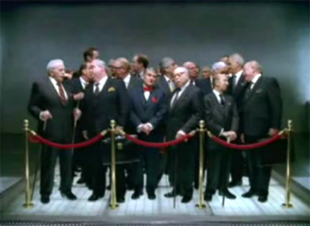
Candidate’s Self Statement
How should it/they be pitched? i.e. to whom are they speaking?
Others in your scholarly field
To Chair, Dean, CAP, VPAP, PEVC, Chancellor

Slide 34

Self Statement
For merits it can only be two pages long
For promotions, it may be longer, but the longer you make it, the less likely it will be carefully read from beginning to end – so be judicious
Other people’s self statements could be a good resource (inside/outside department), but always ask yourself was it good? You don’t know whether the statement helped or hindered the decision.

Slide 35
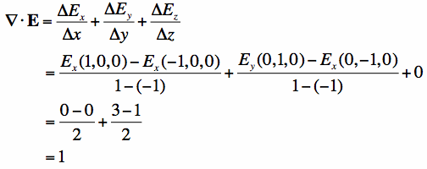
Research
Is the description of the research understandable to someone not in the field? Could you turn around and summarize immediately after reading it?
Is it clear who is the driving intellectual force of the work? This is particularly important if the research is the result of a collaboration
Has the importance of the research been communicated? How does it advance the mission of the university?
Has the impact of the research been communicated?
Is there a good balance between necessary blowing of one’s own horn and perspective?
Is there jargon that should be eliminated?
Are assumptions made? e.g. is the reader expected to understand the importance of a publication in the journal of YYY or a talk at conference XXX or an invitation to speak at University ZZZ etc?

Slide 36

Teaching
Is teaching addressed?
Is the candidate’s interest in/passion for teaching communicated?
Are the contributions well-described –e.g. development of new courses, large lecture versus graduate etc.?
If there were problems with teaching are these acknowledged and approaches re how to improve addressed?

Slide 37
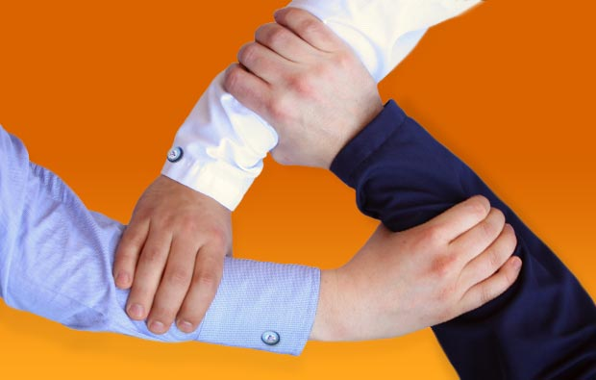
Service
Have the service contributions been adequately described? Lists are not helpful and the lists are elsewhere in the file.
Not everyone knows what the “PGT” committee is! Be aware that different departments have different names/acronyms for the same thing.
Has some context been given? Being a part of the undergraduate advising committee may mean you meet with 20 or 200 students. Being graduate advisor may mean you are all alone or one of three advisors etc.
If a committee was particularly demanding, has this been explained? Hours per week/month is one way to illustrate this- also room for this in efile section

Slide 38

Candidate’s Self Statement
What can be included?
Research, teaching, service that is in the file – a common reason for return of files is because of inclusion of other things
What shouldn’t be included?
Notes:
Table 4 output follows this slide

Slide 39
Table Discussion of Questions distributed

Slide 40
Questions given to tables
How would you determine how much is enough in terms of research to make tenure?
What service commitments do you think are appropriate for an assistant professor?
How do you think reviewers (inside UCR and whomever will be asked to evaluate your work from outside UCR) will measure the impact of your research?
What do you think you have to do to get excellent teaching evaluations?

Slide 41
Questions given to tables
How might having a baby/adopting a baby potentially affect the time you have to make tenure?
What impact would not seeing eye to eye with your Chair have on your ability to make tenure?
What would you do if you suffered a major illness?
Do you have any questions that are not already on the agenda?

Slide 42


Time and work/life management
Keep perspective
Rotate focus
Explain to your loved ones ahead of time when there may be periods of intense work and stress – forewarning really helps
Make sure you express your appreciation for those around you so when your focus is on work, it does not make them feel they are in second place

Slide 43
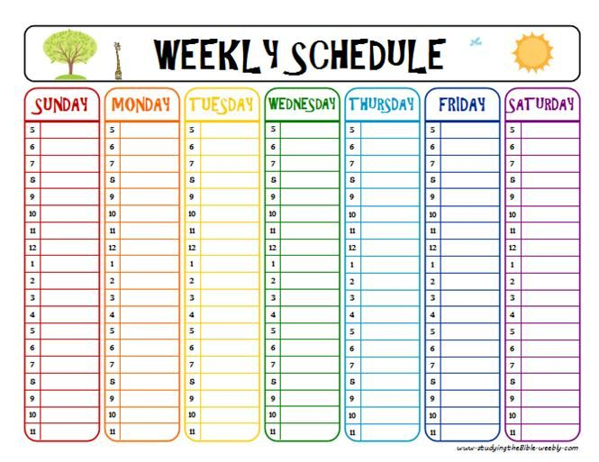
What worked for me - tips for time management
Create a schedule of activities with due dates so you can plan and work ahead – reduces stress
Schedule your day and only let true emergencies interfere with the schedule. If you don’t, you will work hard and accomplish little! Include time for new initiatives or even thinking about them
Scheduling includes when to deal with e mails. Turn off the sound and maybe also the pop-ups if you cannot resist looking at them. Don’t be distracted by cell phone calls, restrict those who have your cell phone number and don’t have it ping when an e mail comes in
Keep e mail folders to manage the relative urgencies of them and/or subject matter

Slide 44
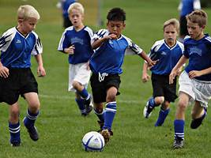
What worked for me - tips for time management
Use your time optimally. I used to record my lectures and listen to last year’s during soccer games (mom is still watching the game!)-most efficient prep for the current year
I would read journal articles during the kid’s pre-game warm up
I would work in my car during soccer and baseball practices
I still divide tasks between those that need optimal focus (do during best working hours) and those I can do when tired in the evening (e.g. answer emails, write letters of recommendation).

Slide 45

Questions from previous groups
How to say no - best to have worked out a rough
service participation plan with your Chair.
2) How to decide what to expend your service efforts on.
Think about contributions that will be useful to the department/school/campus and will further your career goals – e.g. seminar series, annual symposium, graduate student admissions, faculty search committees
Work on something you have a passion for/long term interest in
Only work on committees you perceive as actually accomplishing a goal
Say yes to grant reviewing duties

Slide 46
Questions from previous groups
3) When to go up for tenure – best discussed with your Chair, but with an up-to-date efile serving as the basis of the discussion
4) Quality versus quantity of publications – holistic review including number, importance, impact, where published/citations, senior authorship, driving force of work, how many from your main research focus versus collaborative etc.

Slide 47
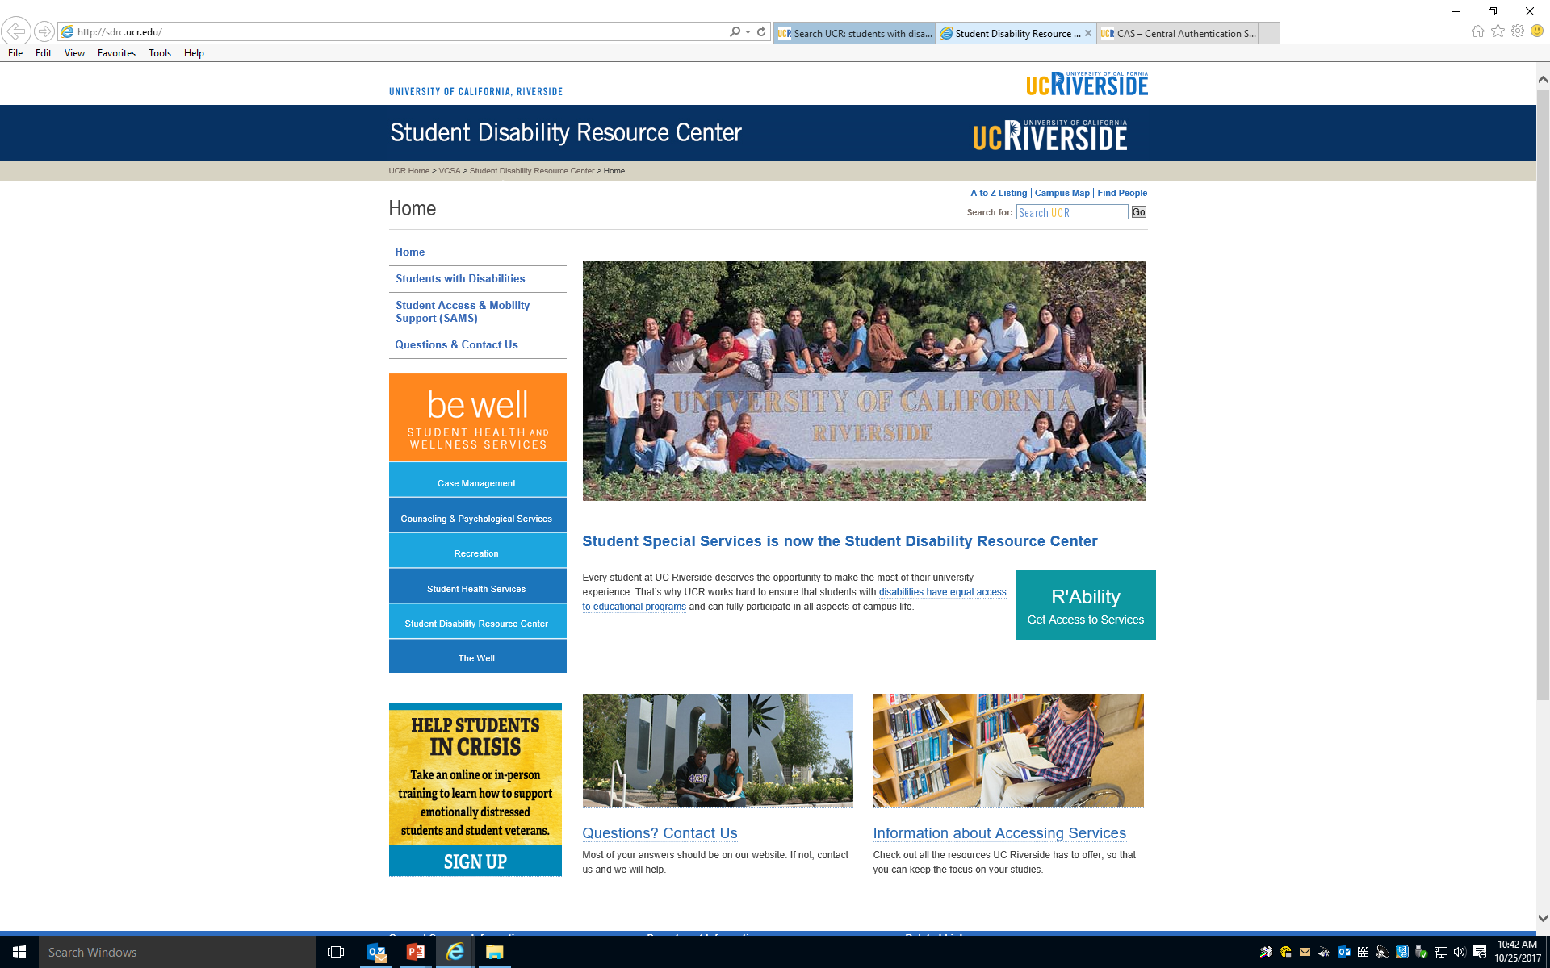
What a Junior Faculty Member had wished she had known about

Slide 48
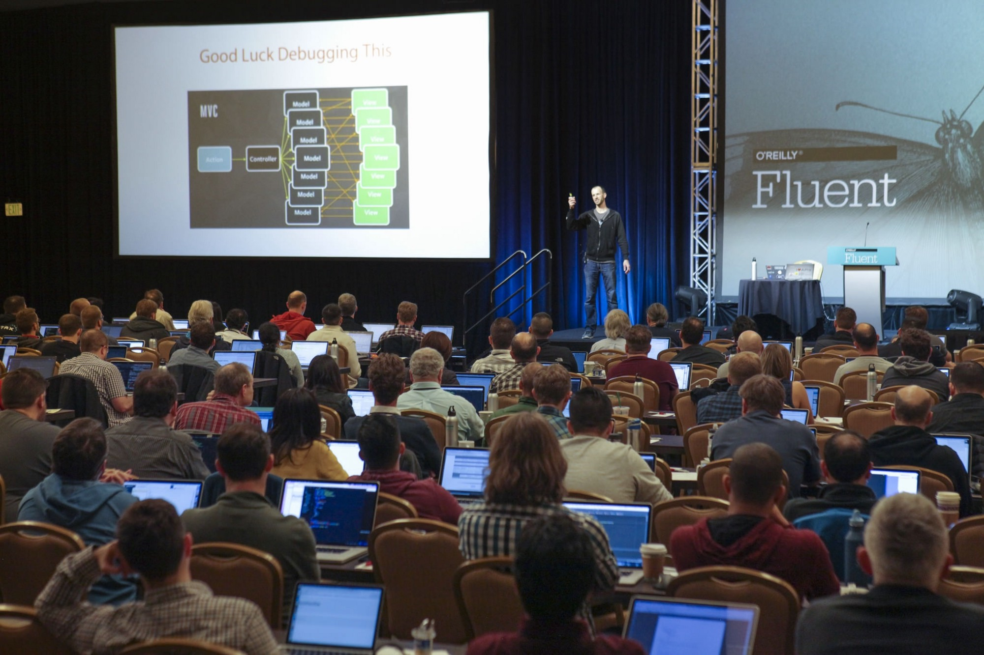
How do you make yourself known in the field?
Present your work at meetings –small focused ones are best so that you meet people. In the sciences, examples would be Gordon conferences and Faseb summer conferences
Run a seminar series for your department and invite people in your field
Start a local conference in your field to which you can invite those whom you would like to get to know about your work
If there are senior faculty in the same research area in your department, ask them to introduce you to people at meetings
Publish, and publish early so that there is time to be noticed

Slide 49
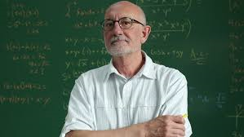
For Your Tenure/SOE Letters, who should you suggest as an external reviewer?
Who yes?
Respected names in your field
Those at an academic level above you
Those whom you think will be fair
Try to arrange for some from UC
Who not?
Do not suggest people with whom you have collaborated recently. While they may be well qualified to comment on the work, they may not be considered objective
Do not suggest your peers – those who you were a graduate student or postdoc with
Do not suggest only people from a prior institution. This suggests a lack of impact of your work
Depending on years since PhD/postdoc, a former advisor may not be a wise choice

Slide 50
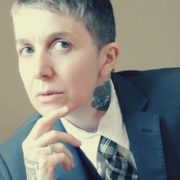
What can be included in Packet that goes to external reviewers?
CV plus- e.g. add hours etc to explain teaching or organizational or service obligations
Teaching evaluations
Self statement aimed at those in the same field
Publications/gallery brochure etc.
ALL MUST BE INCLUDED IN EFILE
Exams too hard
You rock
Knows her stuff
Best professor at UCR
Loved the performance piece
Too much homework

Slide 51
Research Program that involves Intellectual Public Engagement
Difficult to be general, but for example what would be research and what would be community service and what would be community involved research?
I work on milk immune cells. I publish in Journal of Immunology – research
I give continuing education talks at local Breast Feeding coalition meetings – community service
If I involve the breast feeding coalition in my research project (Interviewing patients, collecting samples, producing data etc), this would be research involving public intellectual engagement.

Slide 52

Come on out and meet people! Encourage other faculty, staff, postdocs, project scientists, grad students etc
Thursday Nights Live Last one for the Fall is next Thursday, Nov 1st! There is free music, complementary parking in lot 1 for the first 50 car loads of spouses/partners/significant others/friends/community members who do not have UCR parking passes. Come out and dance!
Children very welcome – they are the best dancers!
Wine, beer, cocktails and food to purchase.

Slide 53
Reference Slides
CAP Role
Committee of the Academic Senate
  10 members / Quorum is 6
  Members appointed by Committee on Committees
Advisory to Administration
Equitable Application of Academic Personnel Manual (APM) 210, 220
Adherence to additional guidelines defined in the CALL and By Law 55
Links:
http://senate.ucr.edu/
http://senate.ucr.edu/committee/?do=info&id=4

Slide 54
Academic Personnel Manual, 210
Review Criteria, APM 210
  Teaching
  Research & Other Creative Work
  Professional Activity
  University & Public Service
The APM is a UC policy manual.
Links:
http://www.ucop.edu/acadpersonnel/apm/apm-210.pdf
http://www.ucop.edu/acadpersonnel/apm/sec2-pdf.html

Slide 55
Contact Information
Ameae Walker
Vice Provost for Academic Personnel
951.827.2304
vpap@ucr.edu
Katina Napper
Assistant Vice Provost for Academic Personnel
951.827.5032
katina.napper@ucr.edu
Academic Personnel Office
academicpersonnel@ucr.edu
http://academicpersonnel.ucr.edu/

Slide 56

Your Questions

