Slide 1
Chairs 201-1
2018-19
Department Letters:
The Good, the Bad, and the Ugly

Slide 2

Departmental Letter- general
The departmental letter should represent the balanced and integrated opinions of the group. It should not be a Chair’s letter or an ad hoc committee letter. It should not be copied and pasted from a candidate’s self statement. It should not be composed by a staff person. Be consistent in approach.

Slide 3
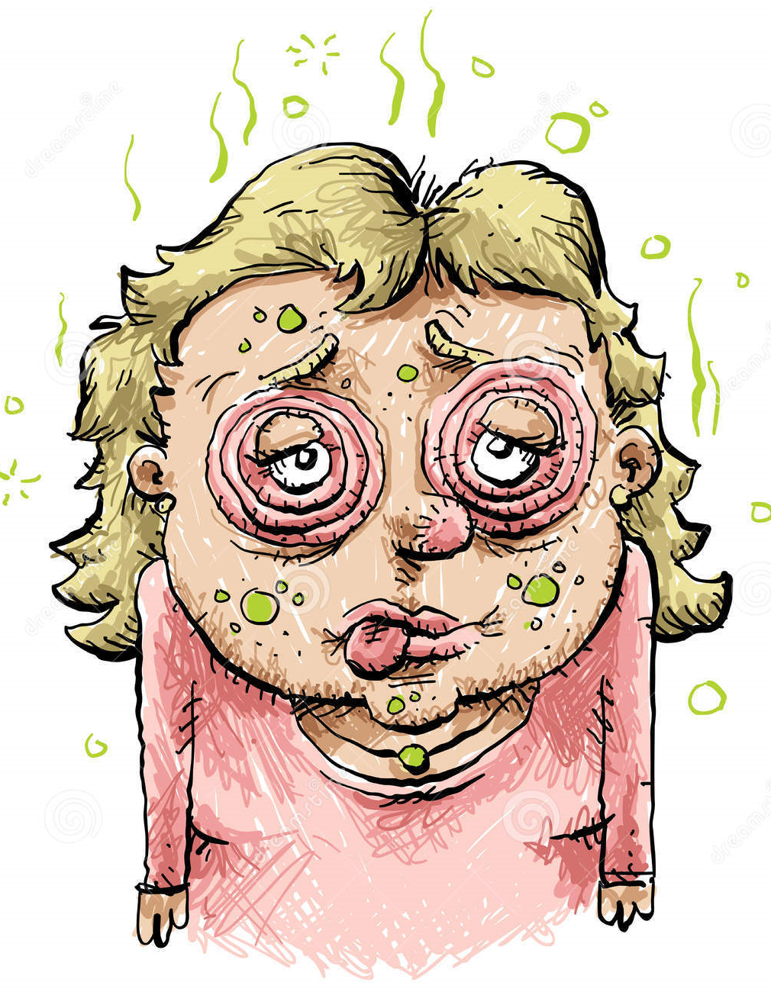
Departmental Letter- general
The department letter should strive to be as objective as possible. While discussion at the Department meeting will add important and very useful evaluative information, the letter writer must be sure that the statements gleaned from the discussion (good or bad) would stand up to scrutiny. Discuss
“The department letter should also not contain detailed discussion of the reasons for a leave of absence in instances where this may constitute a potential breach of confidentiality. “ Discuss

Slide 4

Departmental Letter - Research
We need Context and Evaluative Comments.
Evaluative comments such as “important breakthrough”, “first to show”, “only one to tackle such a difficult problem”, “technically very challenging”, “controversial and therefore more difficult to publish”, “years to accumulate data”, “chosen by faculty of 1000”, “will feed the world”, “most important prize in modern art”, “seminar presented at best-ranked philosophy dept. in US", "curation at most important gallery in New York”, “twice the normal publication rate in the field” etc.
Maybe priority score on an unfunded grant could be useful if the candidate is “between grants”
Don’t use numbers ($1.97 million to candidate during this period) since there is then the obligation to check. Replace with – “impressive success in extramural funding” – the numbers are elsewhere in a section where the candidate is attesting to their accuracy.

Slide 5
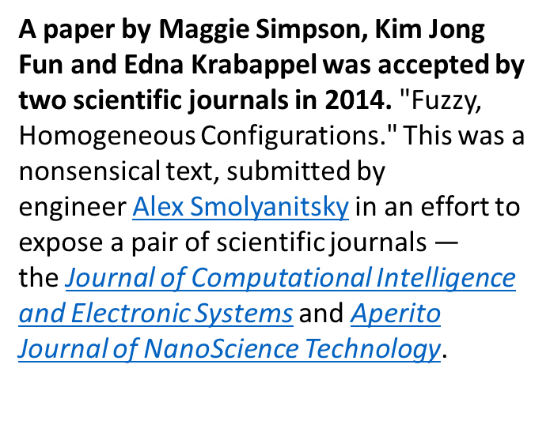

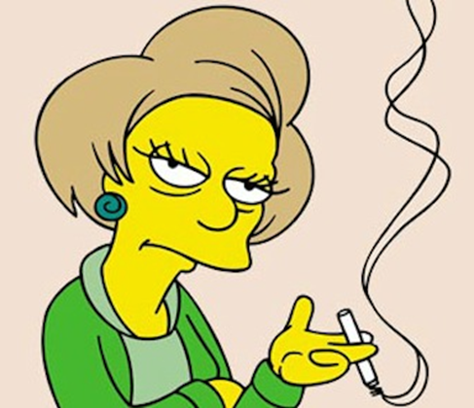
Departmental Letter- Publications
We often can’t judge if its outside our field, so we need your help. Anything can get published somewhere!

Slide 6
Departmental Letter – Editorial Boards and Conference Committees
'Dr Fraud' experiment
In 2015, four researchers created a fictitious sub-par scientist named Anna O. Szust ('Oszust' translates to 'a fraud' in Polish), and applied on her behalf for an editor position to 360 scholarly journals. Szust's qualifications were dismal for the role of an editor; she had never published a single article and had no editorial experience. The books and book chapters listed on her CV were made-up, as were the publishing houses that published the books.
40 journals accepted her – These were journals we would consider predatory – i.e. only in the business to make money. The results of the experiment were published in Nature in March 2017.
So, we need your help to determine what is meaningful recognition. Is the service on an excellent editorial board or not? Is the conference the most important in the field or not?
I receive 5-10 invitations daily to be on editorial boards and conference committees for subject matter way removed from my expertise.
Therefore, we need context in department letters when reporting on such items

Slide 7
Departmental Letter: Teaching- APM 210-d-1
Teaching - Clearly demonstrated evidence of high quality in teaching is an essential criterion for appointment, advancement, or promotion. Under no circumstances will a tenure commitment be made unless there is clear documentation of ability and diligence in the teaching role. In judging the effectiveness of a candidate’s teaching, the committee should consider such points as the following: the candidate’s command of the subject; continuous growth in the subject field; ability to organize material and to present it with force and logic; capacity to awaken in students an awareness of the relationship of the subject to other fields of knowledge; fostering of student independence and capability to reason; spirit and enthusiasm which vitalize the candidate’s learning and teaching; ability to arouse curiosity in beginning students, to encourage high standards, and to stimulate advanced students to creative work; personal attributes as they affect teaching and students; extent and skill of the candidate’s participation in the general guidance, mentoring, and advising of students; effectiveness in creating an academic environment that is open and encouraging to all students, including development of particularly effective strategies for the educational advancement of students in various underrepresented groups. Discuss this and additions to student evaluations

Slide 8
Departmental Letter-
What we get and don’t need
Reiteration of numerical data in the file:
Professor N has given 10 talks at national and international meetings.
I receive about 10 invitations per day and I am not qualified for many. So now more than ever, it is important to let the reader know the importance of the venues in the field
Professor O has published 16 items.
Where? “Top journal” means nothing without context. If not in a traditional peer reviewed journal and yet the department considers an important publication, it is especially important to explain. Some books with chapters/articles are rigorously reviewed, while others are in books less so and edited by friends or even by the candidate. Is there “double counting”? They were credited as chapters and again as a book.
Professor Q has curated 11 exhibitions. Importance of venue?
Professor R has given 10 performances of this original composition/choreography. Importance of venue?

Slide 9

Departmental Letter
Evaluate service contributions in terms of quality and time commitment and in terms of dept. and stage of career norms. The senate keeps records of attendance at senate committees. You may request this information, but as in all things, this must be done for all candidates in the dept. if done for one.
Notes:
Table 5 output follows this slide

Slide 10

Departmental Letter
If a new paper/exhibit etc was not listed when the requests for outside letters went out, make sure to say this in dept. letter.
Evaluate collaborative research -does it show dependence, does it result in research that could not otherwise be done, does it result in synergy, does it attract new kinds of funding etc? This is particularly important for promotion files. I don’t like percentages
Be balanced in the evaluation. Advocacy is a good trait, but if all faculty in the department all deserve an acceleration year after year, then the letter becomes useless
Less than optimal aspects of the file have to be addressed, but keep matters proportional
Explain all negative votes

Slide 11

From the 357 M&P files received in APO during the 2017-18 review period, 88 had to be returned. From the 107 appointment files submitted during the 2017-18 recruitment year, 23 were returned
Department Letter issues
Letter not included in file
Missing signature, votes, reasons for negative/abstained votes, off scale
Listing incorrect % of Appointment
Has incorrect action, yrs @rank/step, name disclosure of UC faculty
Does not provide explanation for minority vote
Missing assessment of Endowed Chair appointment
Listing incorrect recommendation (Distinguished + o/s)
Revision dates listed incorrectly
Not addressing extraordinary accomplishments for additional o/s
Does not justify acceleration
Merit file contains vote for reappointment (now OK for first file)
Contains criteria not compliant with the CALL (when evaluating candidate contributions) (CAP)
Recommendation based on a book manuscript not yet accepted (CAP)

